Slide 1

MUNICIPAL BUILDINGS ADVISORY COMMITTEE
TOWN OF SALEM NH
NOV 20, 2023
UPDATE to THE TOWN COUNCIL

Slide 2
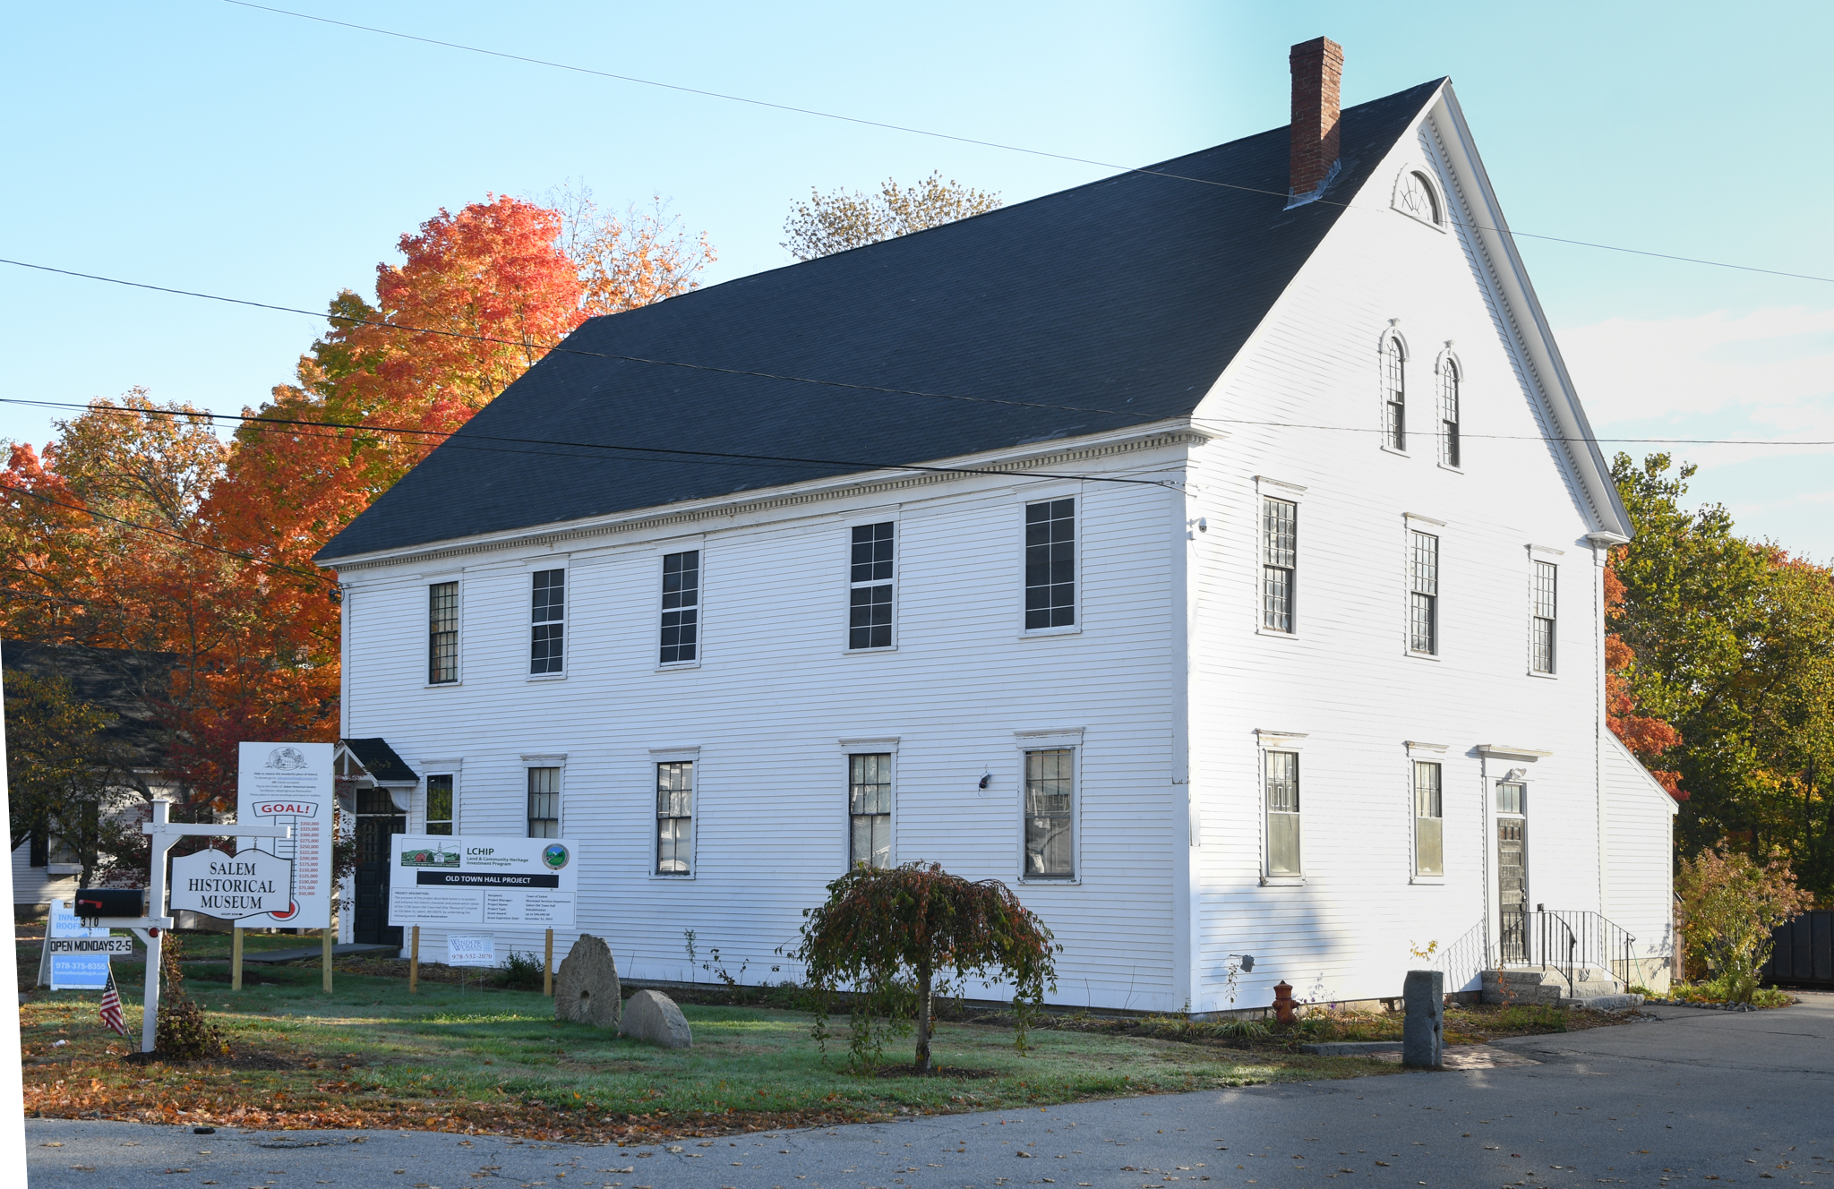
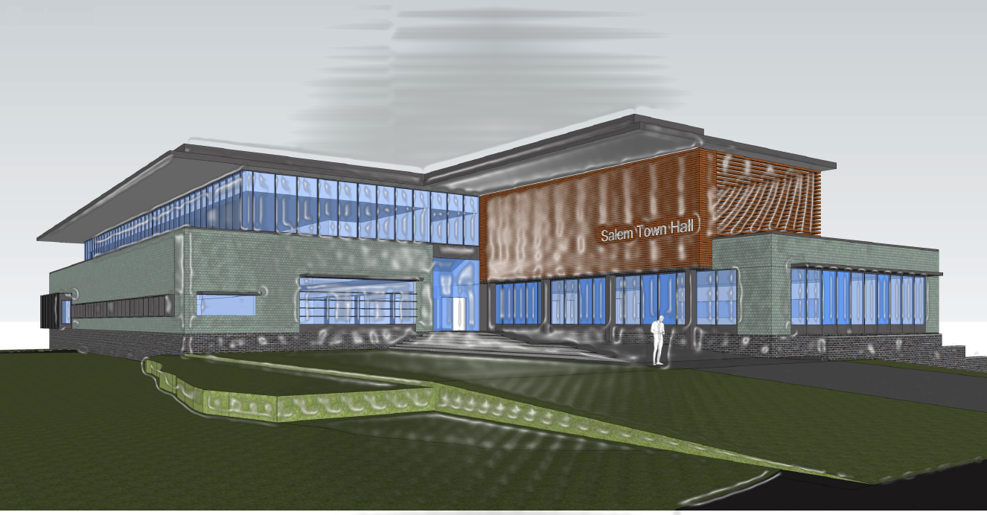
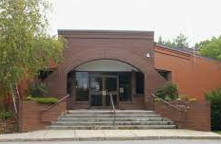
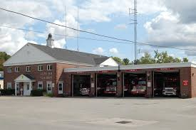
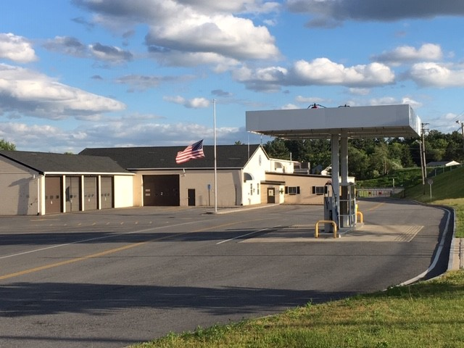
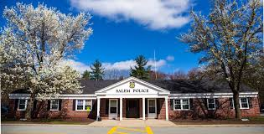
SINCE 2021 – MBAC HAS CONDUCTED 53 MEETINGS
PROJECT UPDATE
Last Window Batch - December
Interior Carpentry and Electrical Ongoing
Fundraising Ongoing
ICON – Building Program Complete
Conceptual Deliverables to Town Council April 2024
Roofing Project Complete
MBAC
RFQ 2022-046 - Architectural Services Public Safety Buildings
Fire Department Four Phase Facility Station Plan
Weston and Sampson – Finalizing Feasibility Study
TGAS Conceptual Complete
Town Council – Primary Goal
MBAC

Slide 3

ACTION ITEMS
“The Board of Selectmen hereby confirms that the best location to house a new Police Station will be at 9 Veterans Memorial Parkway, otherwise known as Map 108, Lot 7960, and which is the current location of the existing Police Station.”
“The Board of Selectmen hereby authorizes funding an amount up to $500,000 for the purpose of procuring all professional services necessary for preliminary engineering and design for a new Police Station. Funding shall be through Public Safety Impact fees in the amount of $150,000 and by monies made available through the American Rescue Plan Act in the amount of $350,000.”
RFQ 2022-046 – Architectural Services Public Safety Buildings: The Town of Salem (TOWN) is seeking to contract with a professional firm to provide architectural and engineering services (FIRM) to provide design professional drawings for a new Police Station, possibly a new West Side Satellite Fire Station, and renovation/rehabilitation of the existing Central Fire Station.
June 12, 2023, meeting - Town Council goal was for a new Police Station to be on the 2024 Warrant
MBAC

Slide 4
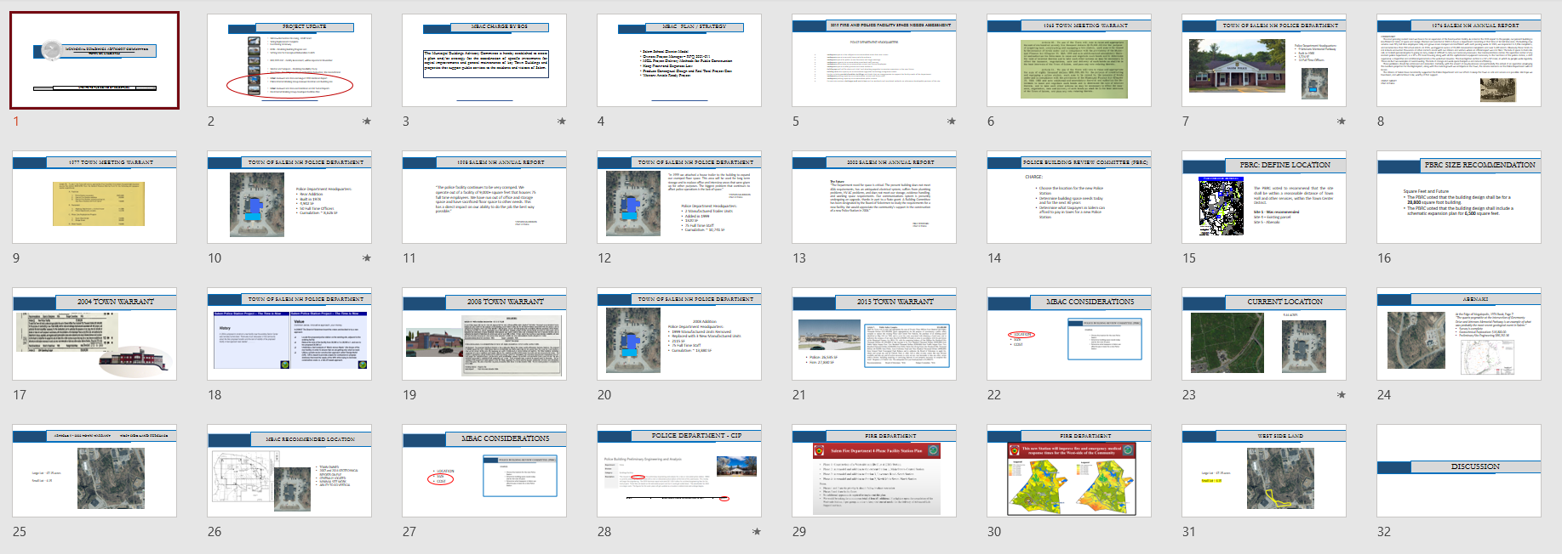
MBAC PRESENTATION TO TOWN COUNCIL - JUNE 2023
LOOKING AHEAD
AVOID 11th HOUR
DESIGNER SELECTION
TOWN COUNCIL – MAY 15
PUBLIC RELATIONS
SUB COMMITTEES
MASTER PLAN
REAL PROJECT
2004 - FAILED
2007 - FAILED
2015 - FAILED
MBAC

Slide 5
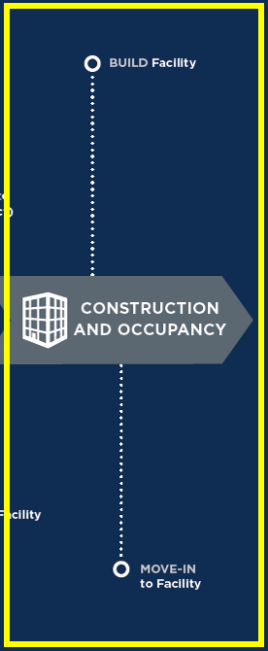

MOVING AHEAD
TOWN COUNCIL
MBAC
SUB COMMITTEES
PUBLIC RELATIONS
MBAC

Slide 6
MBAC ACTION
Concept 1
Concept 2
Concept 3
Motion: by Member Stramaglia
That we accept option one to be recommended to the TC on current location,
SECOND: by Member Boyer
VOTE: 4-0-0
The motion passed unanimously.
MBAC

