Slide 1

MUNICIPAL BUILDINGS ADVISORY COMMITTEE
TOWN OF SALEM NH
September 25, 2023
UPDATE to THE TOWN COUNCIL

Slide 2
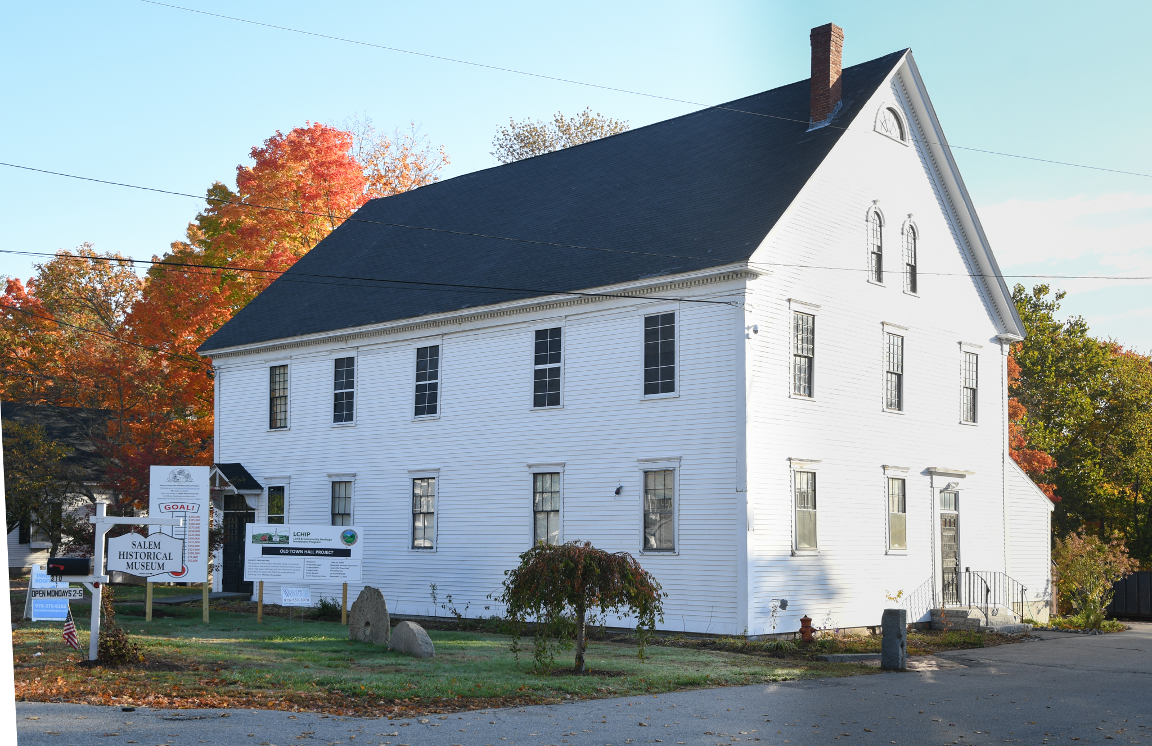
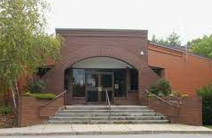
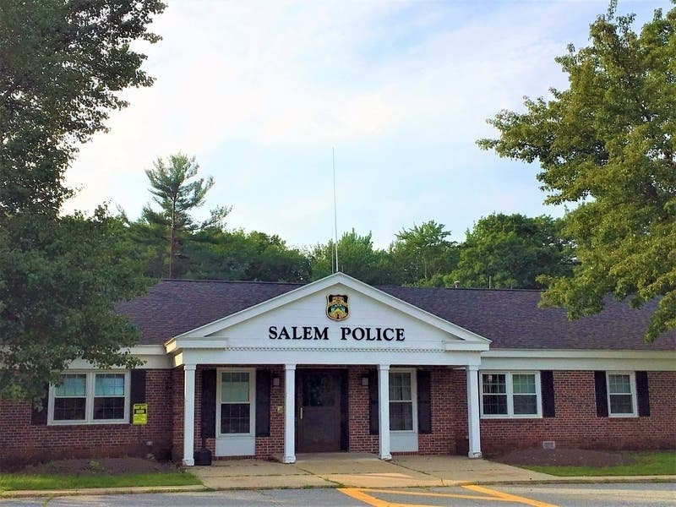
PROJECT UPDATE
Window Batch 3
Interior work started
Fundraising Ongoing
MBAC
Roofing Membrane Replacement
Design Engineering
Developing 3Concepts
MBAC

Slide 3
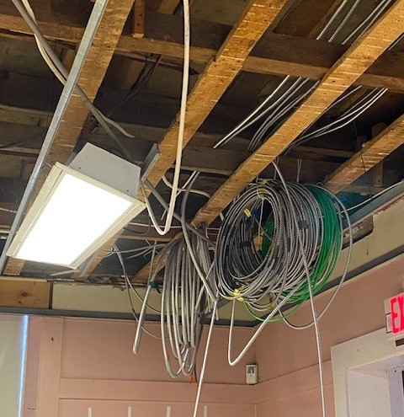
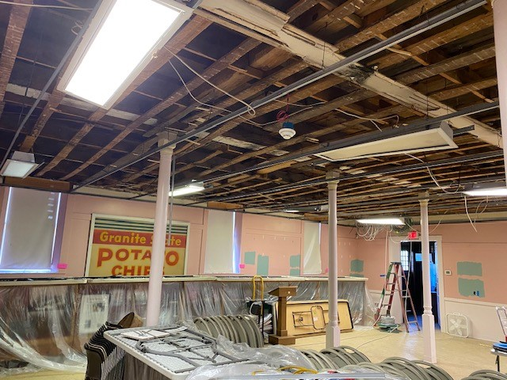
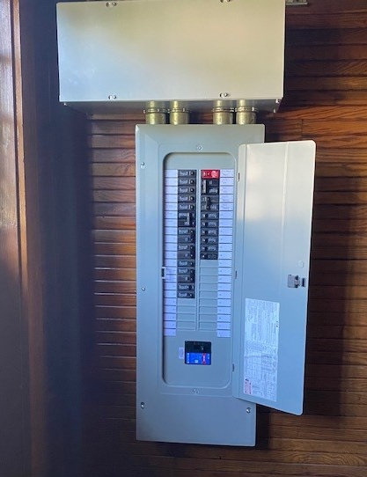
OLD TOWN HALL
Windows (6) – Ongoing
Ceilings Removed
Wiring Ongoing
Panel - Complete
Fundraising - Ongoing
MBAC

Slide 4
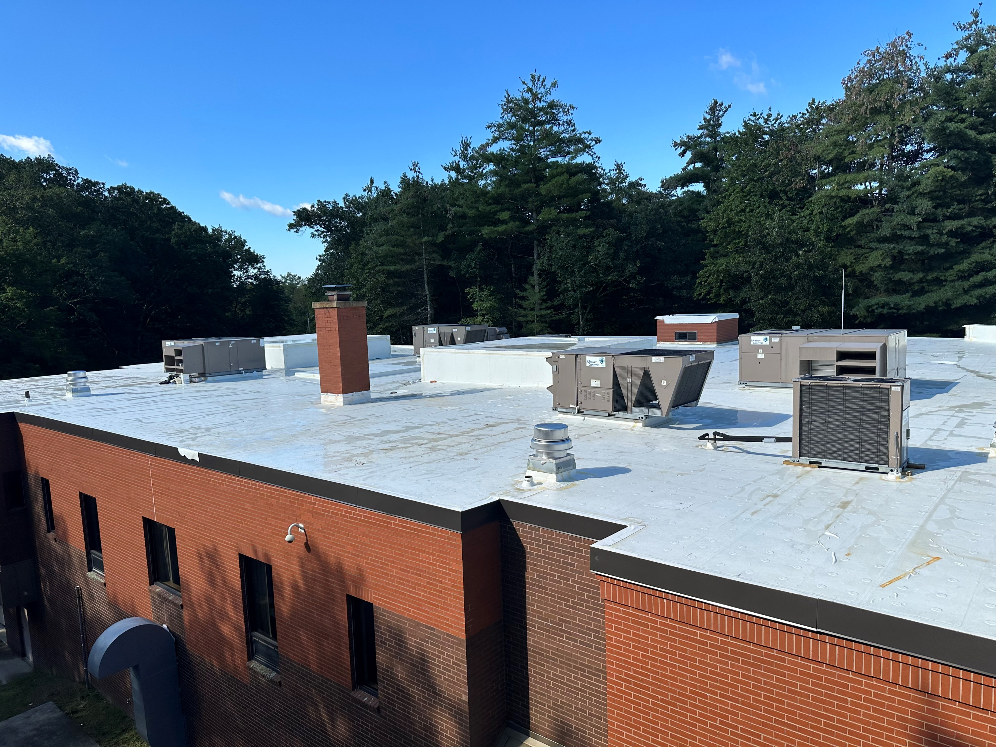
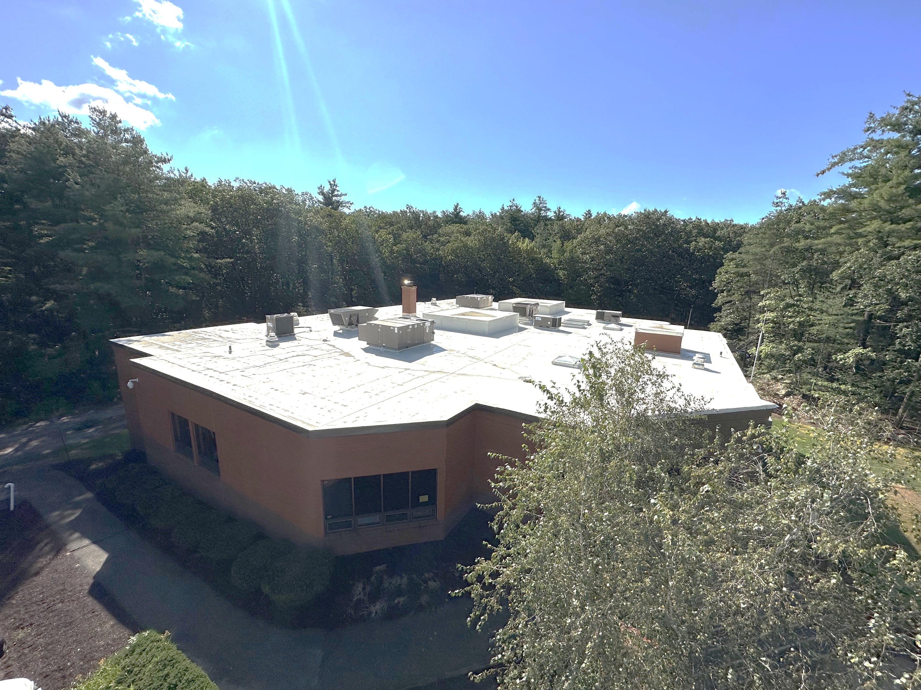
DISTRICT COURT
Membrane Complete
Metal Complete
Skylights - Ongoing
Roof Drains - Ongoing
MBAC

Slide 5
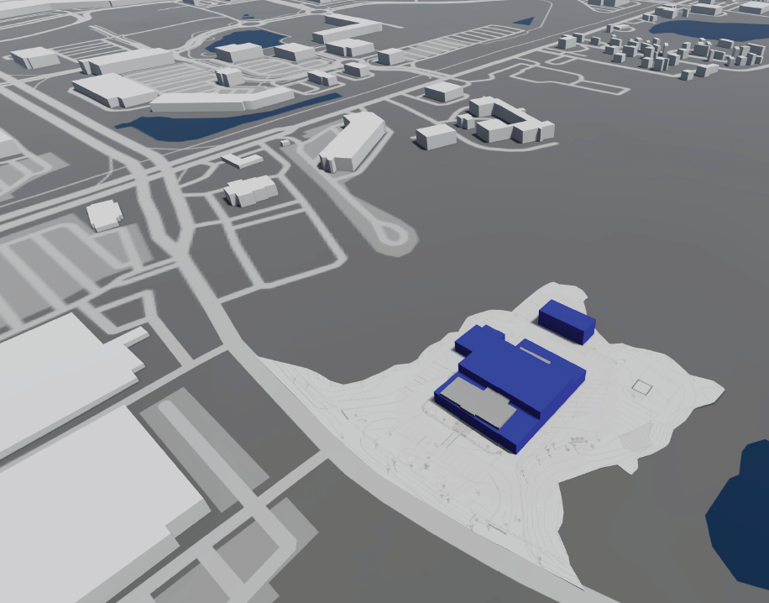
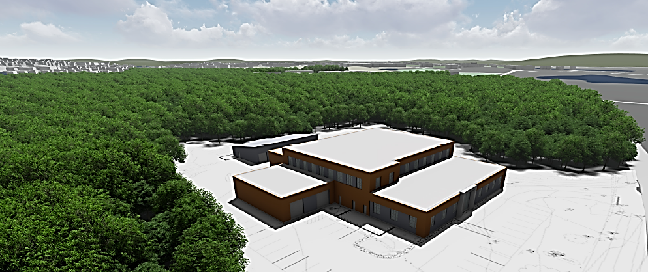
SALEM NH POLICE DEPARTMENT
ICON
Programming Book
Developing 3 Concepts
Site Layout

Slide 6
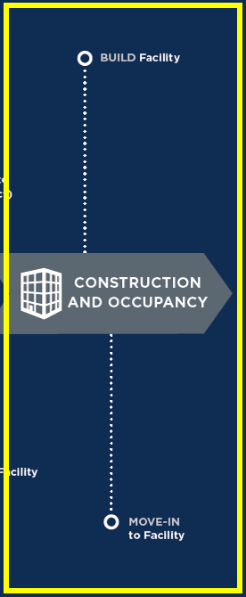

MOVING AHEAD
TOWN COUNCIL
MBAC
SUB COMMITTEES
PUBLIC RELATIONS
MBAC

Slide 7
SUBGROUPS
PD WORKING GROUP
Hosting Tours
Developing Info
Reviewing Programming
Website
FINANCE GROUP
Municipal Bond Advisor
Met with Schools
Bond Timelines
Project Timeline
GF Debt Schedule
“AAA” Rating
COMMS GROUP
Website
Flyers
QR Code
Chamber of Commerce
CITIZENS GROUP
Gov’t Academy
Solicit Applications
Still in Development
MBAC

Slide 8
MBAC – WORKING COMMITTEE
Reviewing and finalizing three concepts for Town Hall Project
Public Works Feasibility Study – Next Phase
RFQ Facility Assessment, Scheduling Consultant Interviews in November
RFQ/ P Construction Manager – October Review/Interviews
Scheduling Subgroup Meetings
MBAC

