Slide 1

MUNICIPAL BUILDINGS ADVISORY COMMITTEE
TOWN OF SALEM NH
JULY 24, 2023
UPDATE to THE TOWN COUNCIL

Slide 2

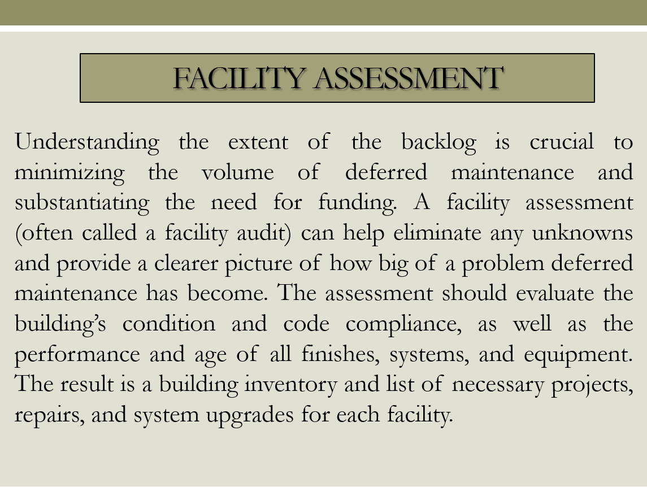
BACKGROUND
A large portion of the inventory of Town Buildings are more than fifty years old respectively and have had significant facility related issues over the past ten years. There are several Town Buildings that lack nominal space needed for staffing and operational standards notwithstanding meeting Americans with Disabilities Act (ADA) compliance. The buildings and systems have been subject to deferred maintenance and have exceeded their useful life. Many of the finishes including walls, ceilings, and floors, are worn and outdated creating hazards for staff. The mechanical, electrical, heating, and plumbing have had critical failures causing operational issues effecting both staff and the public. There have been various assessments done to some of the buildings to date that have forecast major expenses moreover conclude that the Town should consider a strategic long-range plan for all buildings and properties thereof. In April of 2019, the Board of Selectmen (BOS) established a Facility Committee (FC) that was comprised of town wide departments heads, middle management, and a Selectmen’s Representative who were tasked with establishing facility related priorities for a recommendation to the BOS to be included in the 2020 Budget. The FC concluded that a master plan should be established including procuring a consultant to help the Town move forward with a responsible proposal. A major budget allocation of $200,000 was approved for FY2020 to begin the process of dissecting previous reports and current information and begin master planning with a proposition that a Facilities Super Bond may be placed on a warrant in the near future. With the advent of Covid-19 in 2020 the project including funding was placed on hold due to economic uncertainties. In May 2020, the BOS also took up additional discussion on the FC and more specifically its structure and charge all things considered. During the FY21 Budget process the funding was reduced to $125,000 and subsequently approved through town vote. Two separate facility-based Request for Qualifications were let in early 2021 for DPW (RFQ 2021-007) and Town Hall (RFQ 2021-011) with the latter as an Owner’s Project Manager (OPM).
MBAC – July 15, 2021

Slide 3
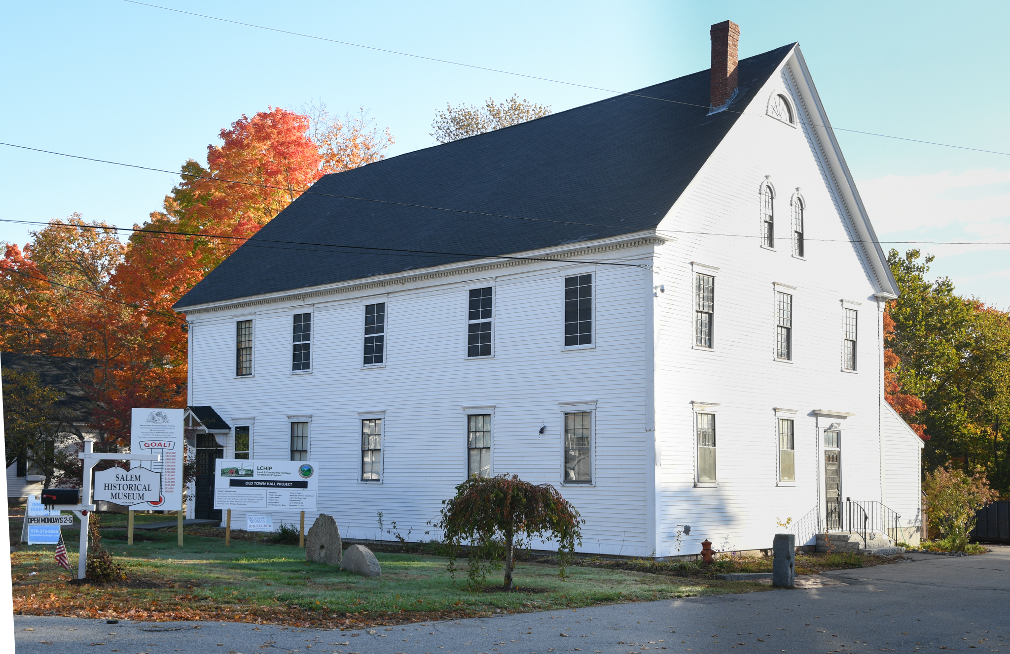
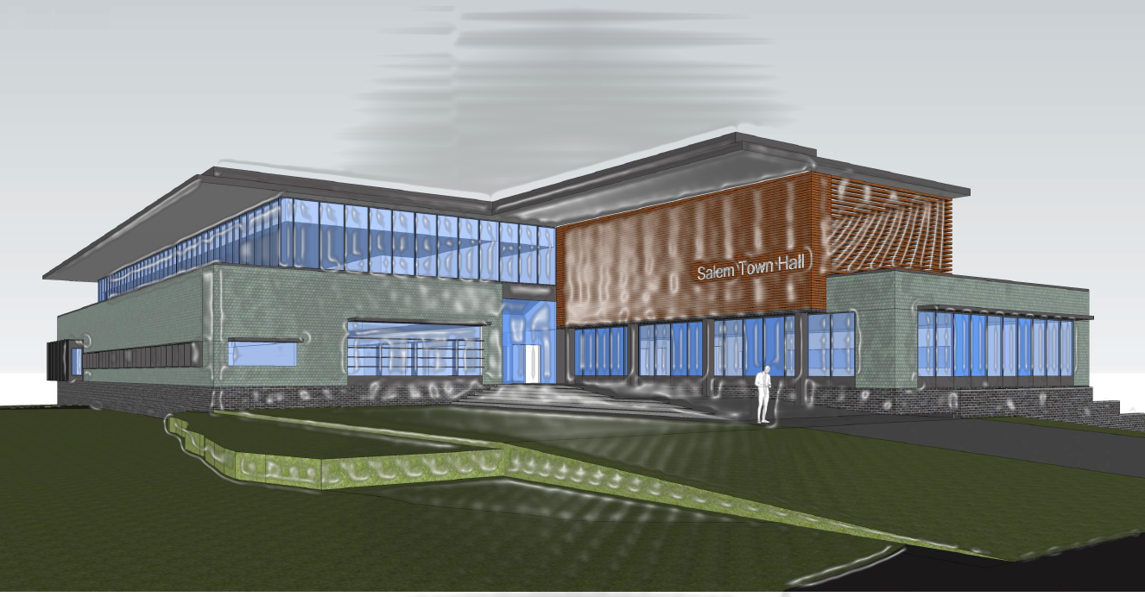
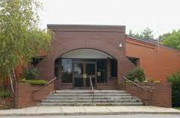
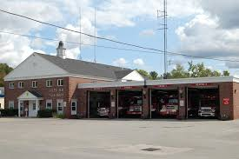
PROJECT UPDATE
Window Batch 3 – End of July
Siding Replacement and Exterior Painting Complete
Fundraising Ongoing
ICON – Finalizing Building Program and
Conceptual Deliverables to Town Council by October
MBAC
Roofing Membrane Replacement starting July 22nd
RFQ 2022-046 - Architectural Services Public Safety Buildings
Fire Department Four Phase Facility Station Plan
MBAC

Slide 4
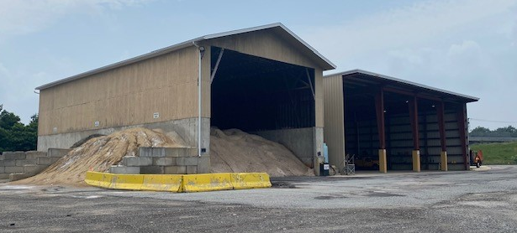
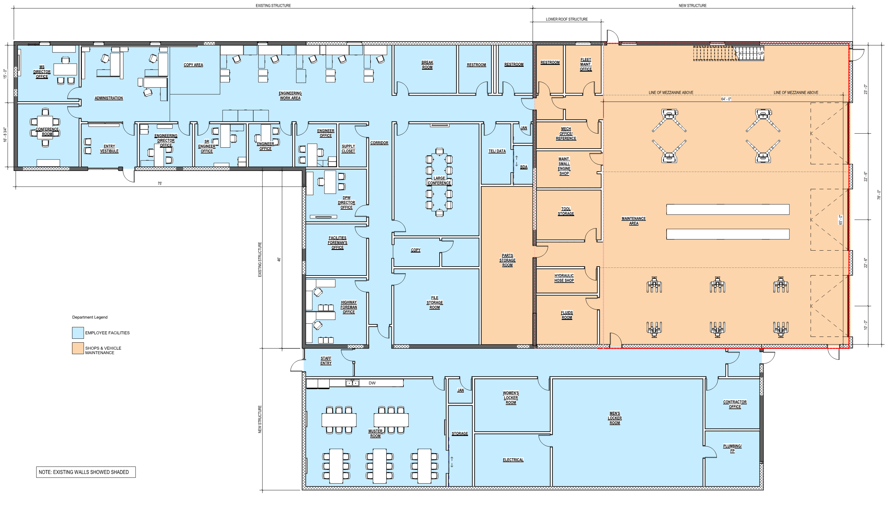
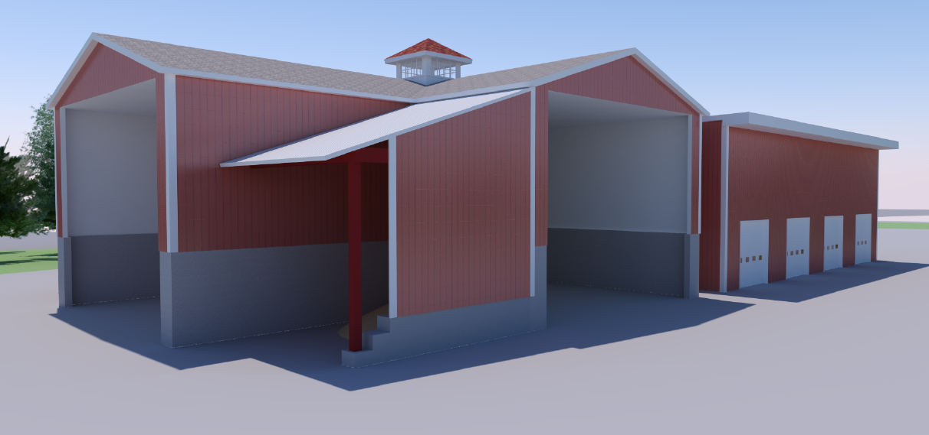
PUBLIC WORKS BUILDING
FEASIBILITY STUDY
Numerous iterations of the conceptual floor plan for the renovated existing building are being developed, working with the MS staff and administration.
Priority was given to renovating the existing building while accommodating the current program needs of the Municipal Services Divisions.
MBAC

Slide 5
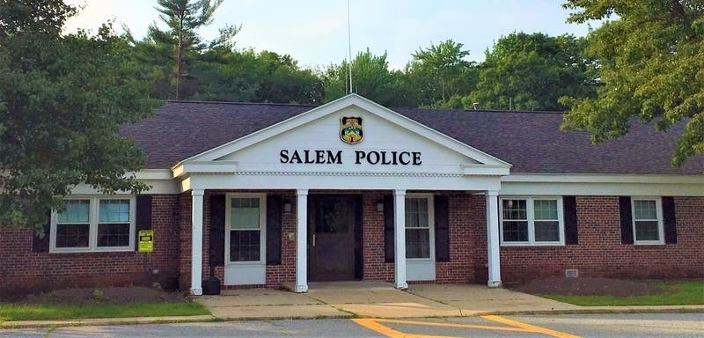
TOWN OF SALEM NH POLICE DEPARTMENT
Town Council – Primary Goal
TGAS
Programming Book
PD/MBAC - Talking Points
PD – National Night Out, 8/1

Slide 6
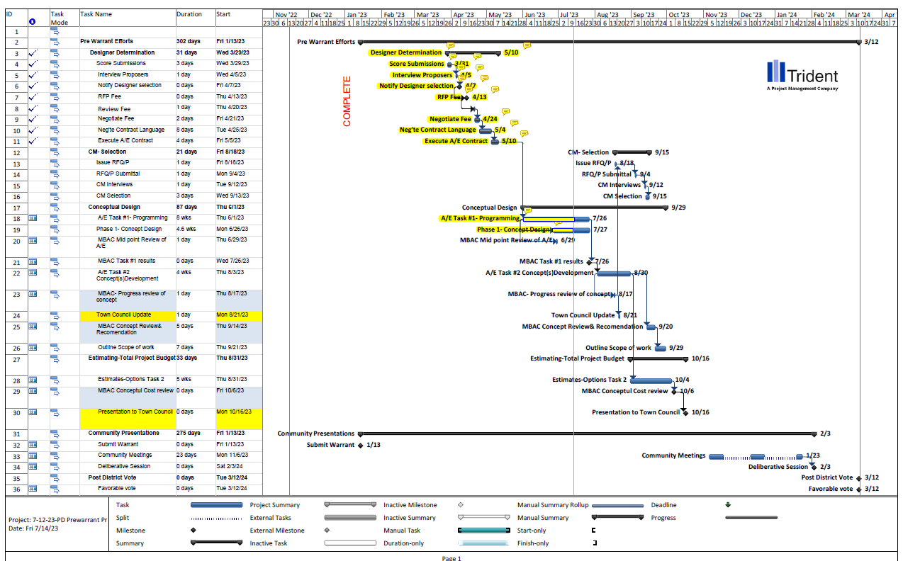
DYNAMIC SCHEDULE
MBAC

Slide 7


Slide 8
MBAC PLAN / Strategy
Salem School District Model
Owners Project Manager – RFQ 2021-011
MGL Project Delivery Methods for Public Construction
Keep Front-end Expenses Low
Produce Conceptual Design and Real Total Project Cost
Warrant Article to Approve Project
Master Plan including Expenditure
MBAC

Slide 9
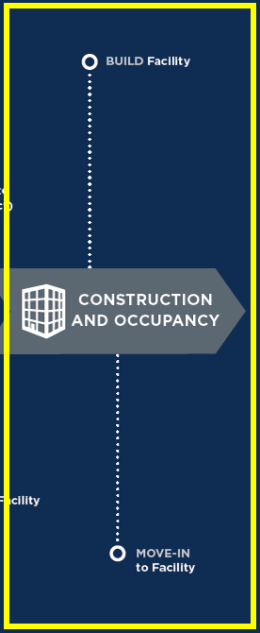

MOVING AHEAD
TOWN COUNCIL
MBAC
SUB COMMITTEES
PUBLIC RELATIONS
MBAC

Slide 10
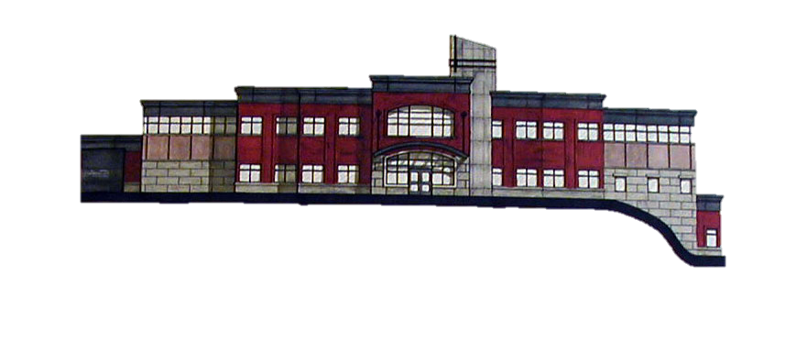
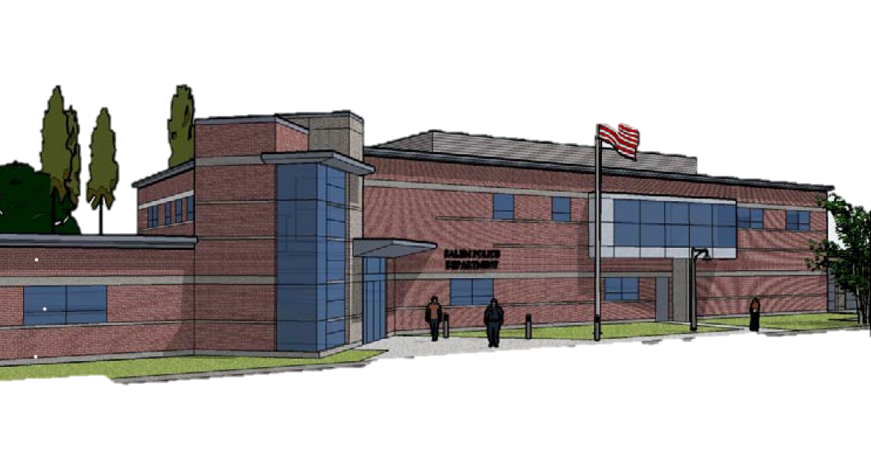
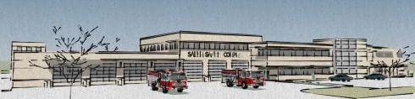
HISTORY
2004
$7,450,000
28,800 SF
2008
$7,135,712
26,000 SF
2015
$23,840,000
24,000 SF
MBAC

Slide 11
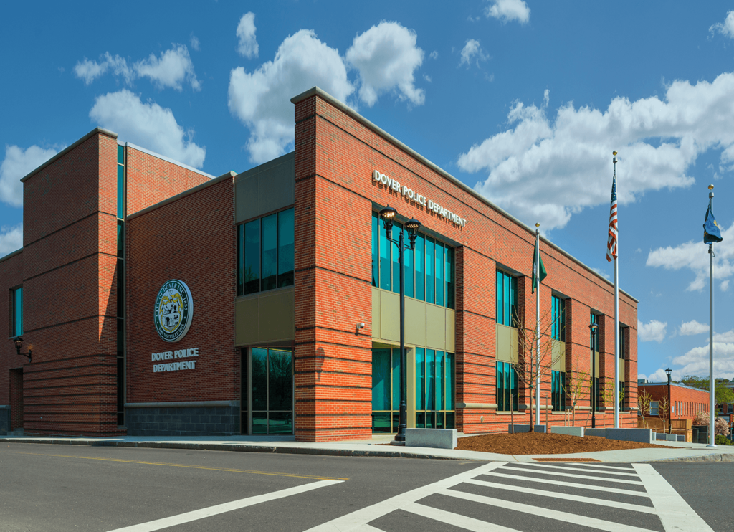
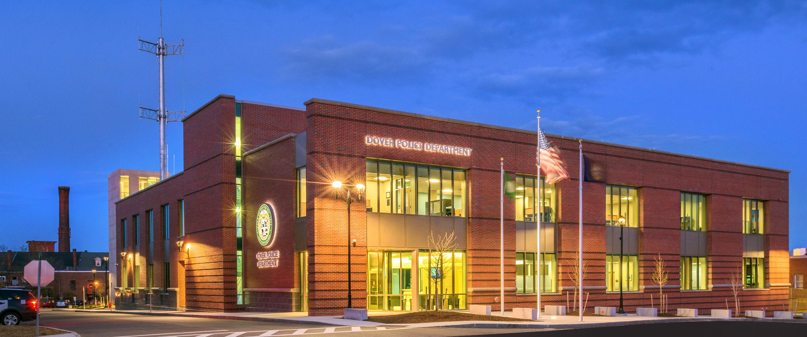
PROJECT ANALYSIS – CASE STUDIES
DOVER NH
OLD | SQ FT | NEW | SQ FT
1935 | 9,000 | 2016 | 30,000

Slide 12
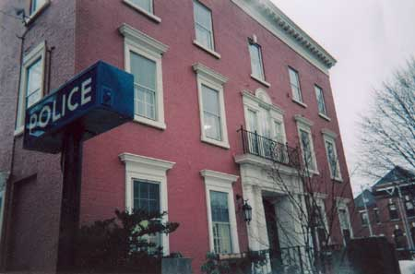
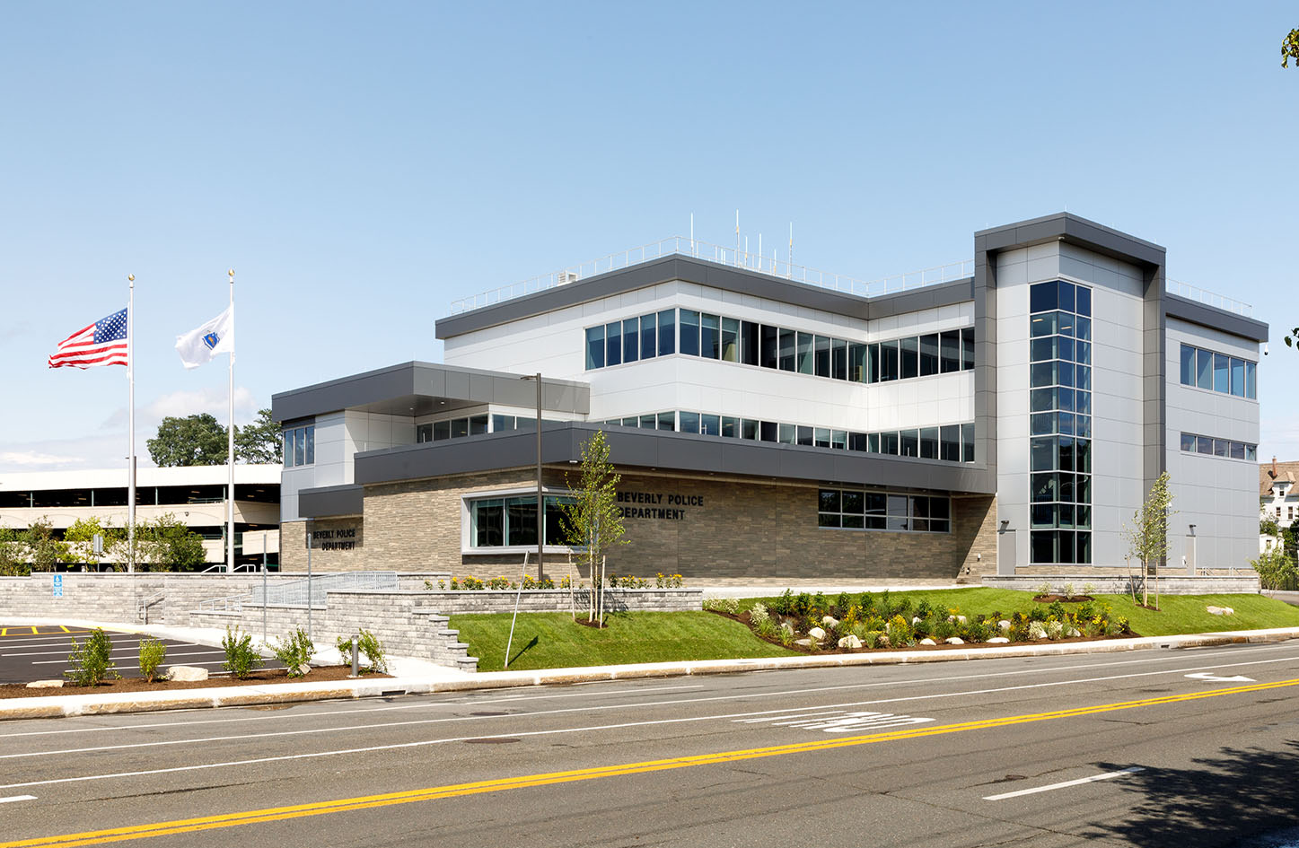
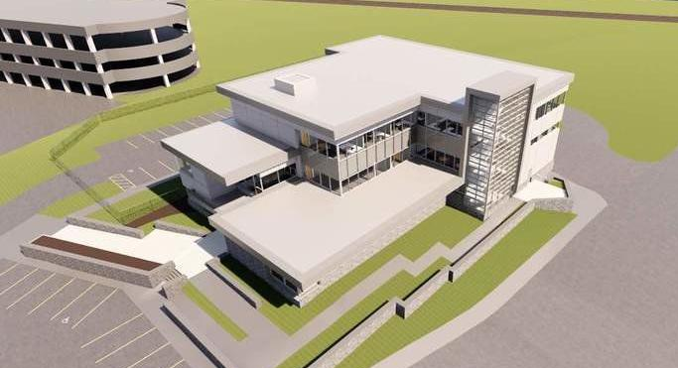
PROJECT ANALYSIS – CASE STUDIES
BEVERLY MA
OLD | SQ FT | NEW | SQ FT
1872 | 9,000 | 2021 | 32,000

Slide 13
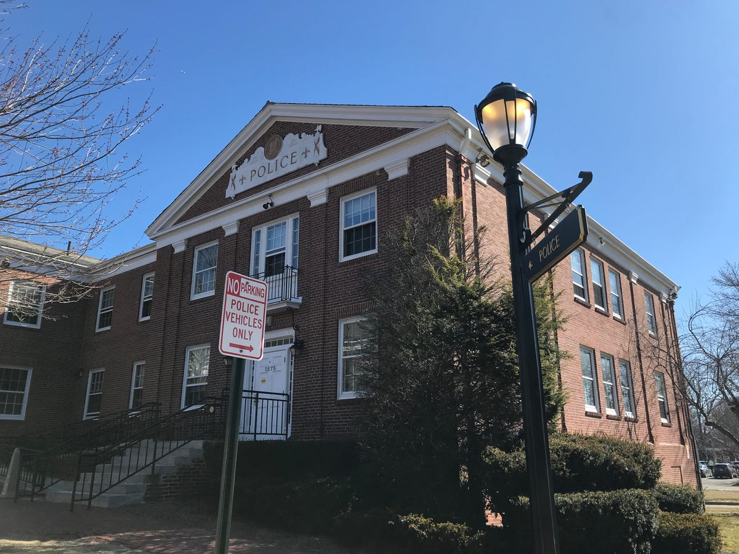
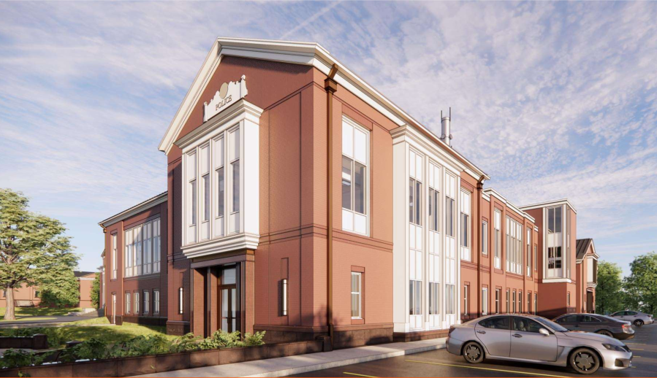
PROJECT ANALYSIS – CASE STUDIES
LEXINGTON MA
OLD | SQ FT | NEW | SQ FT
1956 | 13,000 | 2024 | 30,000

Slide 14
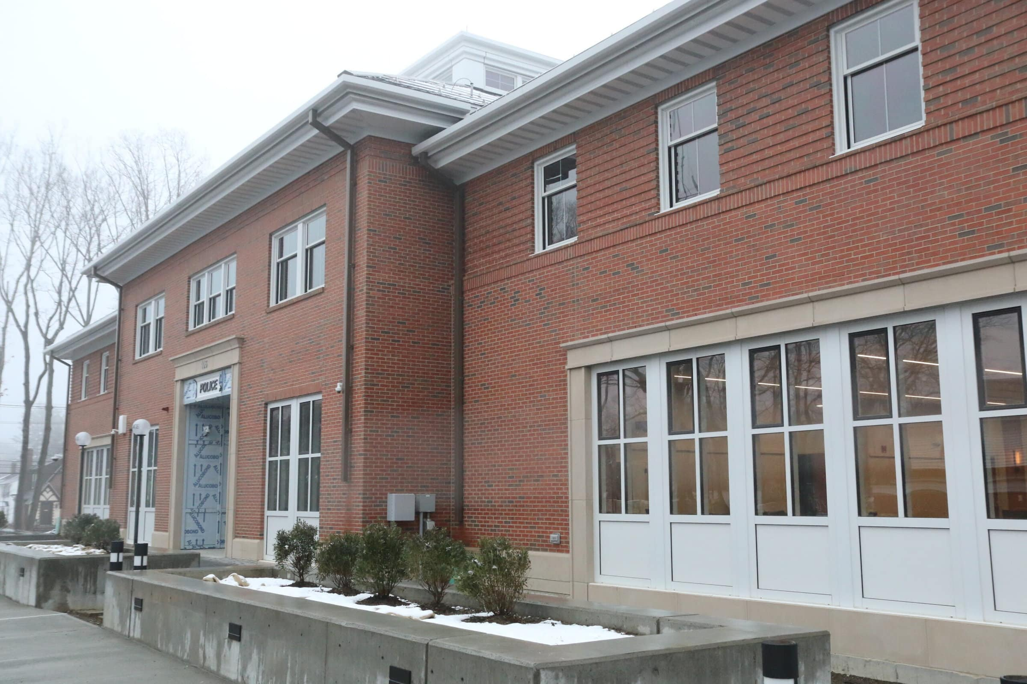
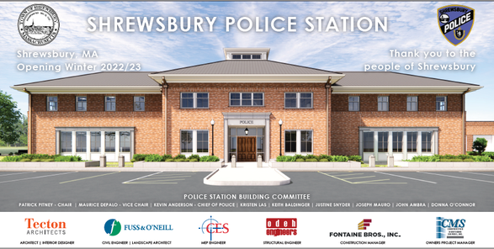
PROJECT ANALYSIS – CASE STUDIES
SHREWSBURY MA
OLD | SQ FT | NEW | SQ FT
1971 | 11,000 | 2023 | 31,000

Slide 15
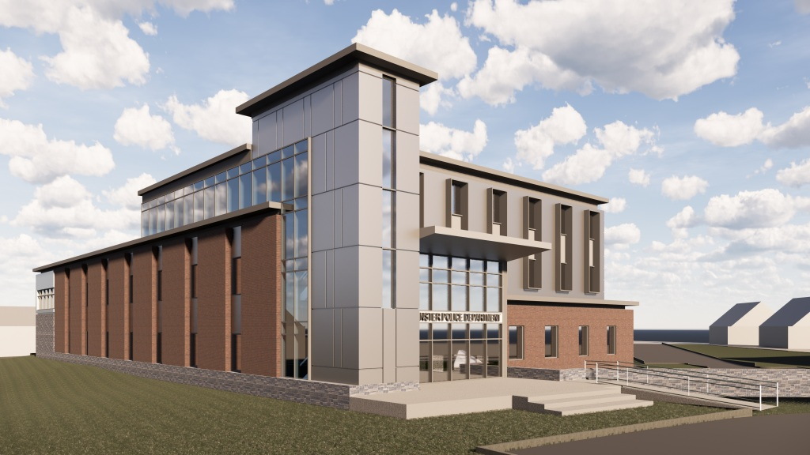
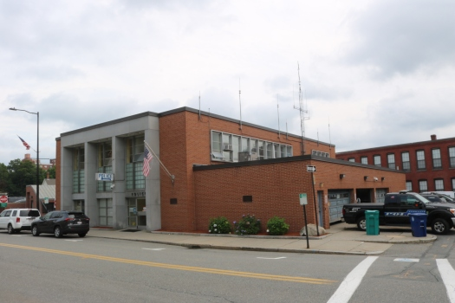
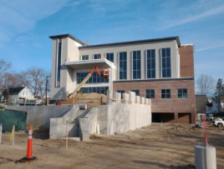
PROJECT ANALYSIS – CASE STUDIES
LEOMINSTER MA
OLD | SQ FT | NEW | SQ FT
1959 | 17,000 | 2024 | 30,000

Slide 16
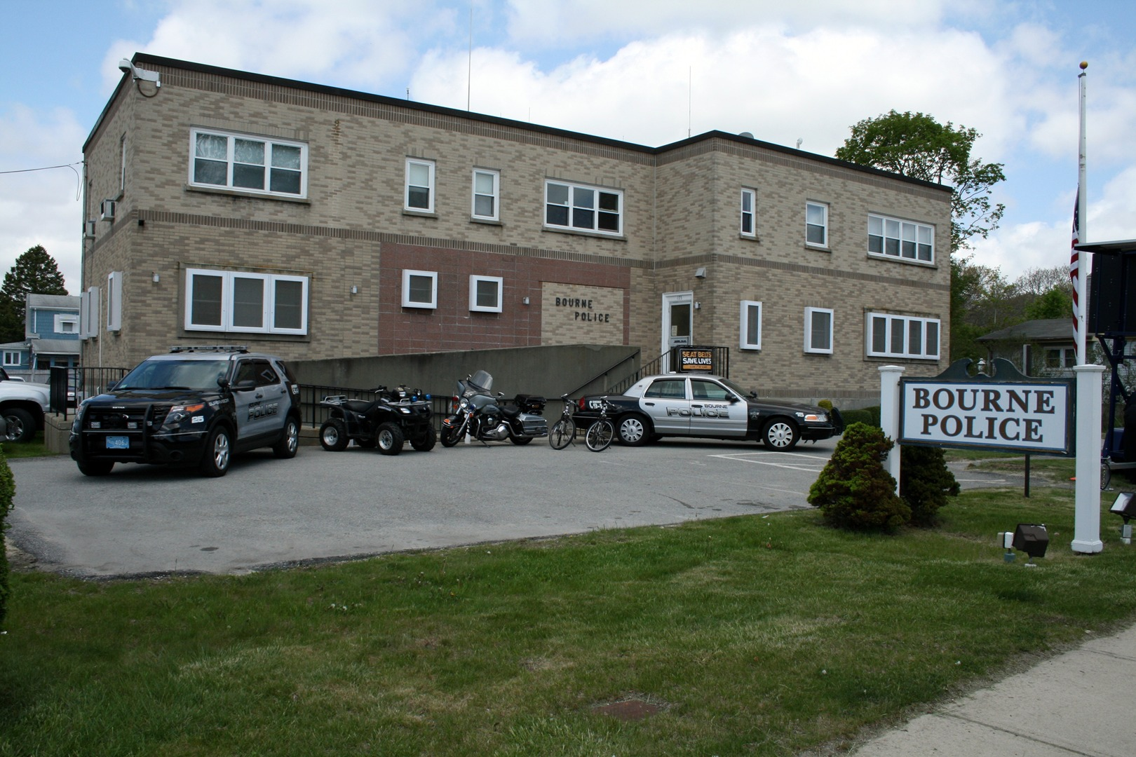
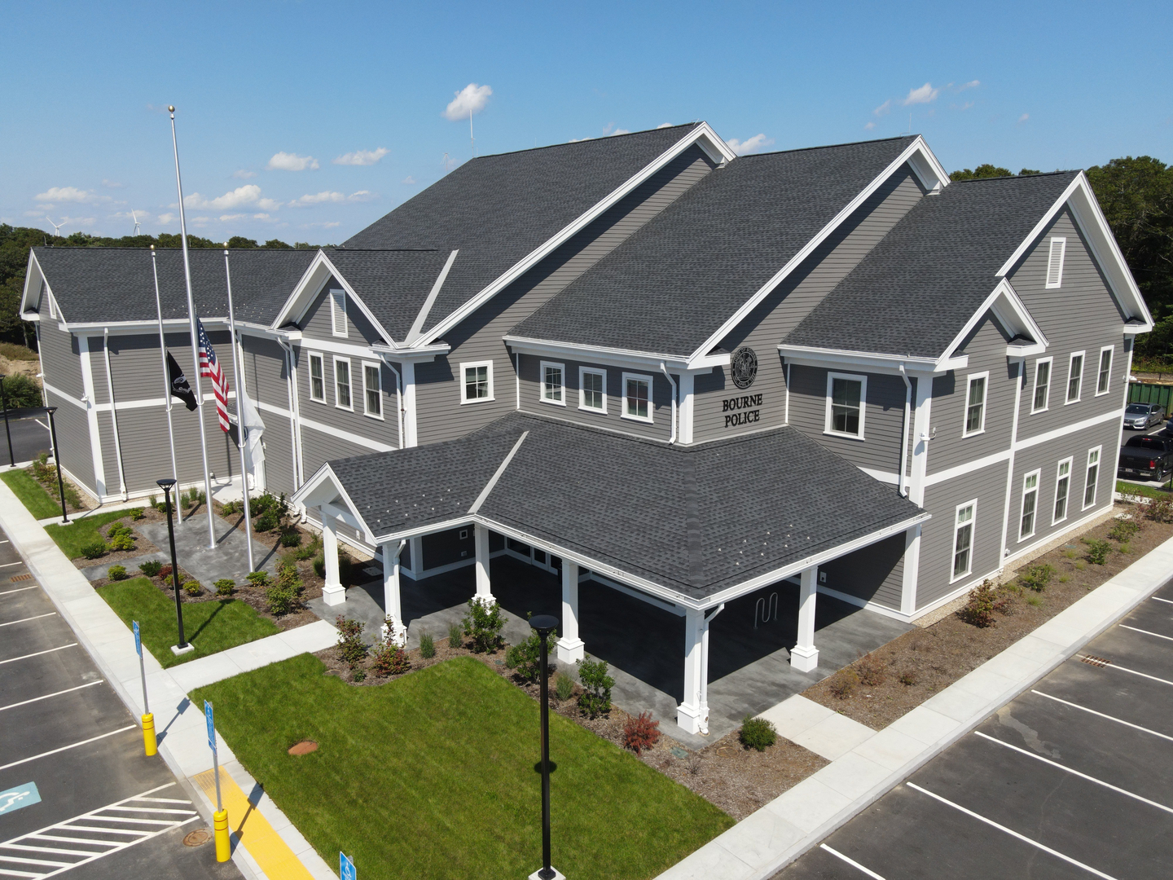
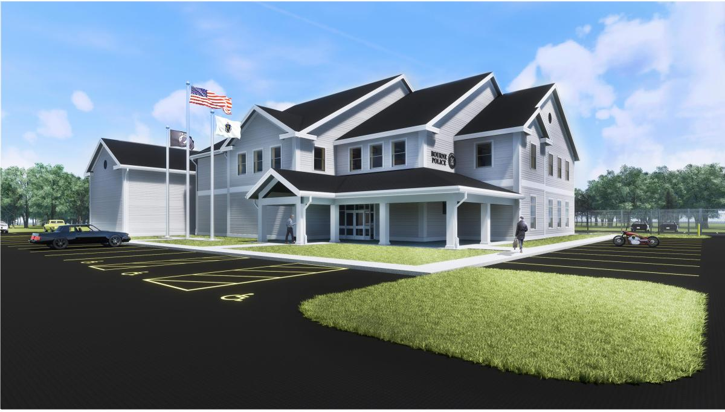
PROJECT ANALYSIS – CASE STUDIES
BOURNE MA
OLD | SQ FT | NEW | SQ FT
1959 | 8,000 | 2020 | 27,000

Slide 17
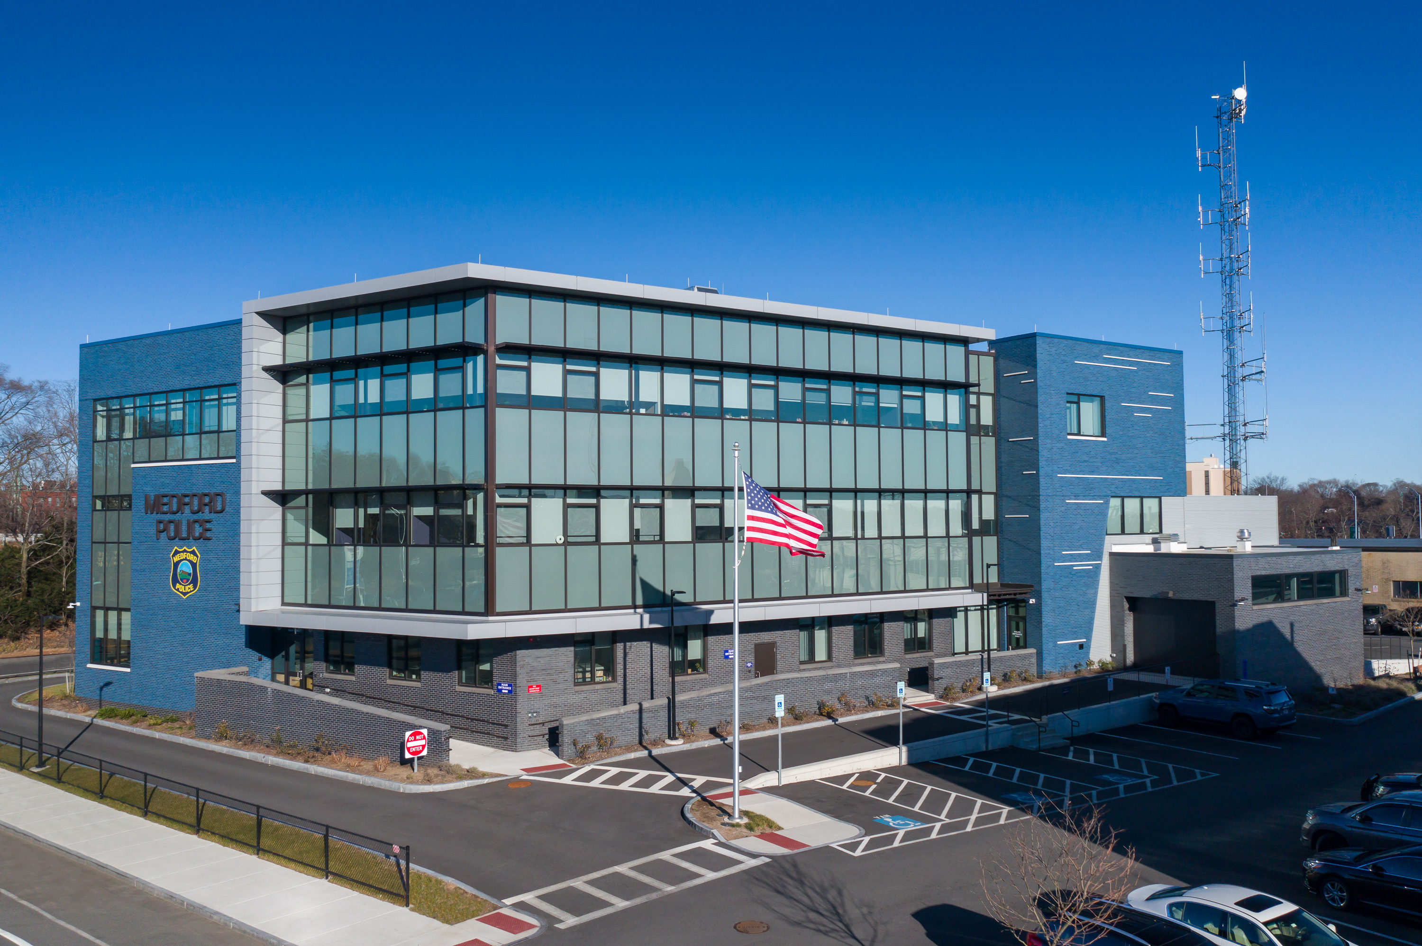
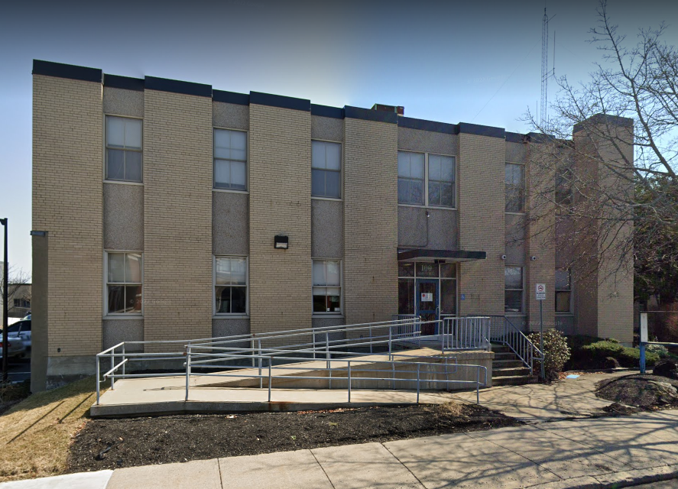
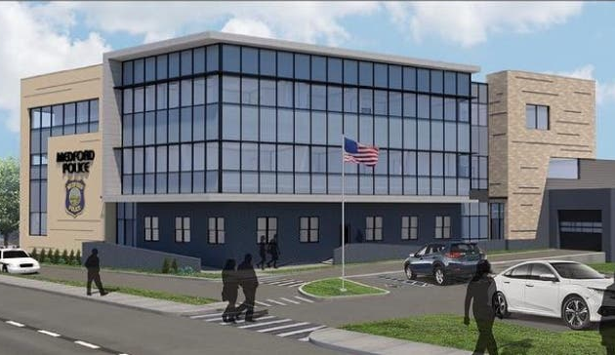
PROJECT ANALYSIS – CASE STUDIES
MEDFORD MA
OLD | SQ FT | NEW | SQ FT
1960 | 11,000 | 2021 | 35,000

Slide 18
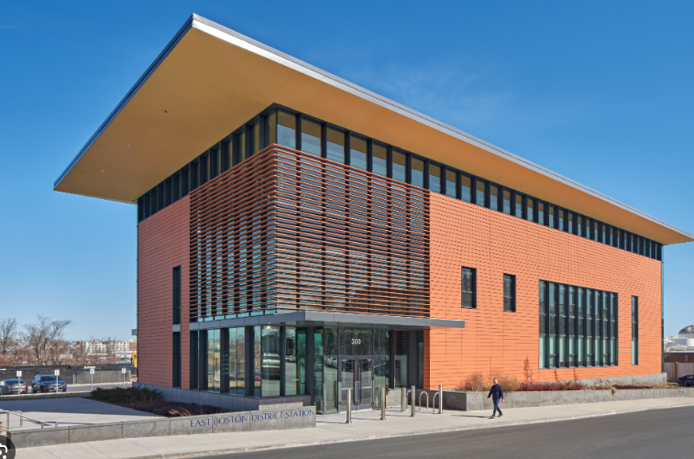
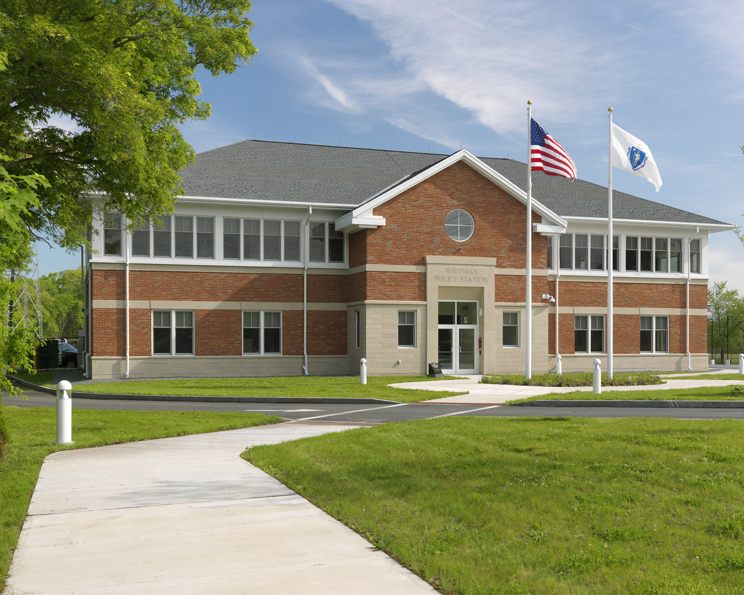
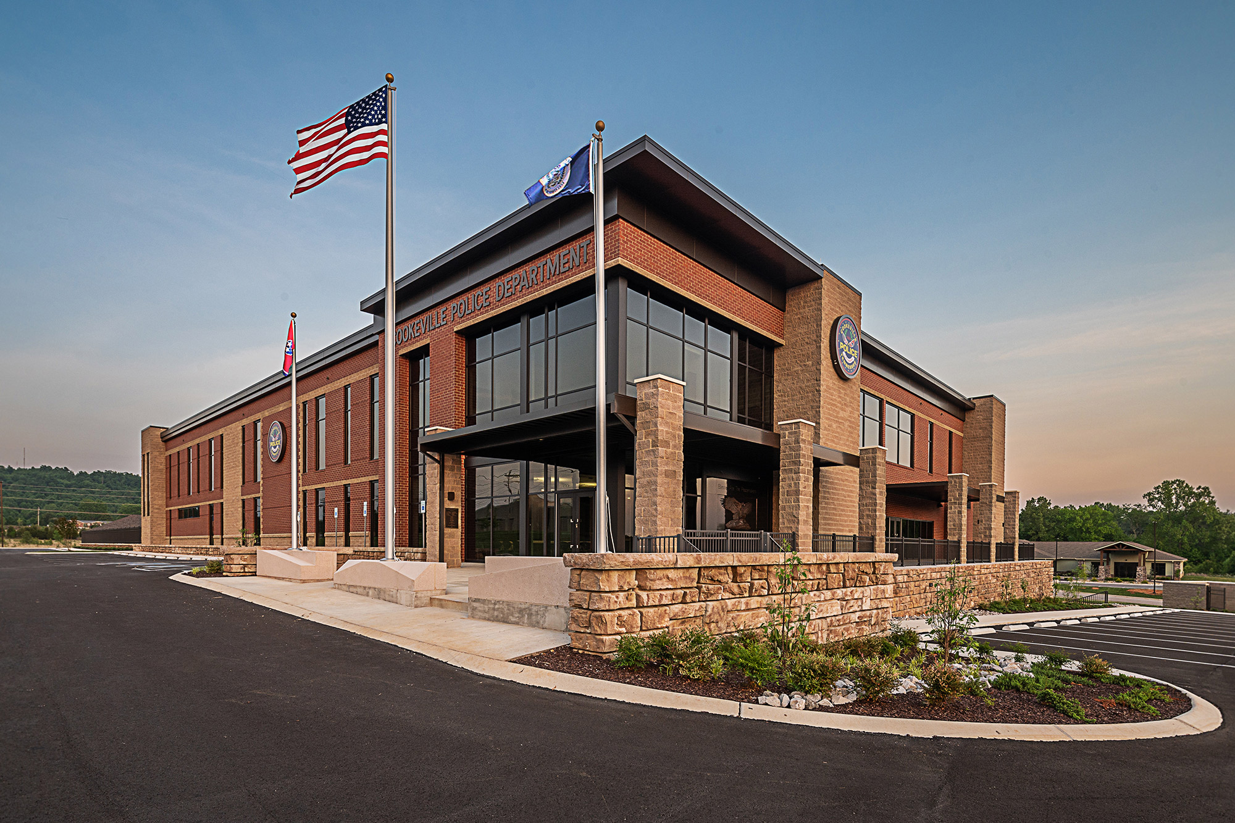
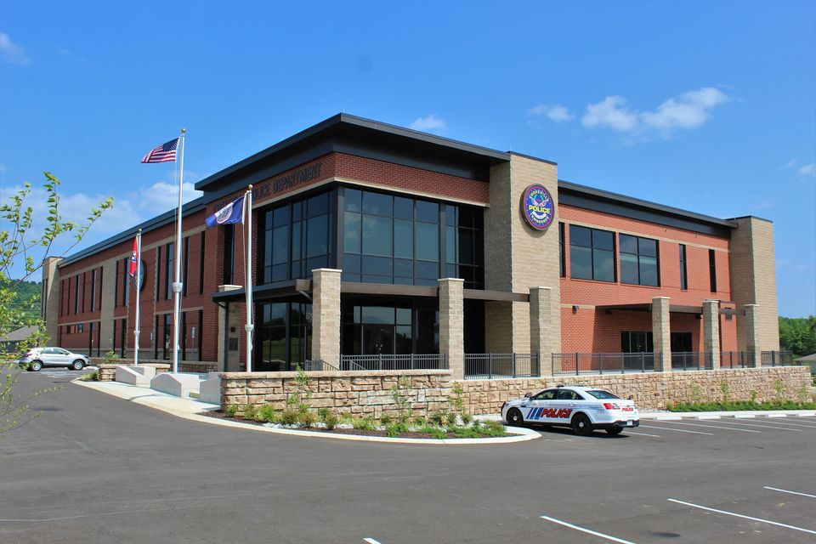
ARCHITECTURE
CONTEMPORARY
TRADITIONAL
MODERN

