Slide 1

MUNICIPAL BUILDINGS ADVISORY COMMITTEE
TOWN OF SALEM NH
JUNE 5, 2023
UPDATE to THE TOWN COUNCIL

Slide 2
MBAC CHARGE BY BOS
June 7, 2021 - BOS Meeting
The Municipal Buildings Advisory Committee is hereby established to create a plan and/or strategy for the coordination of specific investments for capital improvements and general maintenance of key Town Buildings and properties that support public services to the residents and visitors of Salem.
The Municipal Buildings Advisory Committee is hereby established to create a plan and/or strategy for the coordination of specific investments for capital improvements and general maintenance of key Town Buildings and properties that support public services to the residents and visitors of Salem.
MBAC

Slide 3
MBAC PLAN / Strategy
Salem School District Model
Owners Project Manager – RFQ 2021-011
MGL Project Delivery Methods for Public Construction
Keep Front-end Expenses Low
Produce Conceptual Design and Real Total Project Cost
Warrant Article Shovel Ready Project
MBAC

Slide 4
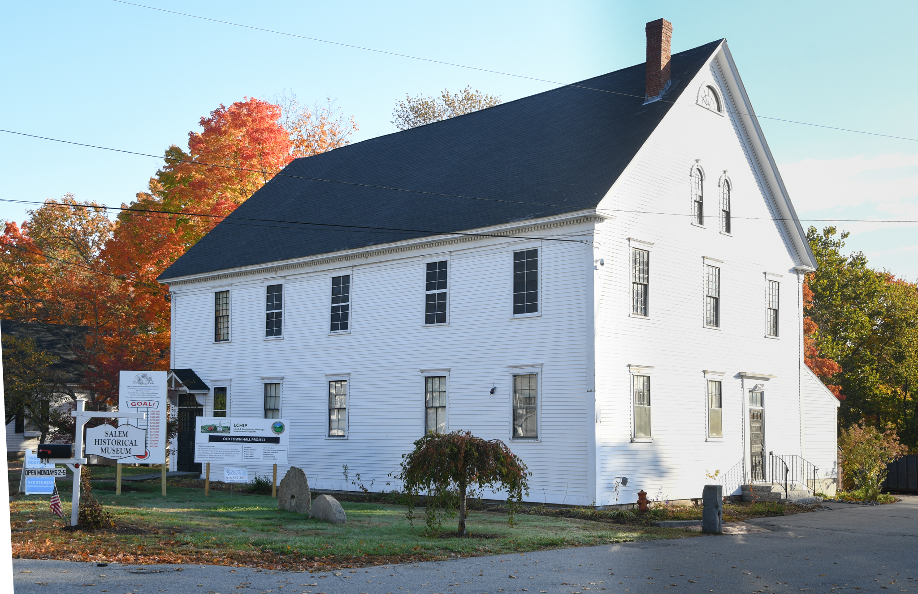
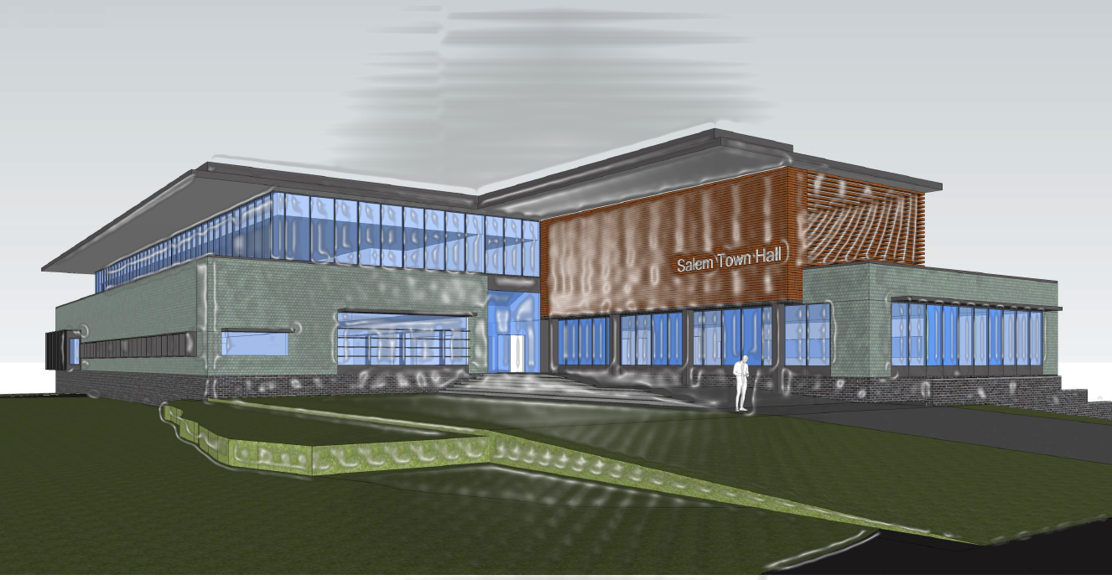
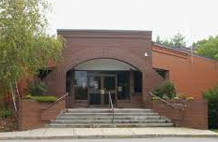
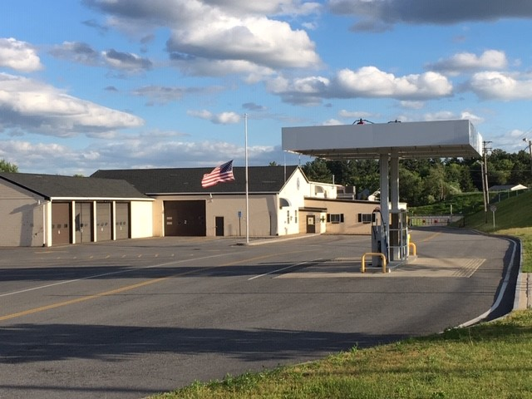
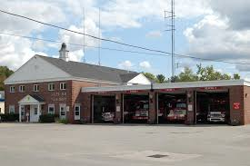
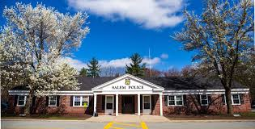
PROJECT UPDATE
Window Restoration Ongoing - LCHIP Grant
Siding Replacement and Exterior Painting Complete
Fundraising Ongoing
ICON – Finalizing Building Program and
Conceptual Deliverables to Town Council
Roofing Membrane Replacement
MBAC
Weston and Sampson – Finalizing Feasibility Study
Next Steps - Due Diligence Structural Building Evaluation, Site Geotechnical
RFQ 2022-046 - Architectural Services Public Safety Buildings
Fire Department Four Phase Facility Station Plan
RFQ 2022-046 - Architectural Services Public Safety Buildings
Consultant Selected – Funding Secured for Preliminary Engineering
MBAC

Slide 5
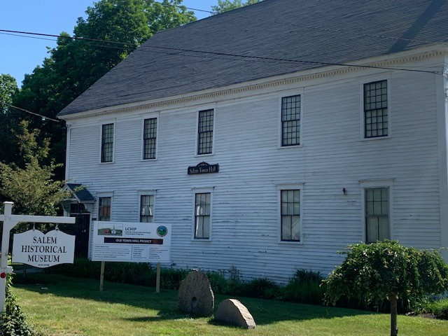
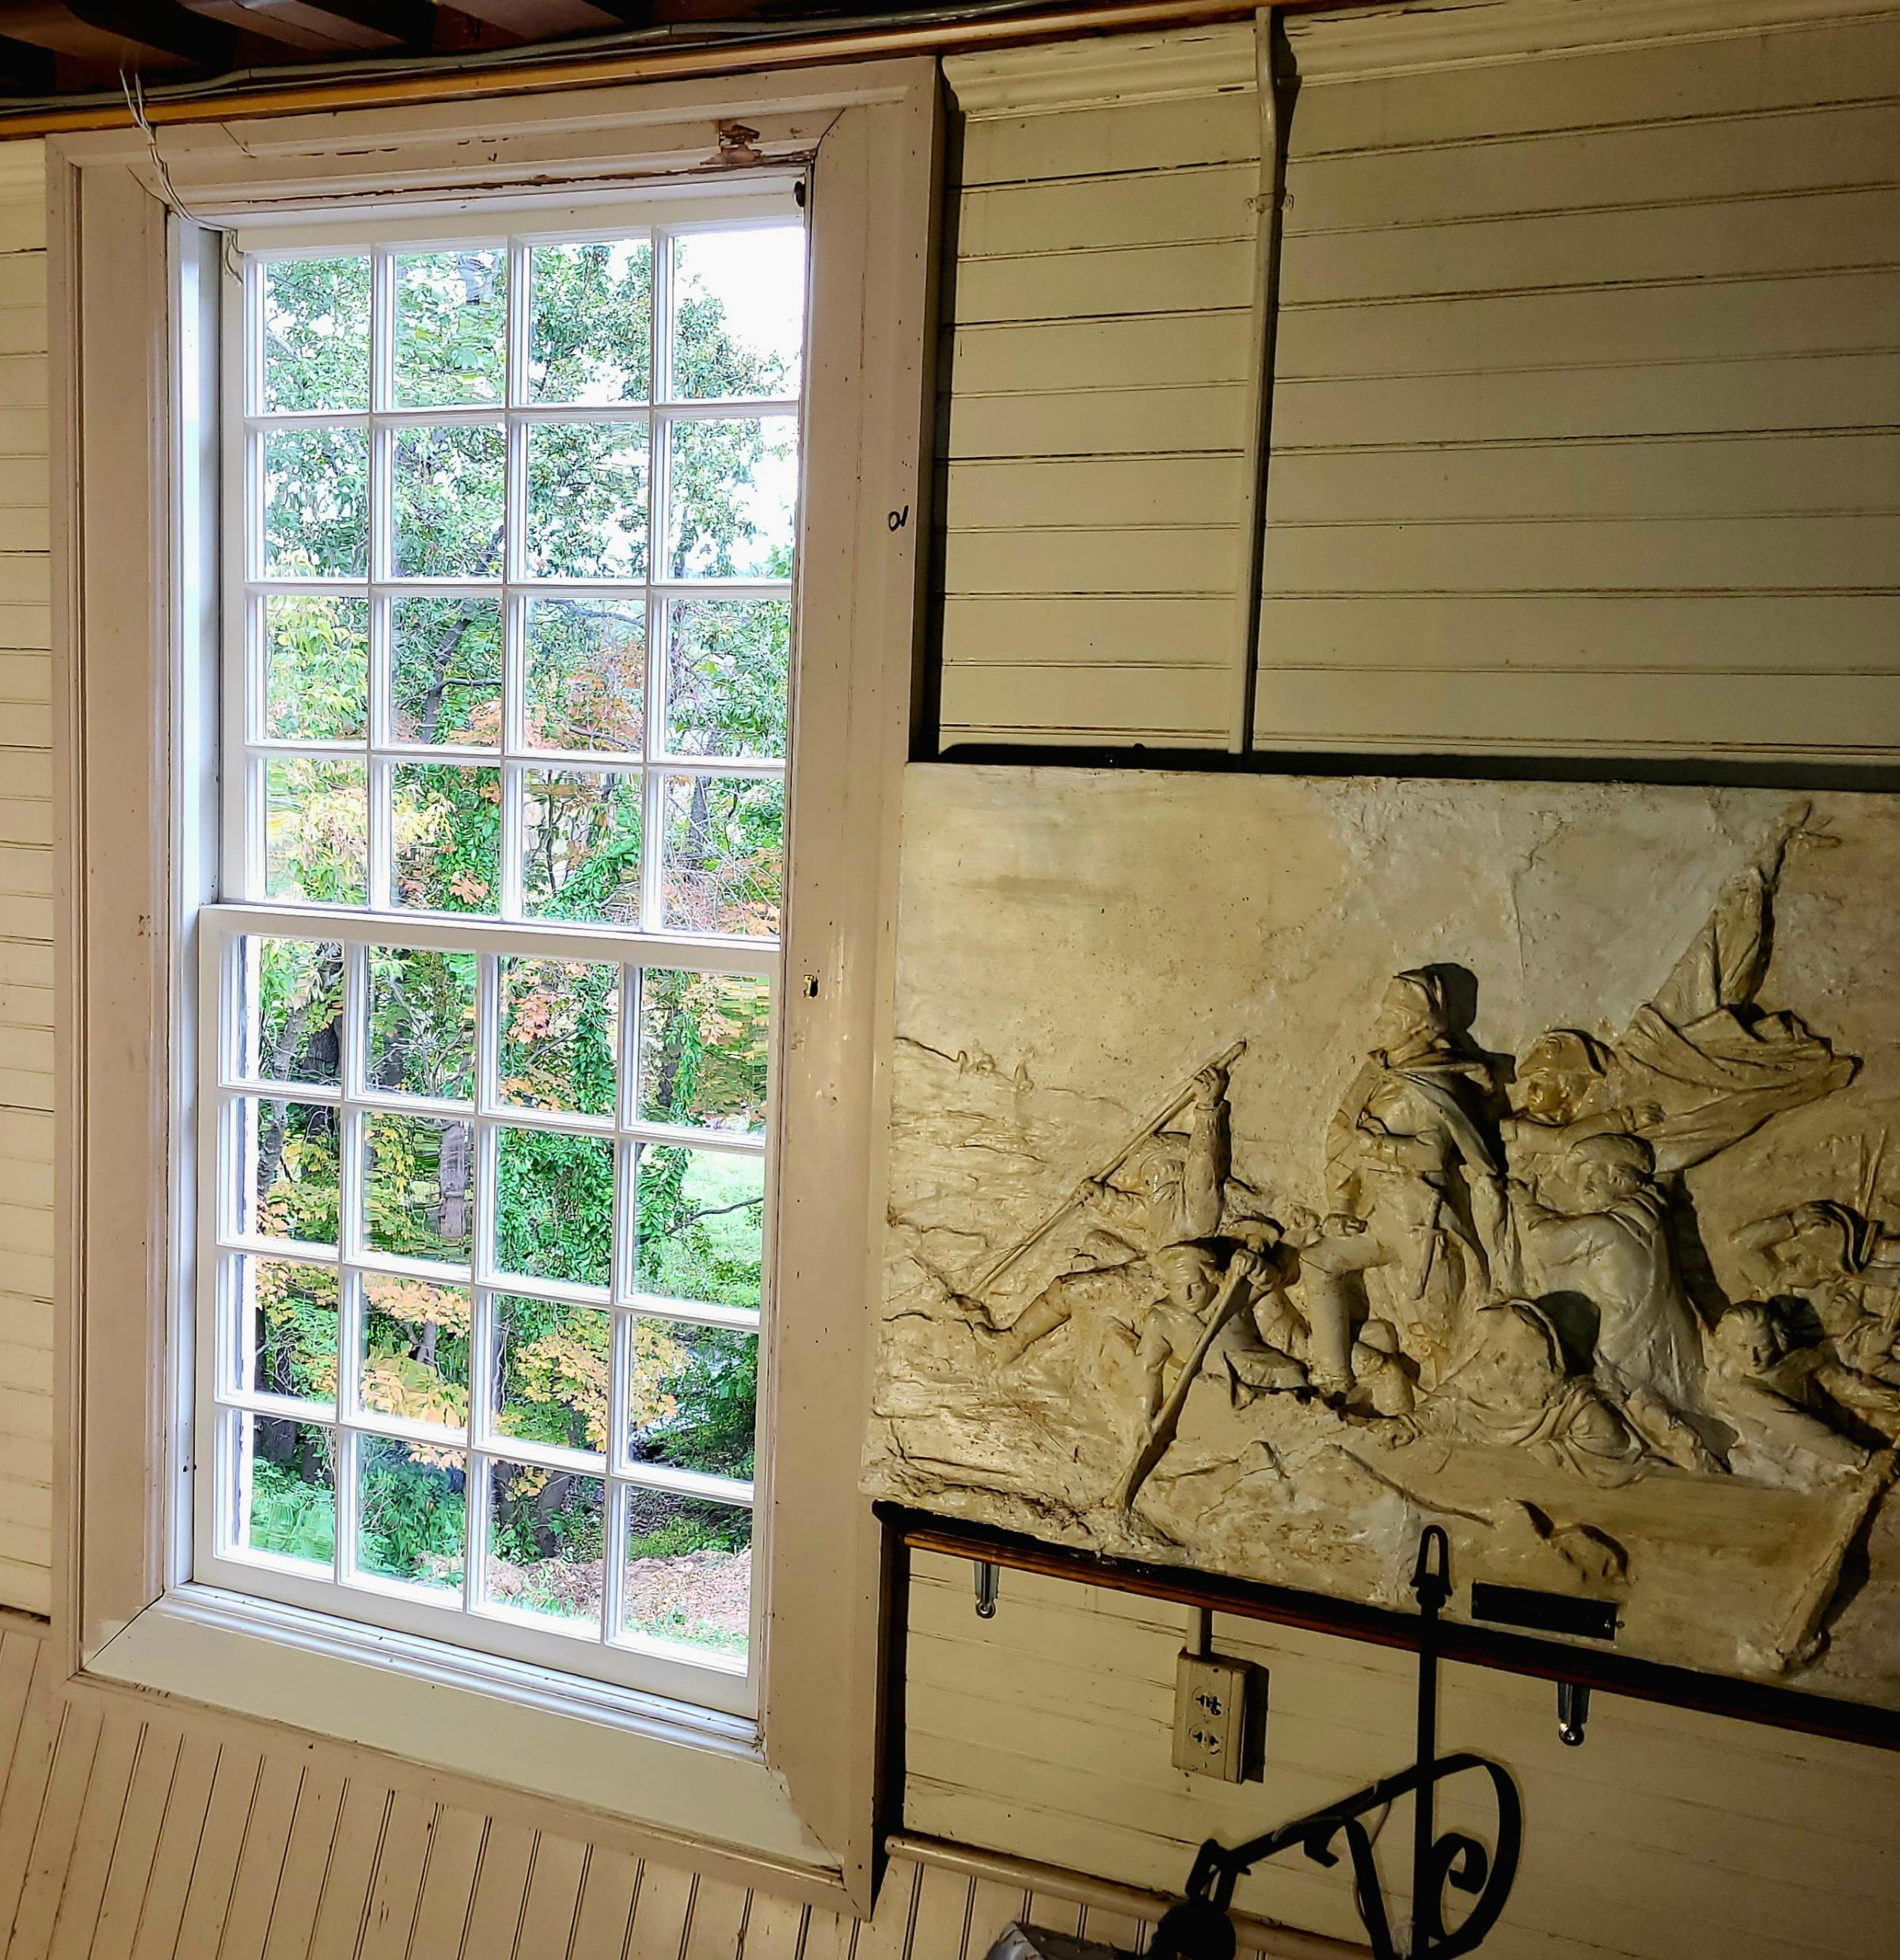
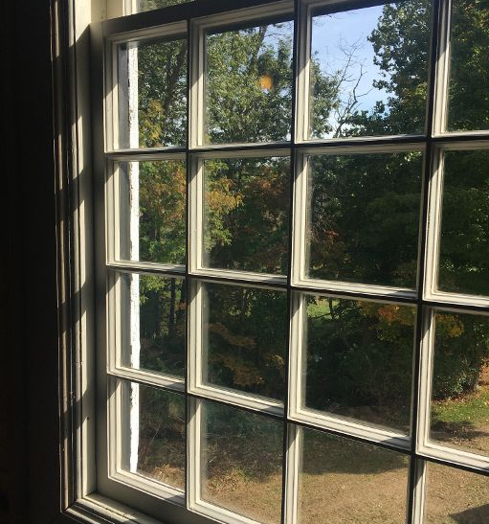
OLD TOWN HALL
LCHIP – Mid-Point
12 Windows Complete
Exterior Siding Complete
Exterior Painting
Interior Carpentry Scope
Electrical Scope
Fundraising Ongoing
MBAC

Slide 6
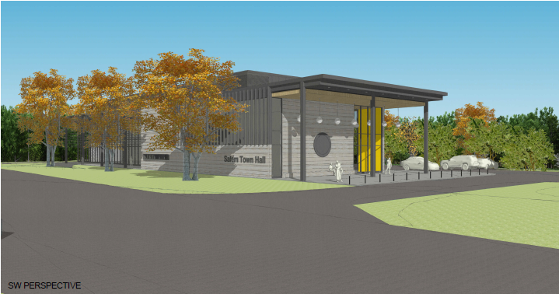
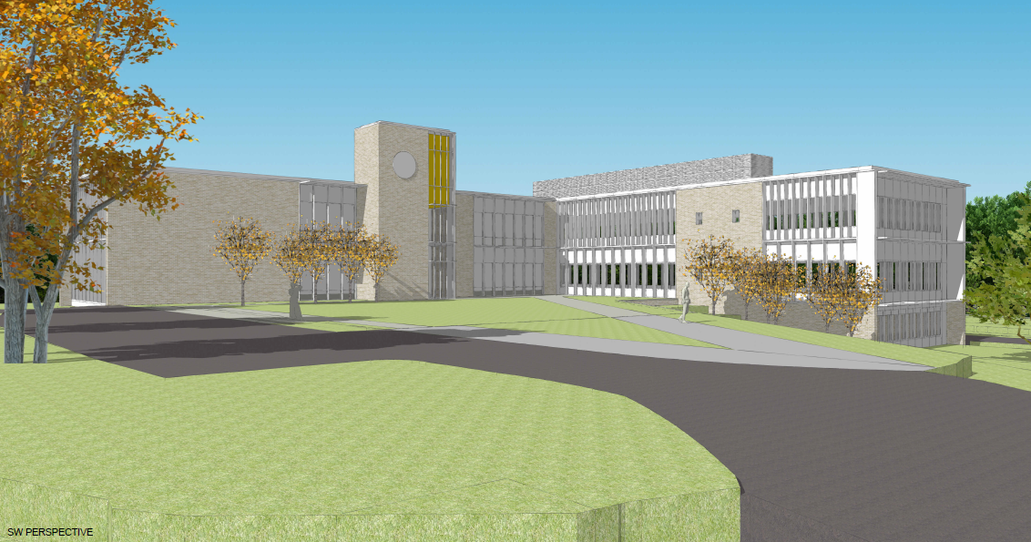
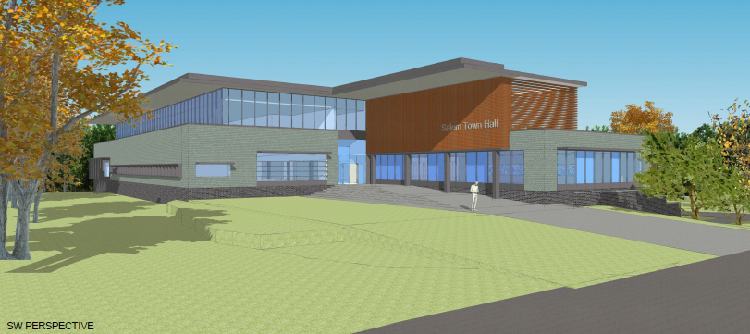
TOWN HALL PROJECT
Conceptual Deliverables to Town Council by Summer
MBAC

Slide 7
DISTRICT COURT
ARTICLE 10: $536,850
COST MATRIX
Low Qualified Bid | $320,150
Architectural Fees | $43,260
OPM - Management | $35,000
Contingency | $32,015
TOTAL | $430,425
FUNDING: Unassigned Fund Balance
MBAC

Slide 8
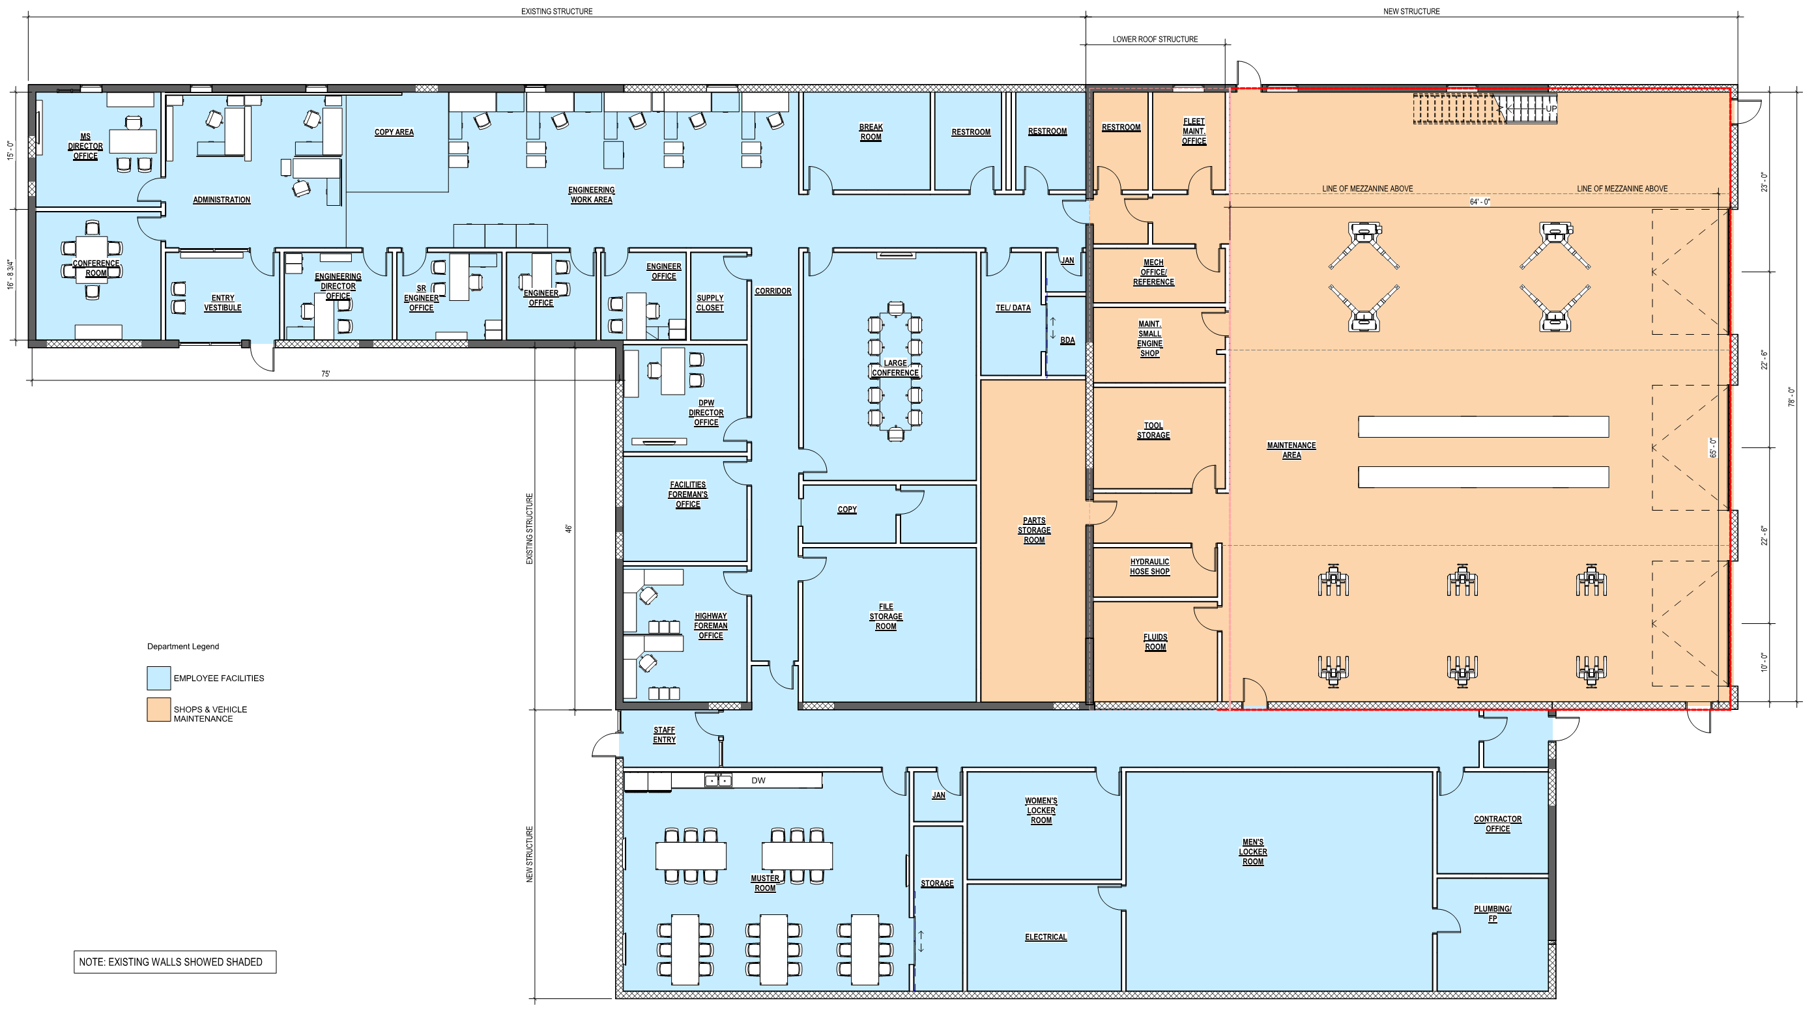
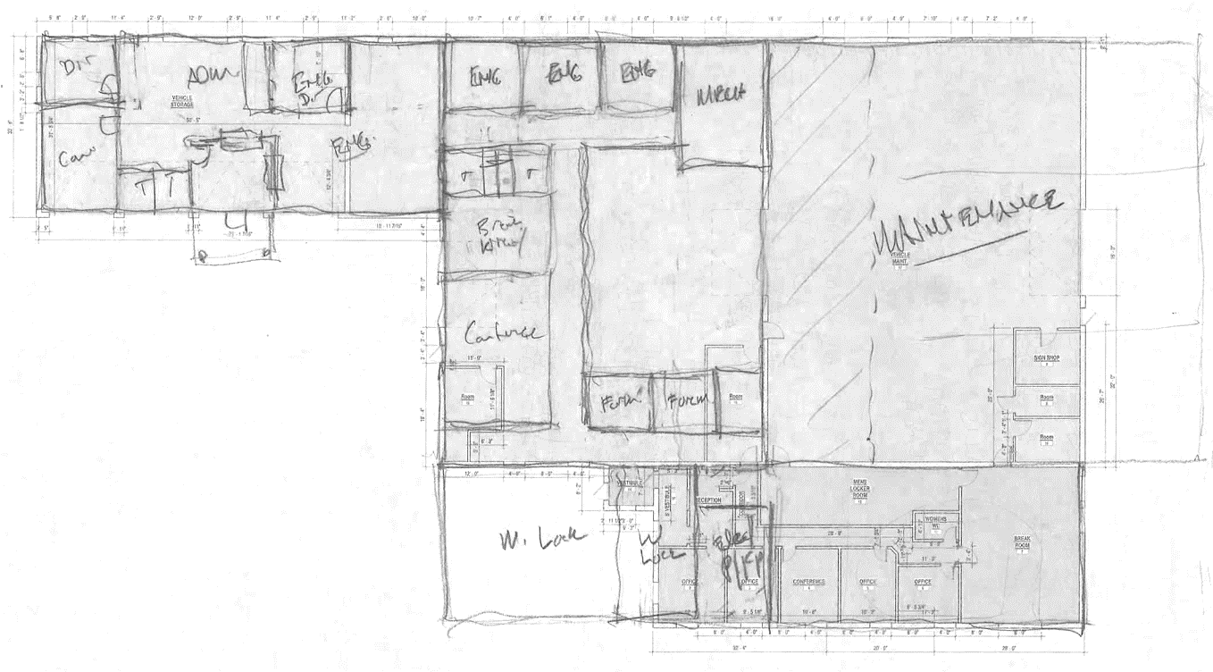
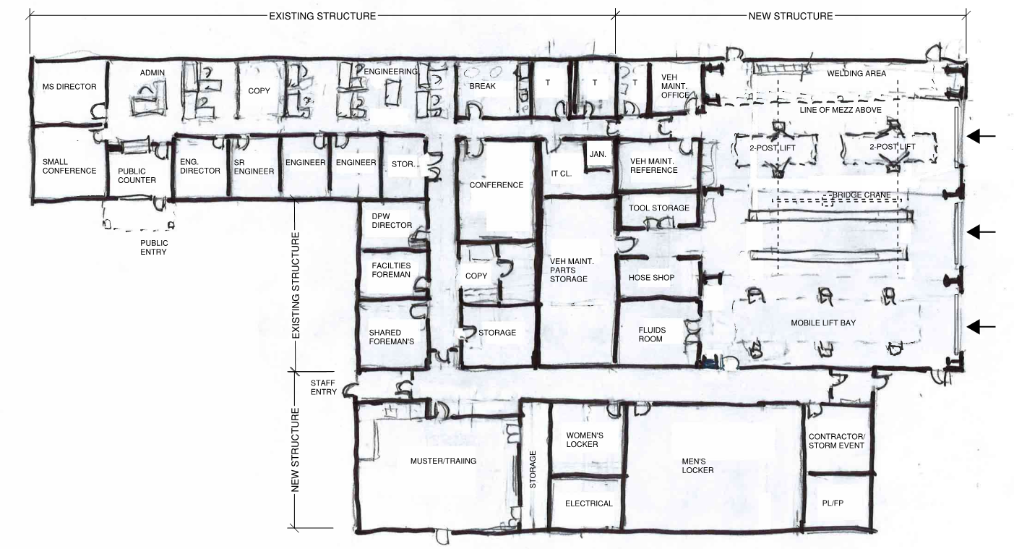
PUBLIC WORKS BUILDING
FEASIBILITY STUDY
Numerous iterations of the conceptual floor plan for the renovated existing building are being developed, working with the MS staff and administration.
Priority was given to renovating the existing building while accommodating the current program needs of the Municipal Services Divisions.
MBAC

Slide 9
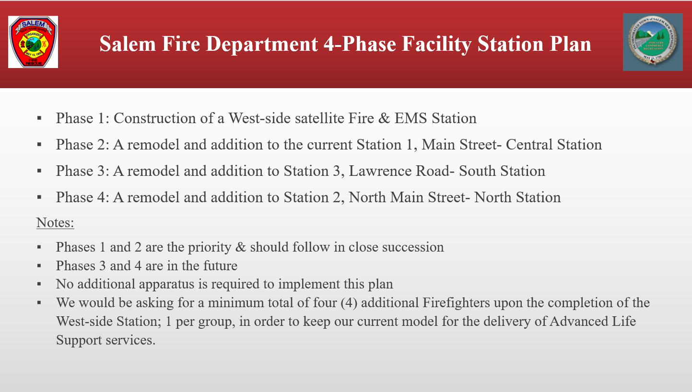
FIRE DEPARTMENT
BOS Endorsed – OCT 17, 2022
MBAC Endorsed

Slide 10

ACTION ITEMS
“The Board of Selectmen hereby confirms that the best location to house a new Police Station will be at 9 Veterans Memorial Parkway, otherwise known as Map 108, Lot 7960, and which is the current location of the existing Police Station.”
“The Board of Selectmen hereby authorizes funding an amount up to $500,000 for the purpose of procuring all professional services necessary for preliminary engineering and design for a new Police Station. Funding shall be through Public Safety Impact fees in the amount of $150,000 and by monies made available through the American Rescue Plan Act in the amount of $350,000.”
RFQ 2022-046 – Architectural Services Public Safety Buildings: The Town of Salem (TOWN) is seeking to contract with a professional firm to provide architectural and engineering services (FIRM) to provide design professional drawings for a new Police Station, possibly a new West Side Satellite Fire Station, and renovation/rehabilitation of the existing Central Fire Station.
MBAC

Slide 11
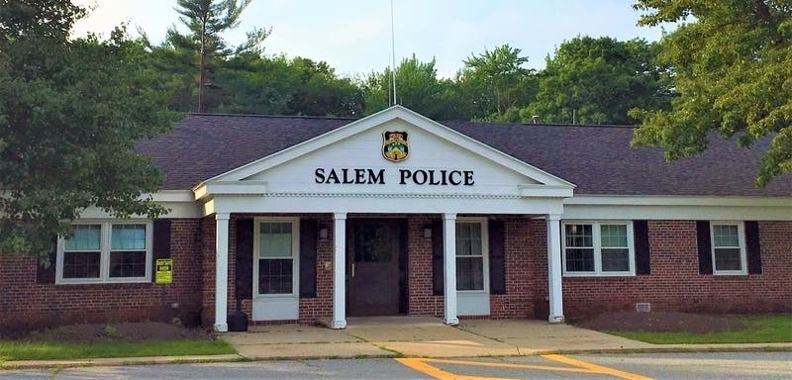
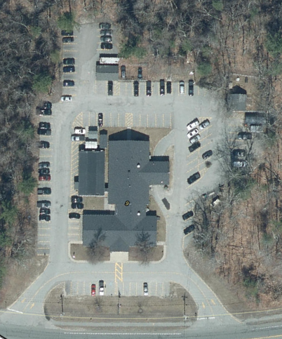
TOWN OF SALEM NH POLICE DEPARTMENT
Police Department Headquarters:
9 Veterans Memorial Parkway
Built in 1966
3,724 SF
14 Staff members

Slide 12
TOWN OF SALEM NH POLICE DEPARTMENT
Police Department Headquarters:
Rear Addition
Built in 1978
4,902 SF
50 Staff Members
Cumulative: ~ 8,626 SF

Slide 13
TOWN OF SALEM NH POLICE DEPARTMENT
“In 1999 we attached a house trailer to the building to expand our cramped floor space. This area will be used for long term storage and to replace office and interview areas that were given up for other purposes. The biggest problem that continues to affect police operations is the lack of space.”
STEPHEN MacKINNON
Chief of Police
Police Department Headquarters:
2 Manufactured Trailer Units
Added in 1999
1320 SF
75 Staff Members
Cumulative: ~ 10,741 SF

Slide 14
TOWN OF SALEM NH POLICE DEPARTMENT
Police Department Headquarters:
3 Manufactured Trailer Units
Placed in 2008
78 Staff Members
2,115 SF (increase of 795 SF)
Cumulative: ~ 11,536 SF
2023 - 102 Staff Members

Slide 15
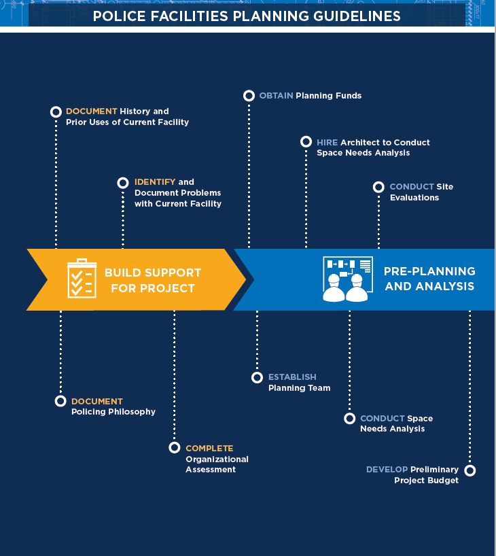
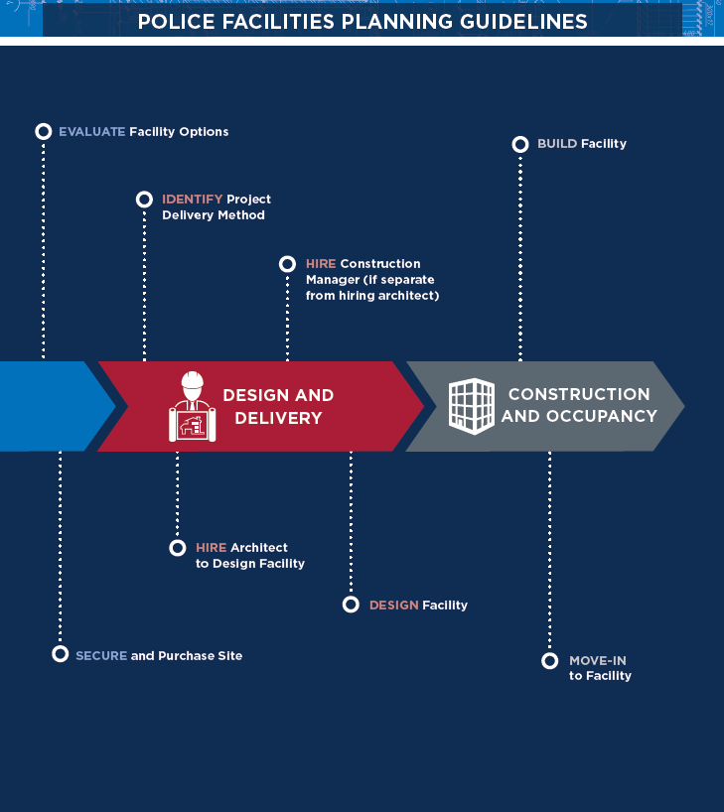

Slide 16
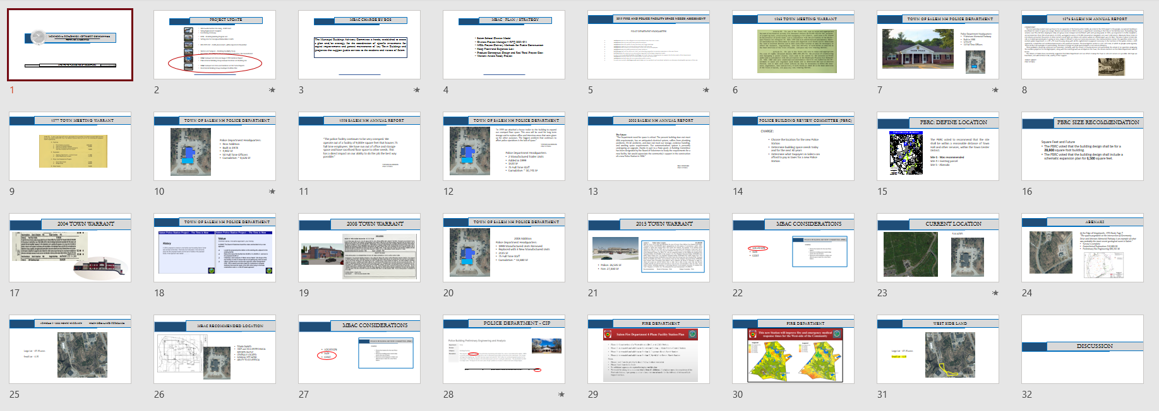
LOOKING AHEAD
TOWN COUNCIL
SUB COMMITTEES
PUBLIC RELATIONS
MASTER PLAN
MBAC

Slide 17
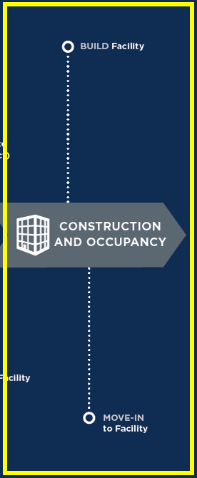

MOVING AHEAD
TOWN COUNCIL
MBAC
SUB COMMITTEES
PUBLIC RELATIONS
MBAC

Slide 18
SUB COMMITTEES
PD WORKING GROUP
Police Chief
PD Designee
PD Designee
PD Designee
PD Retiree
TC Member
TC Member
BC Member
PB Member
FINANCE GROUP
Finance Director
TC Member
TC Member
BC Member
BC Member
School Liaison
COMMS GROUP
TC Member
Comm Committee
ATM
MBAC Member
Town Board At Large
CITIZENS GROUP
Gov’t Academy
Solicit Applications
MBAC

