Slide 1

MBAC
MUNICIPAL BUILDINGS ADVISORY COMMITTEE
MAY 1, 2023

Slide 2
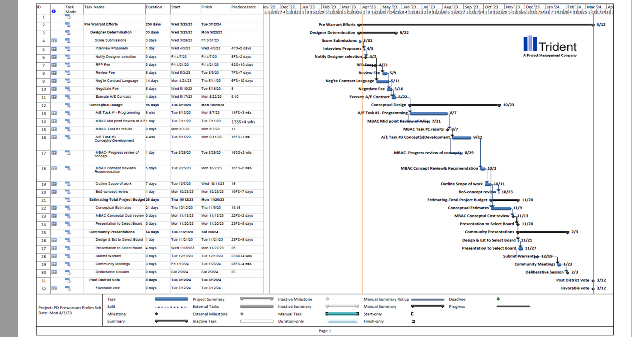
RFQ 2022-046 Architectural Services Public Safety Buildings
EVALUATIONS COMPLETE – NEGOTIATING STAGE
SCOPE:
TASK 1 – PROGRAMMING + CONCEPT PLANNING
Schedule: 8 weeks
TASK 2 – CONCEPTUAL DESIGN + ESTIMATING
Schedule: 4 weeks design + 3 weeks estimating
TASK 3 – EXISTING CONDITIONS VERIFICATION + BASE REVIT MODEL
Schedule: 4 weeks – concurrent with Task 2
Preliminary conceptual designs (three alternatives) – plans, cost estimate, schedule/implementation plan and summary of pros and cons to Town Council for selection of Preferred Option.
MBAC

Slide 3

FACILITY GUIDELINES
Choose a Location
Determine Space Needs
Develop Concepts
Develop Cost
History
MBAC

Slide 4
SIZE OF BUILDING
WHAT IS THE RIGHT SIZE?
ARCHITECTS SCOPE
CURRENT = 13,880 SF
HARRIMAN = 48,300 SF
2004 PROPOSAL = 28,800 SF (Future Expansion = 6,500 SF)
2008 PROPOSAL = 26,000 SF
2015 PROPOSAL = 54,000 SF (PD & FD)
1966 = 3,724 SF
1978 = 4,902 SF
1999 = 9,286 SF
MBAC

Slide 5
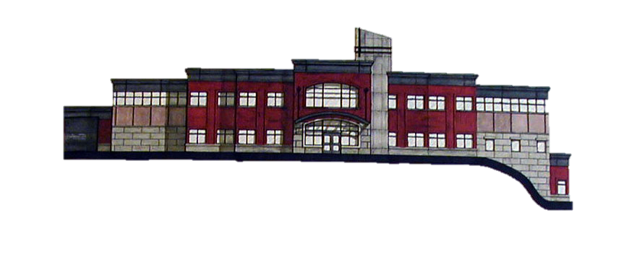
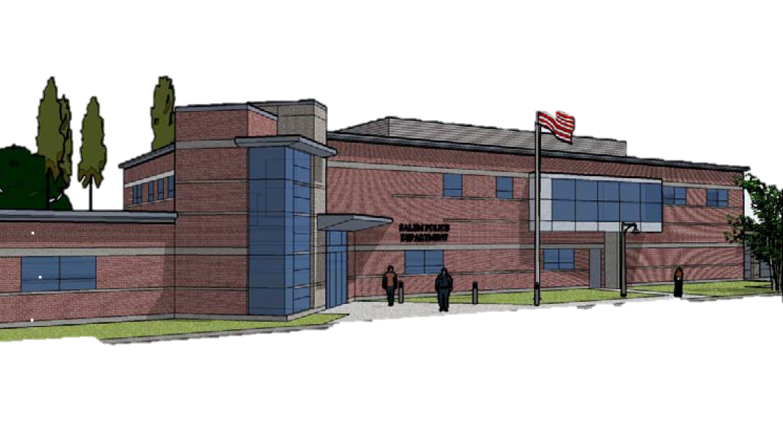
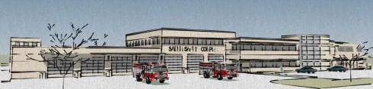
HISTORY & COST
2004
$7,450,000
2007
$7,135,712
2015
$23,840,000
MBAC

Slide 6
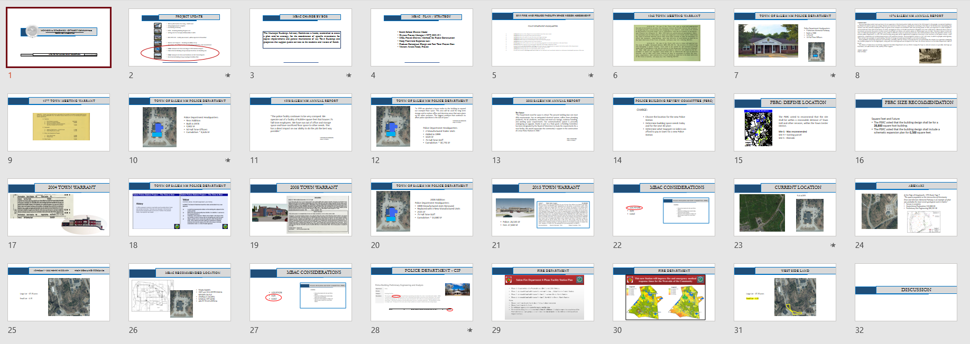
LOOKING AHEAD
TOWN COUNCIL
SUB COMMITTEES
PUBLIC RELATIONS
MASTER PLAN
MBAC

