Slide 1

MUNICIPAL BUILDINGS ADVISORY COMMITTEE
TOWN OF SALEM NH
APRIL 3, 2023
UPDATE to THE Board of selectmen

Slide 2
DISTRICT COURT
ARTICLE 10: $536,850
COST MATRIX
Low Qualified Bid | $320,150
Architectural Fees | $43,260
OPM - Management | $35,000
Contingency | $32,015
TOTAL | $430,425
FUNDING: Unassigned Fund Balance
MBAC

Slide 3
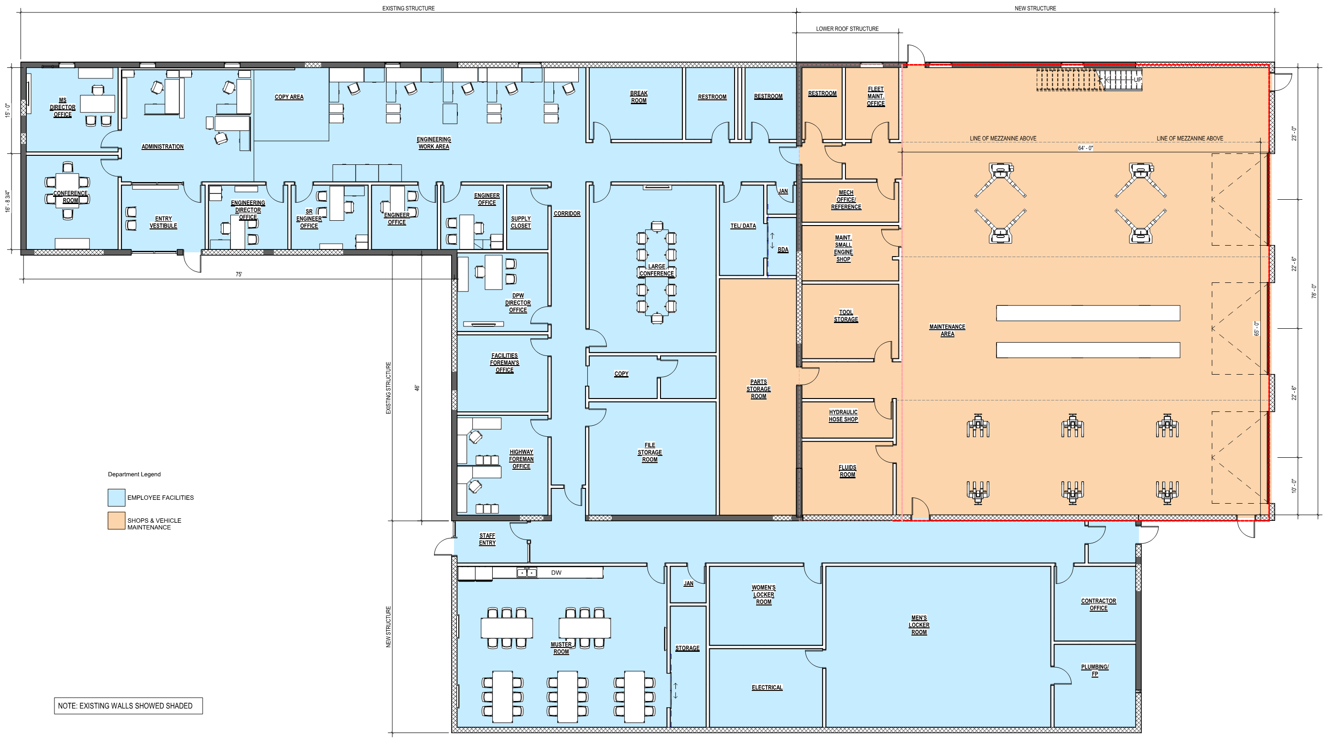
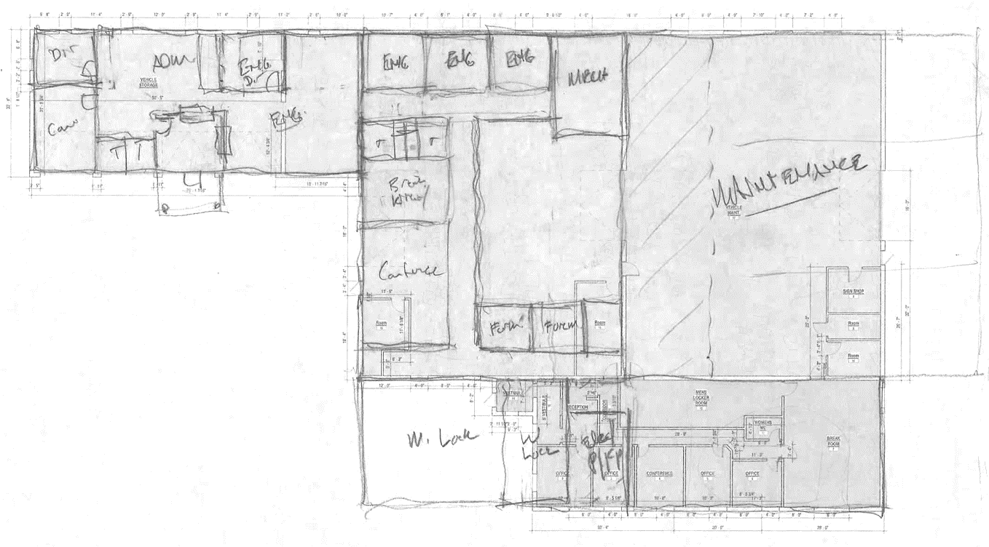
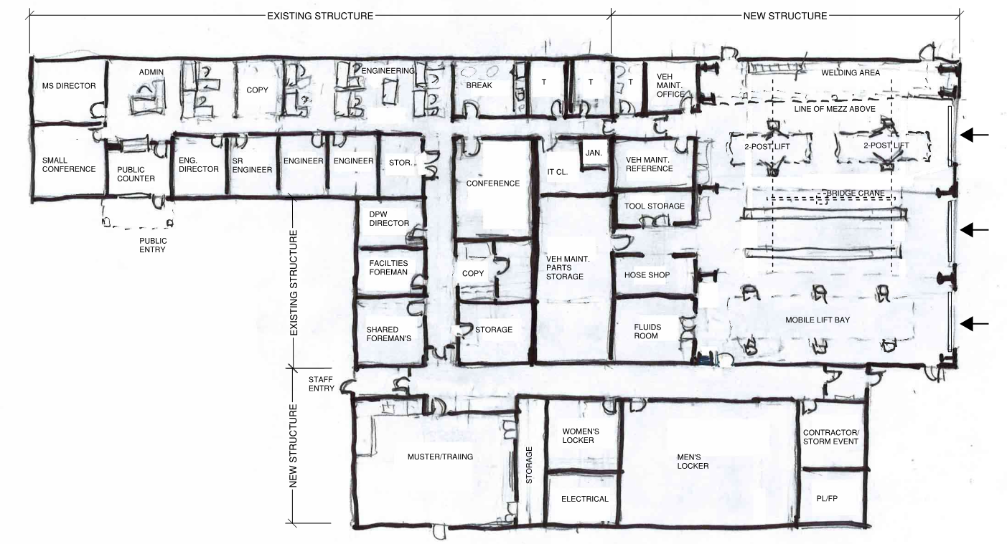
PUBLIC WORKS BUILDING
FEASIBILITY STUDY
Numerous iterations of the conceptual floor plan for the renovated existing building are being developed, working with the MS staff and administration.
Priority was given to renovating the existing building while accommodating the current program needs of the Municipal Services Divisions.
MBAC

Slide 4
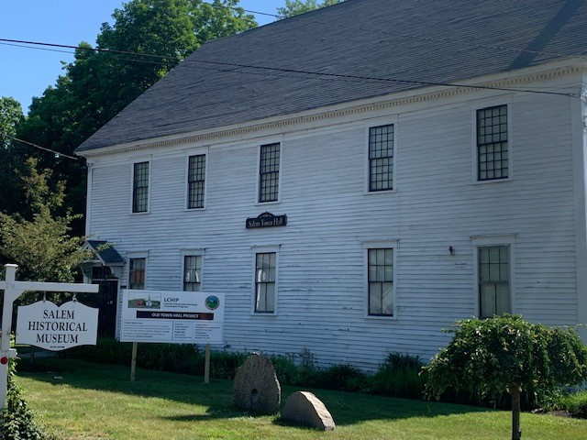
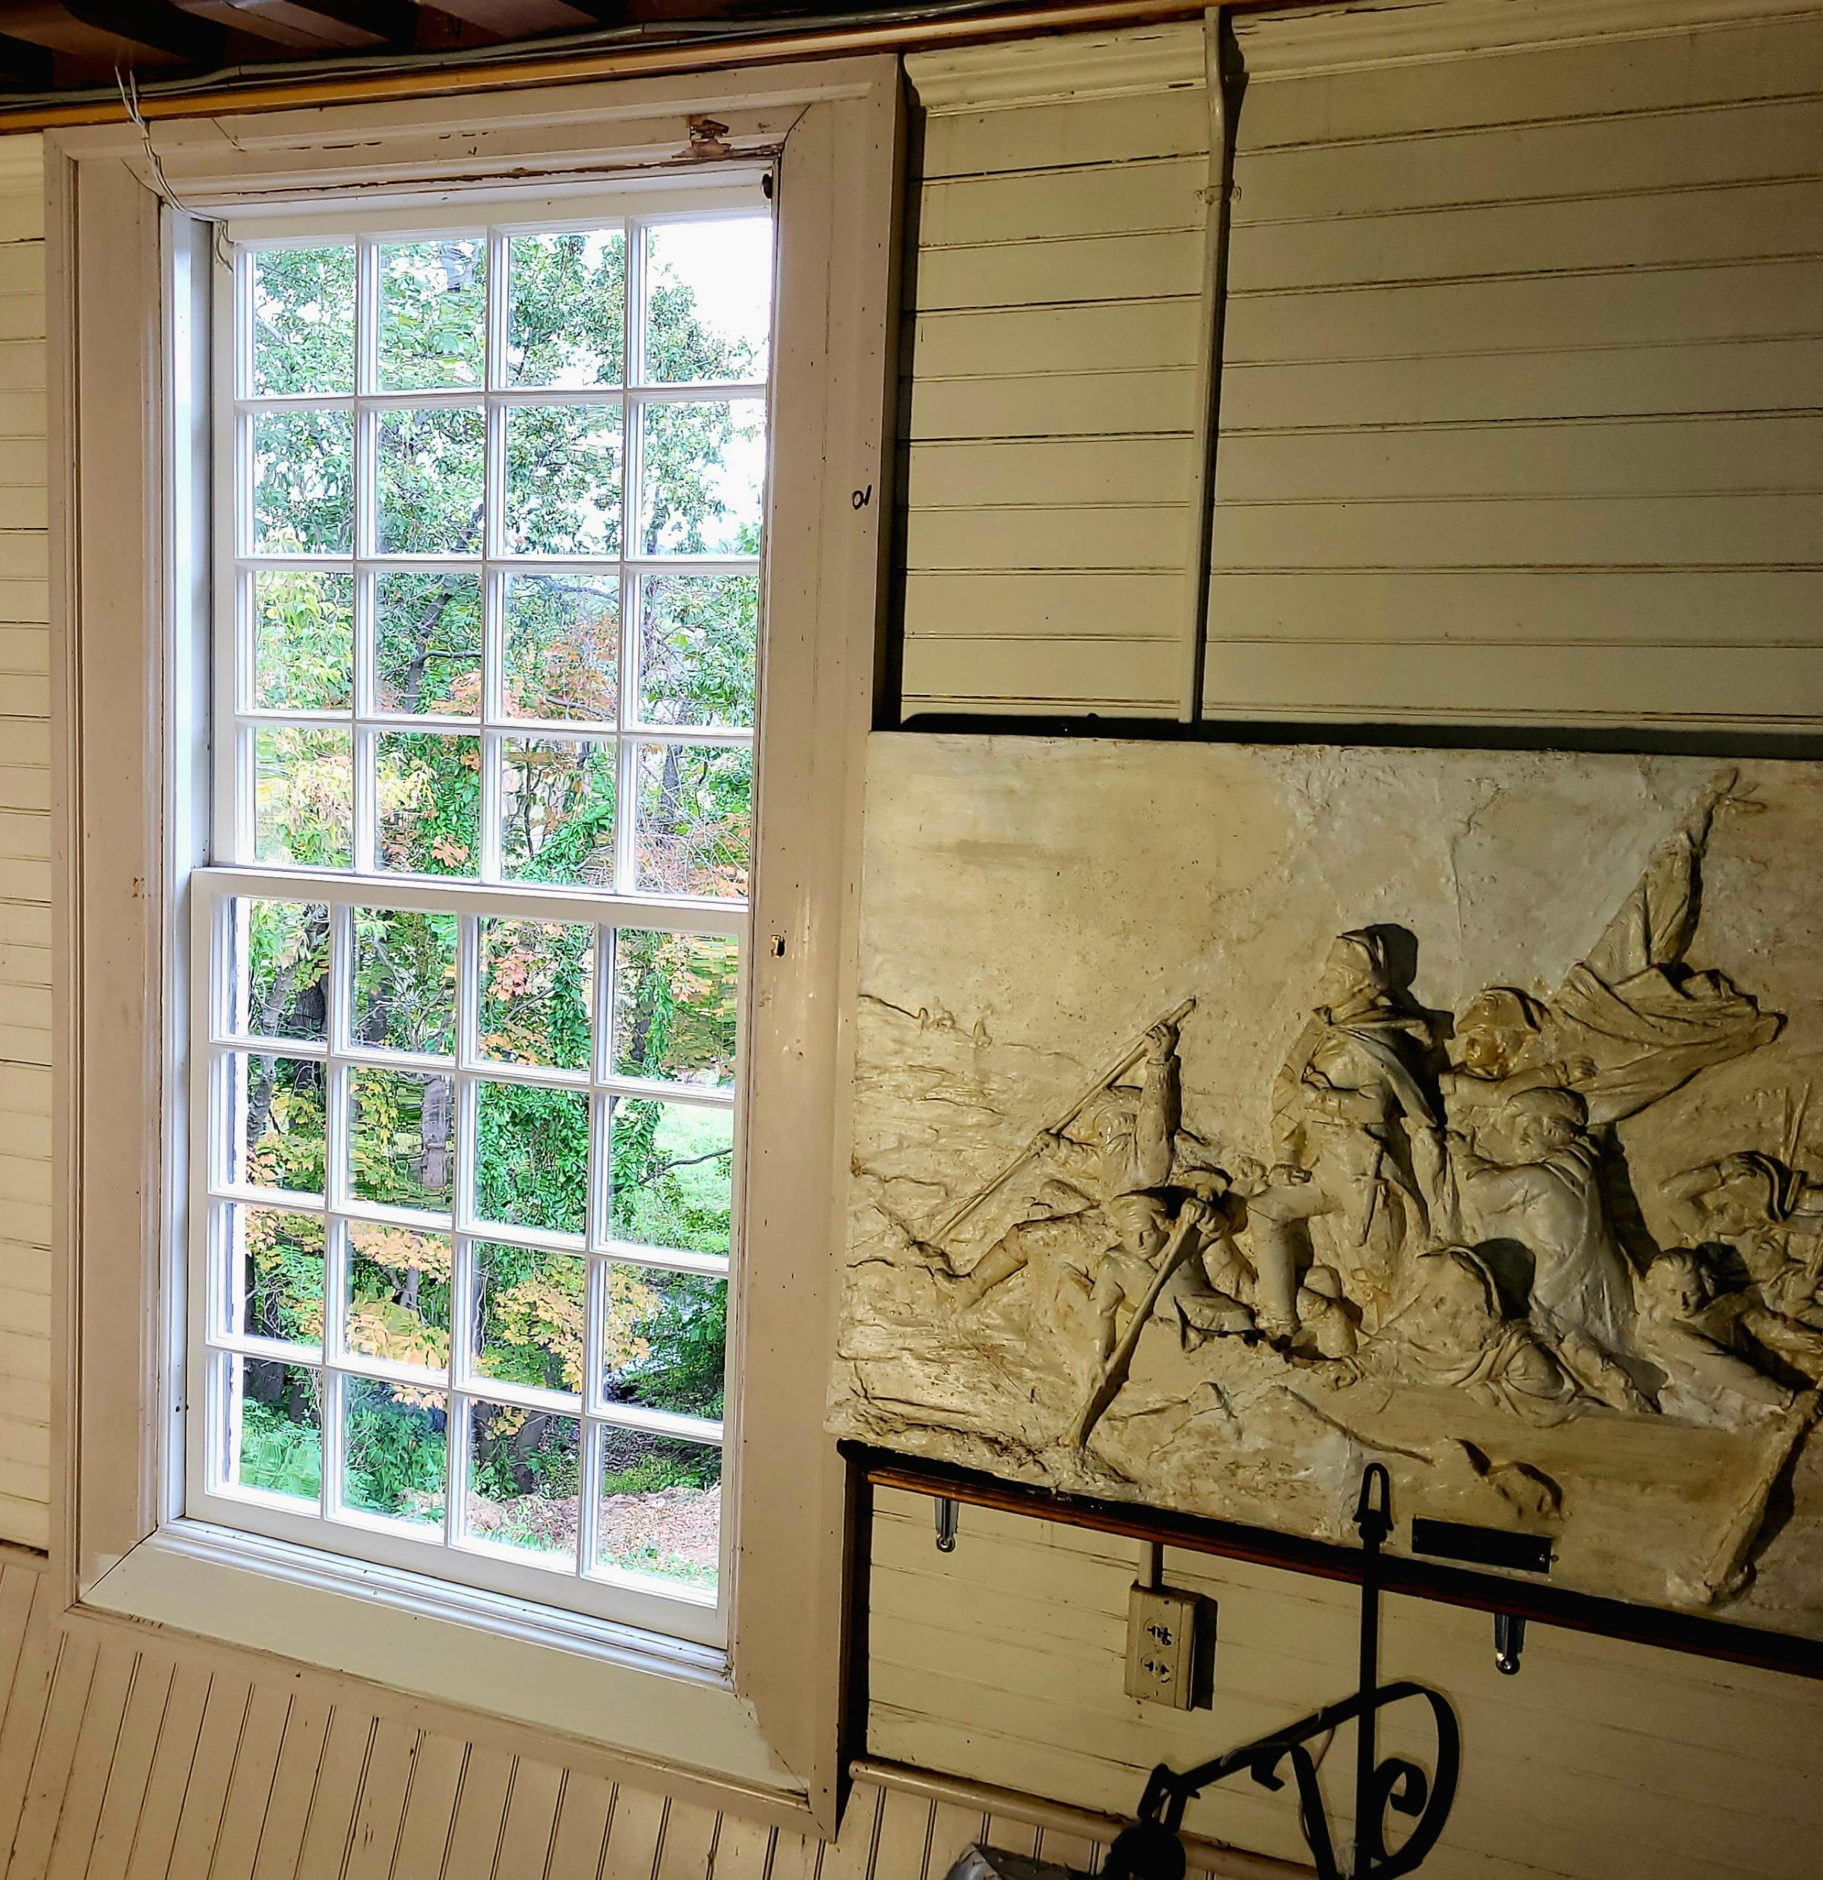
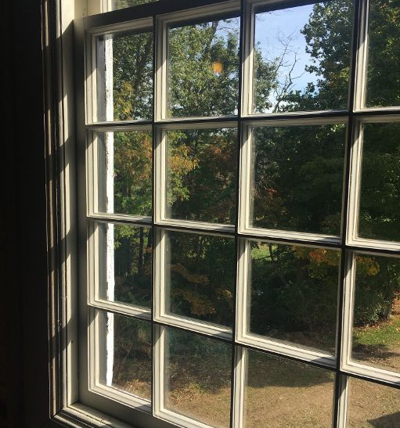
OLD TOWN HALL
LCHIP – Mid-Point
12 Windows Complete
Exterior Siding Complete
Exterior Painting
Interior Carpentry Scope
Electrical Scope
Fundraising Ongoing
MBAC

Slide 5
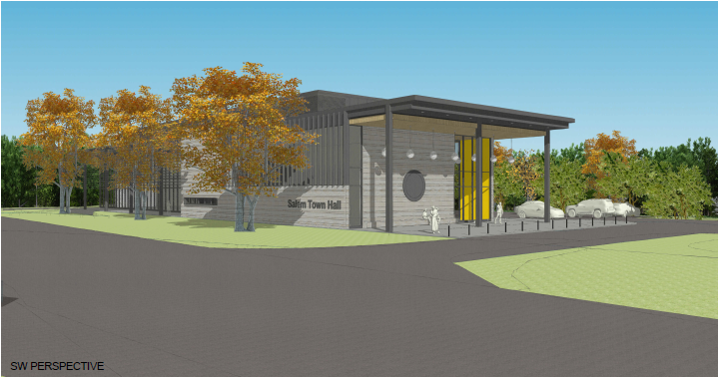
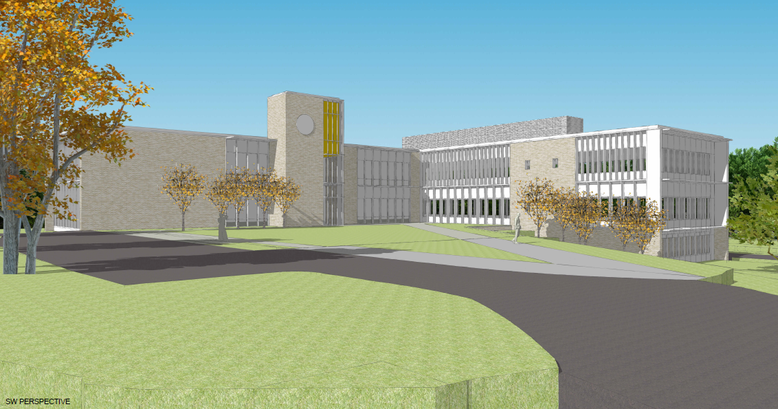
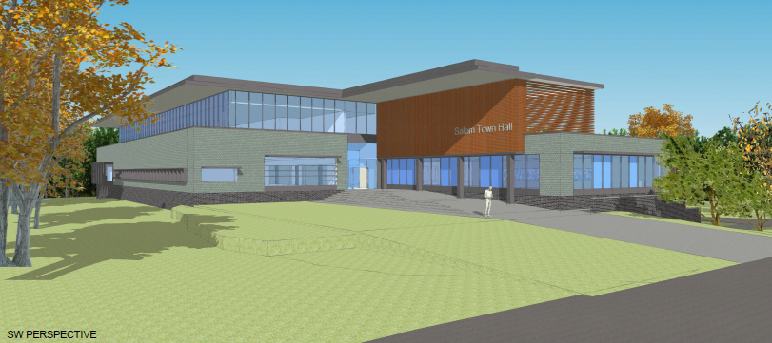
TOWN HALL PROJECT
Conceptual Deliverables to Town Council by Summer
MBAC

Slide 6
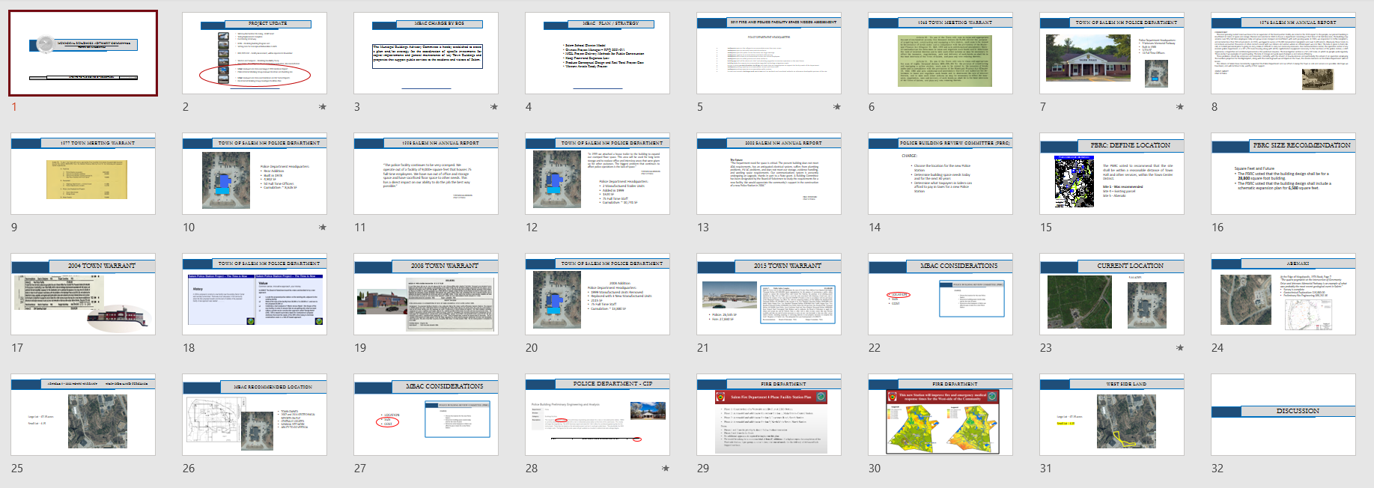
BOS: NOVEMBER 14, 2022
MBAC has established and is prepared to bring the following information:
The Police Department is in dire need of a new facility which should be located on the current site.
The request within Capital for $500,000 for Police Building Preliminary Engineering and Analysis should be included for consideration in FY2024 through the budget, a warrant article, or funded by other monies under the discretion of the BOS.
MBAC fully supports the West-Side Fire Station & Fire Department 4-Phase Facility Station Plan as presented by Chief Best at the OCT 17, 2022, BOS meeting.
MBAC acknowledges that Map 17, Lot 7771, otherwise known as 58 Lowell Road, and which was one of two parcels included in Article 9 of the 2022 Town Warrant, would be suitable for location of a West-Side Fire Station.
MBAC has established and is prepared to bring the following information:
The Police Department is in dire need of a new facility which should be located on the current site.
The request within Capital for $500,000 for Police Building Preliminary Engineering and Analysis should be included for consideration in FY2024 through the budget, a warrant article, or funded by other monies under the discretion of the BOS.
MBAC fully supports the West-Side Fire Station & Fire Department 4-Phase Facility Station Plan as presented by Chief Best at the OCT 17, 2022, BOS meeting.
MBAC acknowledges that Map 17, Lot 7771, otherwise known as 58 Lowell Road, and which was one of two parcels included in Article 9 of the 2022 Town Warrant, would be suitable for location of a West-Side Fire Station.
MBAC

Slide 7
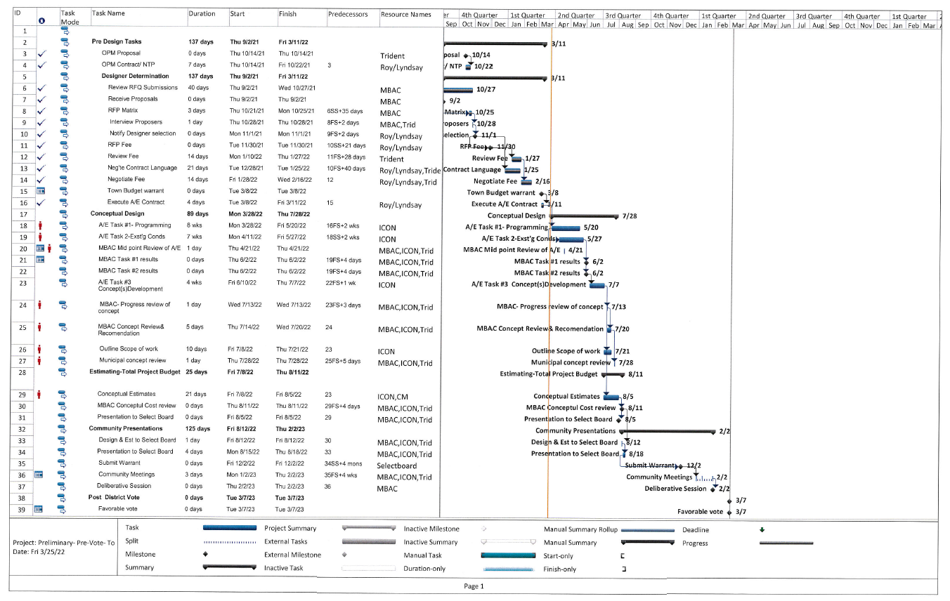

Slide 8
MOTIONS FOR CONSIDERATION
“The Board of Selectmen hereby confirms that the best location to house a new Police Station will be at 9 Veterans Memorial Parkway, otherwise known as Map 108, Lot 7960, and which is the current location of the existing Police Station.”
“The Board of Selectmen hereby authorizes funding an amount up to $500,000 for the purpose of procuring all professional services necessary for preliminary engineering and design for a new Police Station. Funding shall be through Public Safety Impact fees in the amount of $150,000 and by monies made available through the American Rescue Plan Act in the amount of $350,000.”
MBAC

