Slide 1

ROAD STABILIZATION COMMITTEE
2021 ROAD PROGRAM UPDATE
September 27, 2021

Slide 2

ROAD PROGRAM
The upkeep of a rolling 10-year plan would ensure a noticeably better Road System and instill public confidence.

Slide 3
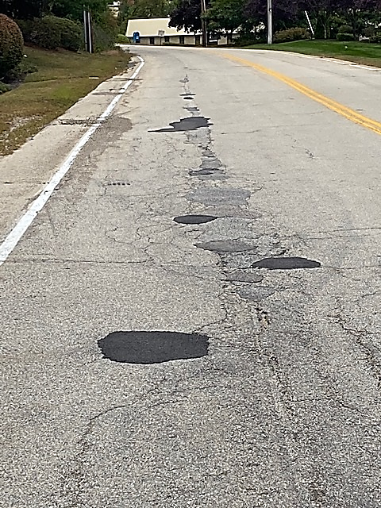
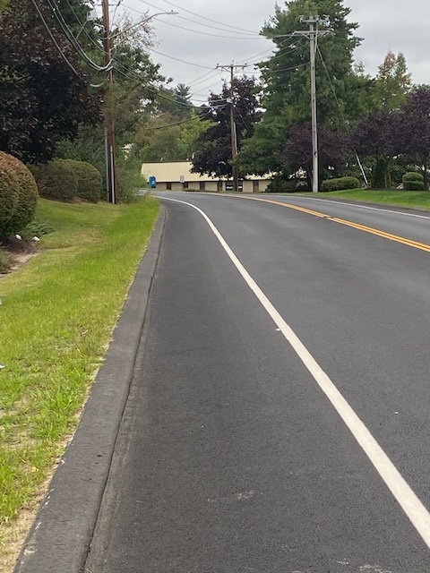
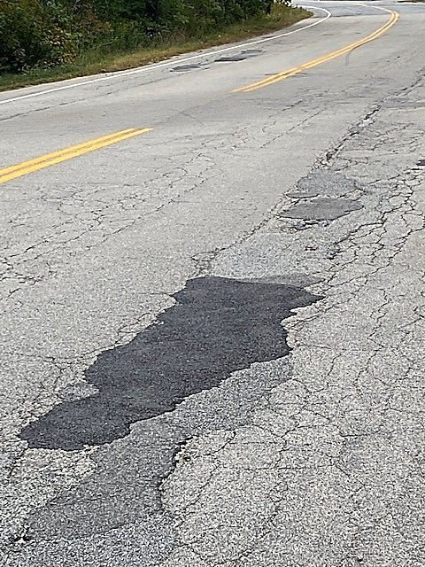

MANOR PARKWAY
2017 PCI = 59
ROAD STABILIZATION COMMITTEE

Slide 4
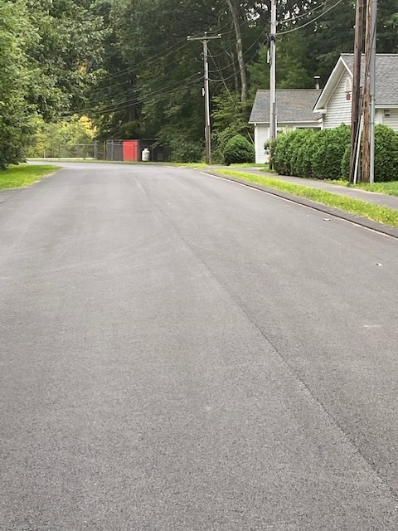
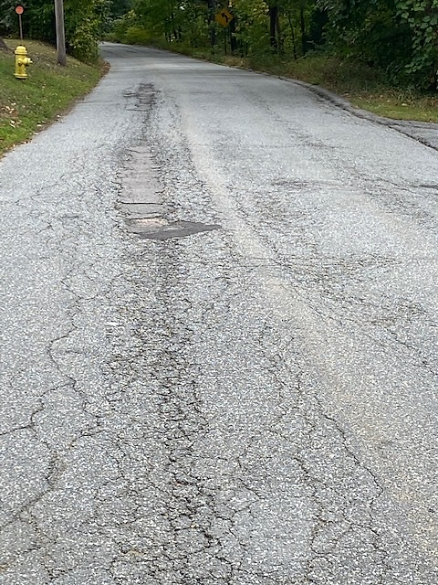
FREEDOM DRIVE
2017 PCI = 54
ROAD STABILIZATION COMMITTEE

Slide 5
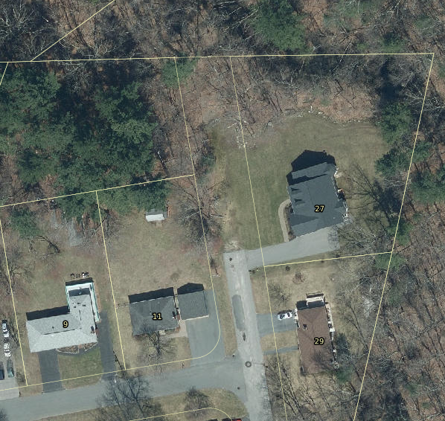
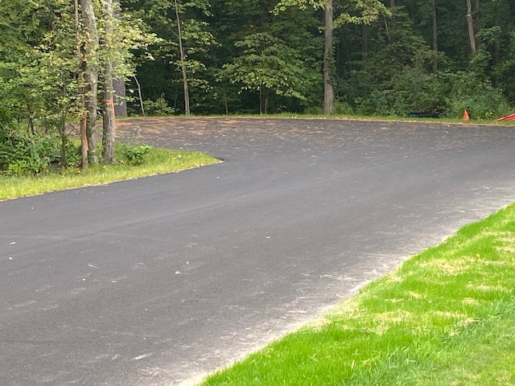
IRIS AVENUE
2017 PCI = 51
ROAD STABILIZATION COMMITTEE

Slide 6
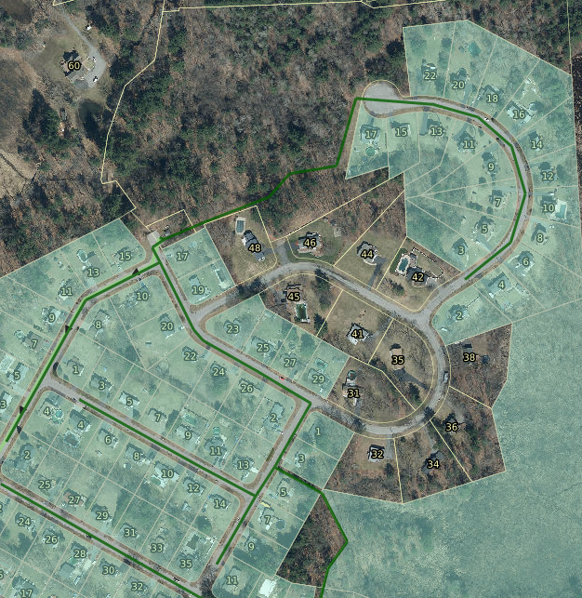
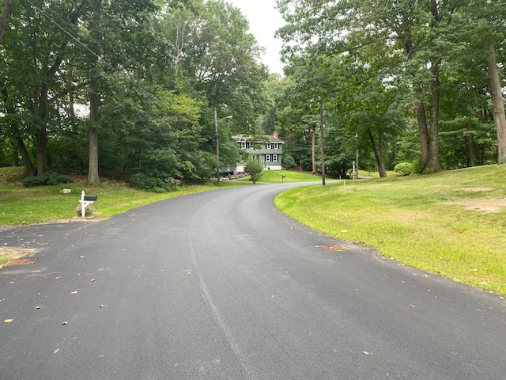
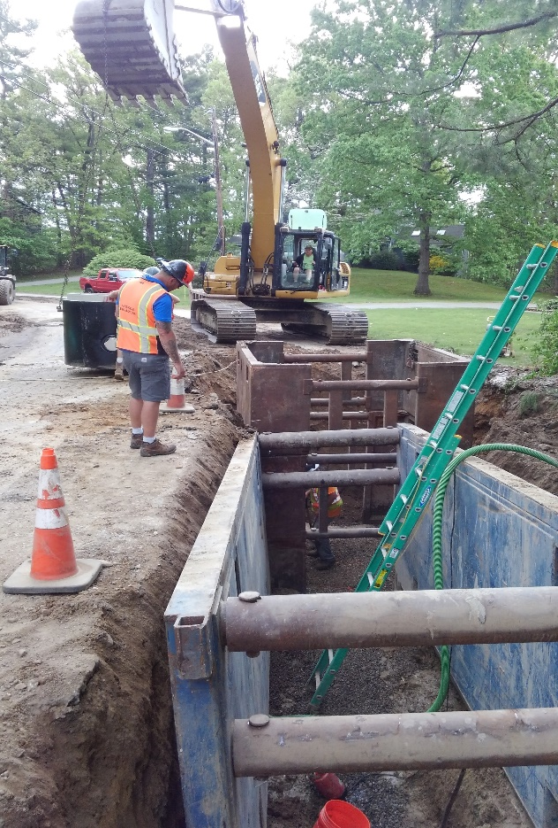
TWINBROOK AVENUE
2017 PCI = 54
ROAD STABILIZATION COMMITTEE

Slide 7
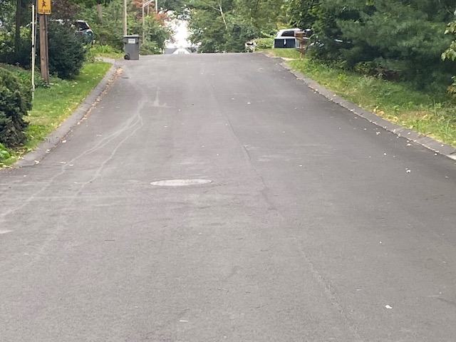
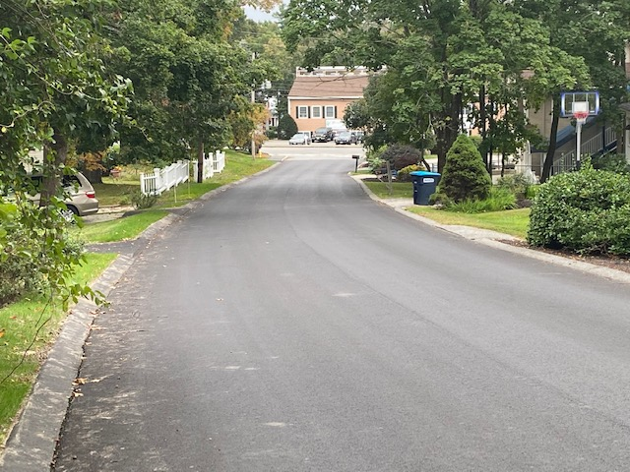
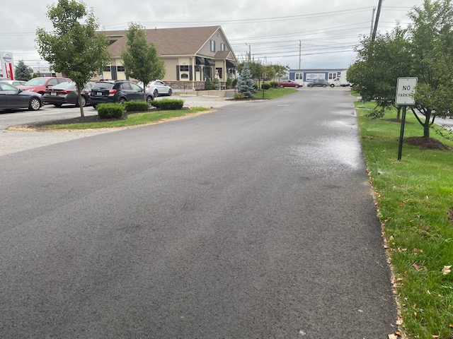
MILL / OVERLAY PROGRAM
ROAD STABILIZATION COMMITTEE

Slide 8
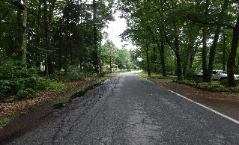
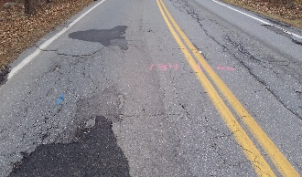
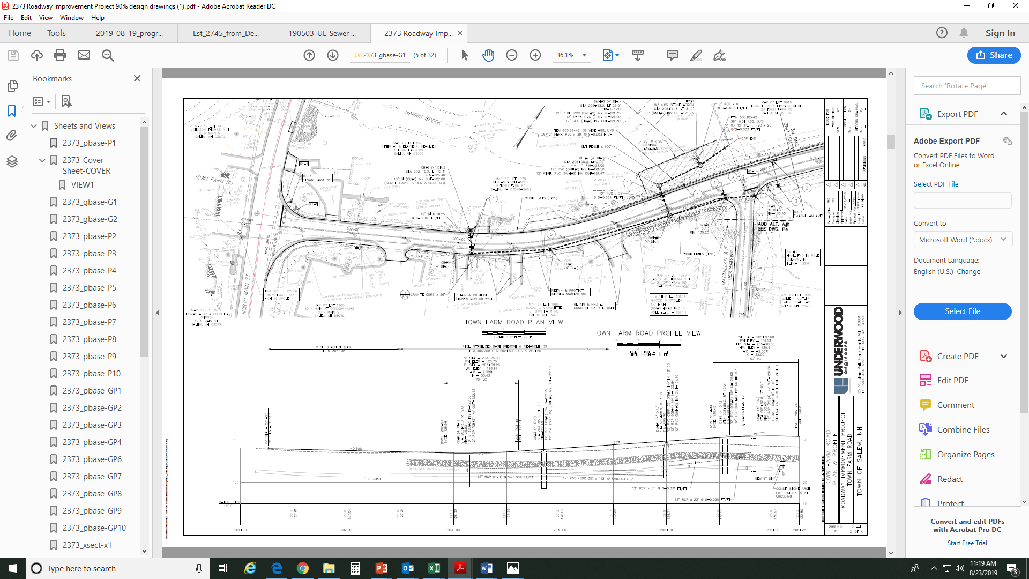
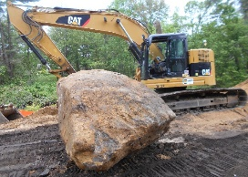
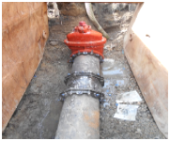
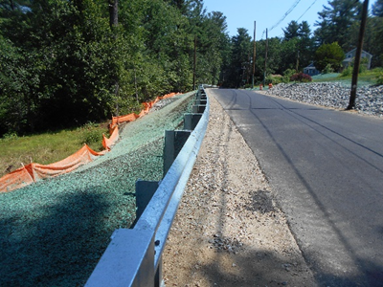
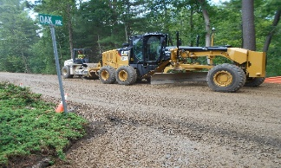
ROAD PROGRAM
$4,430,677
NEIGHBORHOOD ROADS RECONSTRUCTION
Twinbrook Avenue and Iris Avenue
Manor Parkway, Freedom Drive, and Lemay Road
Henry Taylor Street, Old Farm Road, and
Small Brook Lane
$ 594,933
$ 532,163
$ 1,074,933
$ 1,008,361
$1,380,753
$ 1,076,918
ROAD STABILIZATION COMMITTEE

Slide 9
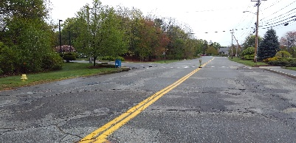
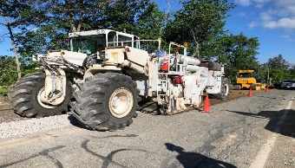
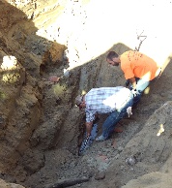
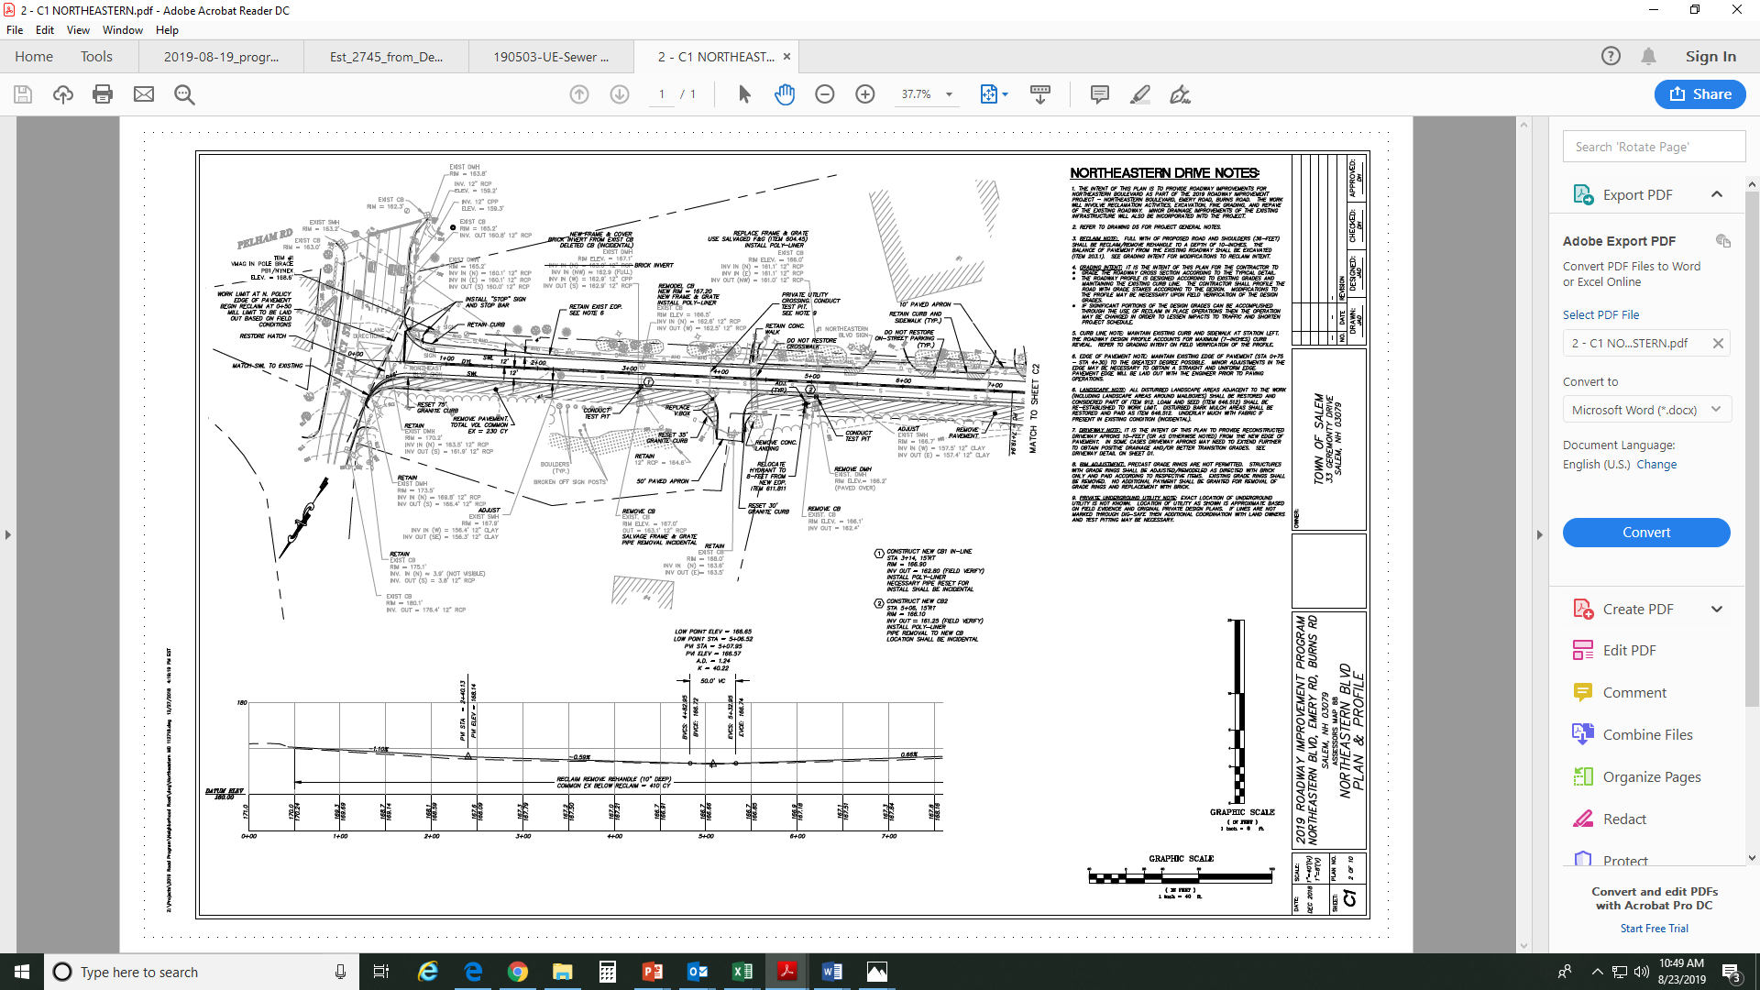
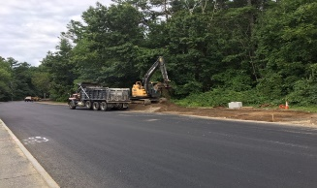
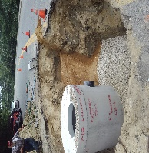
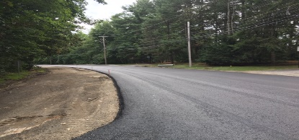
ROAD PROGRAM
$4,430,677
ROAD STABILIZATION(Mill/Overlay)
S. Broadway
E. Broadway
Howard St
West St
Clinton St
Sullivan Ave
Francis St
Earl St
Franklin St
Ackerman St
Granite Ave
Clydesdale Rd
Garrison Rd
Belmont St
Westchester St
$1,058,150
$936,130
ROAD STABILIZATION COMMITTEE

Slide 10
ROAD PROGRAM
$4,430,677
NEIGHBORHOOD ROADS RECONSTRUCTION
Twinbrook Avenue and Iris Avenue
Manor Parkway, Freedom Drive, and Lemay Road
Henry Taylor Street, Old Farm Road, and
Small Brook Lane
$ 953,359
$ 177,140
$ 749,947
$ 138,254
$ 918,819
$ 102,488
ROAD STABILIZATION COMMITTEE

Slide 11
ROAD PROGRAM
$ 427,106
2021 ROAD PROGRAM BID RESULTS
2021 ROAD PROGRAM EXPENDED TO DATE
2021 ROAD PROGRAM APPROVED FUNDS
$ 4,724,343
$ 4,003,571
$ 4,430,677
ROAD STABILIZATION COMMITTEE

Slide 12
CONSIDERATION
$427,106
Authorize expenditure of available funds from the 2021 Road Program Budget for reconstruction of Henry Taylor Street, Frary Street, and Edwards Street.
$357,066
ROAD STABILIZATION COMMITTEE

Slide 13
DISCUSSION
ROAD STABILIZATION COMMITTEE

