Slide 1

ROAD STABILIZATION COMMITTEE
2023-2032 ROAD PROGRAM November 14, 2022

Slide 2

MUNICIPAL ROAD PROGRAM
  The largest and perhaps most important asset of municipal infrastructure are the roads. Simply put paved roads are used as a primary mode of transportation and preserving the condition should be a top priority. Municipalities are best served implementing a Pavement Management Plan that uses geographic information system technology to measure and evaluate the road conditions creating comprehensive data. This process allows a municipality to maximize its reinvestment in a feasible manner while maintaining a sound road network.
ROAD STABILIZATION COMMITTEE

Slide 3
PROGRAM PRINCIPAL GUIDELINES
Spend ~$1.2M annually on Maintenance
Spend Balance on Reconstruction
    ~$500K annually in Neighborhoods (Local)
    Remainder on Main Roads (Operational)
~$60-100K annually in Crack Seal
Funding Model - 3% annually to Maintain Scope
Address Roads relative to PCI as benchmark
PCI Index updated every 5 years
Update the overall plan yearly
Complete Short/Gravel Roads with Remaining Funds
Industrial Roads (1 per year) beginning in 2017
ROAD STABILIZATION COMMITTEE

Slide 4
PROGRAM PRINCIPAL GUIDELINES
  Pavement Condition Index (PCI)
  PCI derived from established measurements of pavement surface condition distresses and deficiencies
  0 to 100 scale, 100 being excellent
  PCI is one of the principal factors in treatment and scheduling
  Town wide assessment underway in 2022
  Report to BOS in early 2023
ROAD STABILIZATION COMMITTEE

Slide 5
PAVEMENT CONDITION INDEX
TREATMENT BAND | PCI | Description
DO NOTHING | 93-100 | Excellent condition - in need of no maintenance.
ROUTINE MAINTENANCE | 86-92 | Good condition – may be in need of minor crack sealing or minor localized repair.
PREVENTIVE MAINTENANCE | 73-85 | Fair condition – pavement surface may be in need of surface sealing, full depth patch and/or crack sealing. Mill/overlay some areas
MILL and OVERLAY | 61-72 | Deficient condition – pavement surface structure in need of added strength for existing traffic. Typical repairs are overlay with or without milling.
RECONSTRUCTION | 0-60 | Poor condition – in need of base improvement. Typical repairs are reclamation or full depth reconstruction.
ROAD STABILIZATION COMMITTEE

Slide 6

PCI BREAKDOWN BY MILES
93 - 100
86 - 92
73 - 85
61 - 72
00 - 60
10%
ROAD STABILIZATION COMMITTEE

Slide 7


TREATMENT COST COMPARISON
TOTAL MILL / OVERLAY
Total Length = 19,039 LF
Total Cost = $978,375
Price per linear foot = $51.39
$1----------$50----------$100----------$150----------$200----------$250--------$300
TOTAL RECONSTRUCTION
Total Length = 13,496 LF
Total Cost = $3,521,625
Price per linear foot = $260.94

Slide 8

HISTORICAL FUNDING
$565,824
$460,690
$443,604
$544,560
$327,674
$258,338
$442,628
~$170,484

Slide 9
INFLATION
80%
65%
7%
EXCAVATION
ASPHALT
PIPE (HDPE)

Slide 10
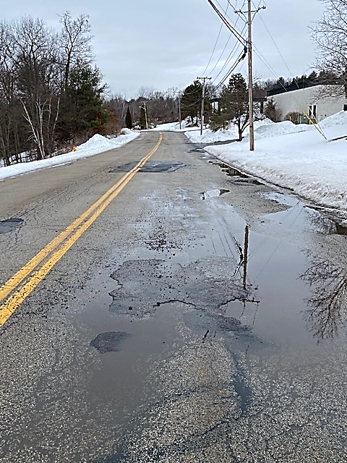
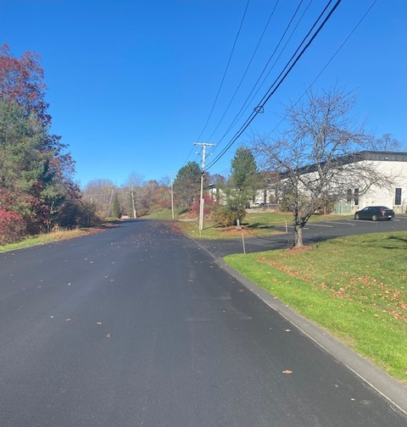
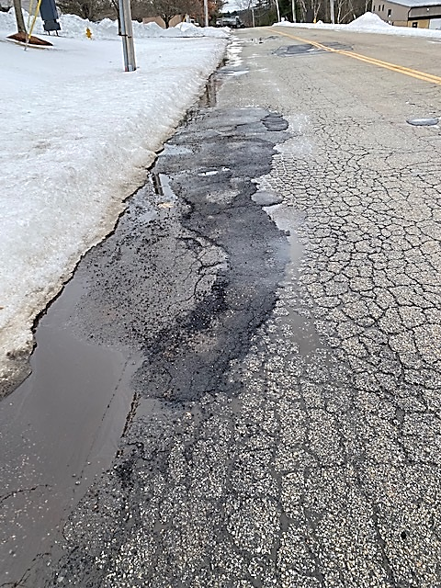
NORTHWESTERN DRIVE
2017 PCI = 62
ROAD STABILIZATION COMMITTEE

Slide 11
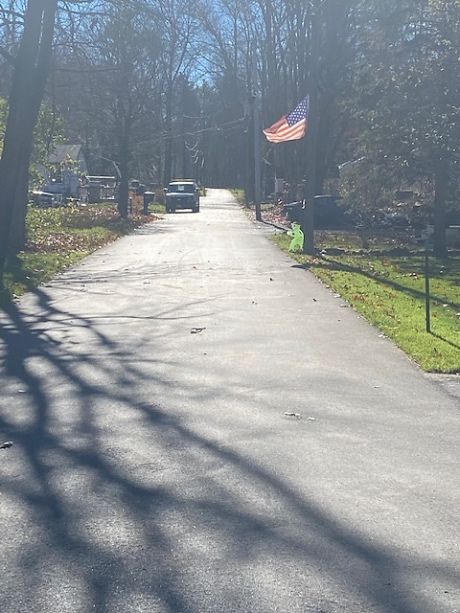
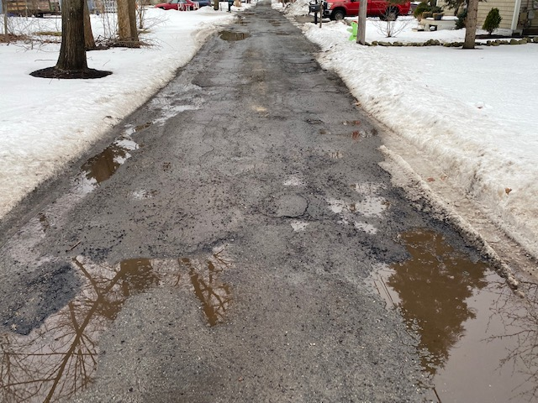
WILSON STREET
2017 PCI = 50
ROAD STABILIZATION COMMITTEE

Slide 12
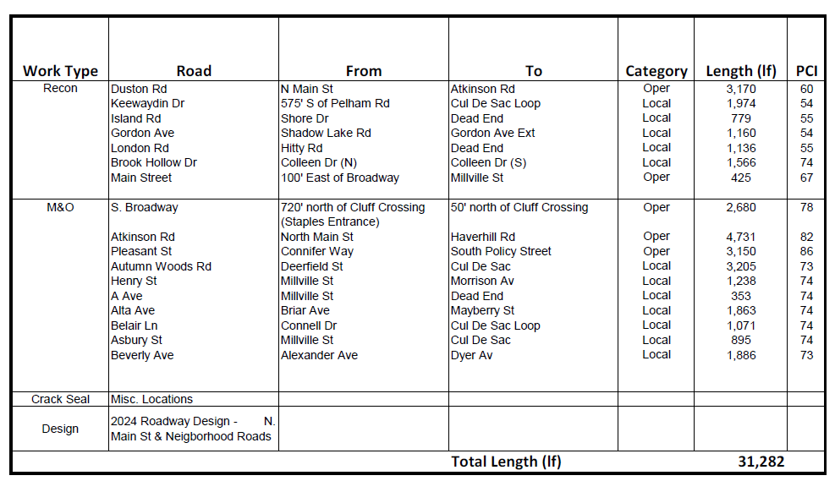
2023 ROAD LIST
ROAD STABILIZATION COMMITTEE

Slide 13
RECOMMENDATION
“The Board of Selectmen adopts the 2023-2032 Road Program as proposed by the Road Stabilization Committee.”

