Slide 1

ROAD STABILIZATION COMMITTEE
2022-2031 ROAD PROGRAM November 1, 2021

Slide 2

MUNICIPAL ROAD PROGRAM
  The largest and perhaps most important asset of municipal infrastructure are the roads. Simply put paved roads are used as a primary mode of transportation and preserving the condition should be a top priority. Municipalities are best served implementing a Pavement Management Plan that uses geographic information system technology to measure and evaluate the road conditions creating comprehensive data. This process allows a municipality to maximize its reinvestment in a feasible manner while maintaining a sound road network.
ROAD STABILIZATION COMMITTEE

Slide 3
PROGRAM PRINCIPAL GUIDELINES
Spend ~$1.2M annually on Maintenance
Spend Balance on Reconstruction
    ~$500K annually in Neighborhoods (Local)
    Remainder on Main Roads (Operational)
~$60-100K annually in Crack Seal
Funding Model - 3% annually to Maintain Scope
Address Roads relative to PCI
Update PCI Index about every 5 years
Update the overall plan yearly
Complete Short/Gravel Roads with Remaining Funds
Industrial Roads (1 per year) beginning in 2017
ROAD STABILIZATION COMMITTEE

Slide 4
PROGRAM PRINCIPAL GUIDELINES
  Pavement Condition Index (PCI)
  PCI derived from established measurements of pavement surface condition distresses and deficiencies
  0 to 100 scale, 100 being excellent
  PCI is one of the principal factors in treatment and scheduling
  Town wide assessment completed in 2017
ROAD STABILIZATION COMMITTEE

Slide 5
PAVEMENT CONDITION INDEX
TREATMENT BAND | PCI | Description
DO NOTHING | 93-100 | Excellent condition - in need of no maintenance.
ROUTINE MAINTENANCE | 86-92 | Good condition – may be in need of minor crack sealing or minor localized repair.
PREVENTIVE MAINTENANCE | 73-85 | Fair condition – pavement surface may be in need of surface sealing, full depth patch and/or crack sealing. Mill/overlay some areas
MILL and OVERLAY | 61-72 | Deficient condition – pavement surface structure in need of added strength for existing traffic. Typical repairs are overlay with or without milling.
RECONSTRUCTION | 0-60 | Poor condition – in need of base improvement. Typical repairs are reclamation or full depth reconstruction.
ROAD STABILIZATION COMMITTEE

Slide 6

PCI BREAKDOWN BY MILES
93 - 100
86 - 92
73 - 85
61 - 72
00 - 60
10%
ROAD STABILIZATION COMMITTEE

Slide 7
TREATMENT COST COMPARISON
Treatment Bands | Miles | % Miles | Cost | % Cost
Do Nothing | 37.1 | 20%
Routine Maintenance | 46.2 | 26% | $270,000 | 1%
Crack Seal | 41.7 | 23% | $2,639,000 | 10%
Mill and Overlay | 37.3 | 21% | $8,189,000 | 31%
Reconstruction | 18.5 | 10% | $15,640,000 | 58%
Totals: | 180.8 |  | $26,738,000
ROAD STABILIZATION COMMITTEE

Slide 8


TREATMENT COST COMPARISON
TOTAL MILL / OVERLAY
Total Length = 28,854 LF
Total Cost = $930,347
Price per linear foot = $32.28
$1----------$50----------$100----------$150----------$200----------$250--------$300
TOTAL RECONSTRUCTION
Total Length = 14,523 LF
Total Cost = $4,124,968
Price per linear foot = $284.00

Slide 9

HISTORICAL FUNDING
$565,824
$544,560
$460,690
$443,604
$327,674
$258,338
$442,628

Slide 10

ROAD PROGRAM
The upkeep of a rolling 10-year plan would ensure a noticeably better Road System and instill public confidence.

Slide 11
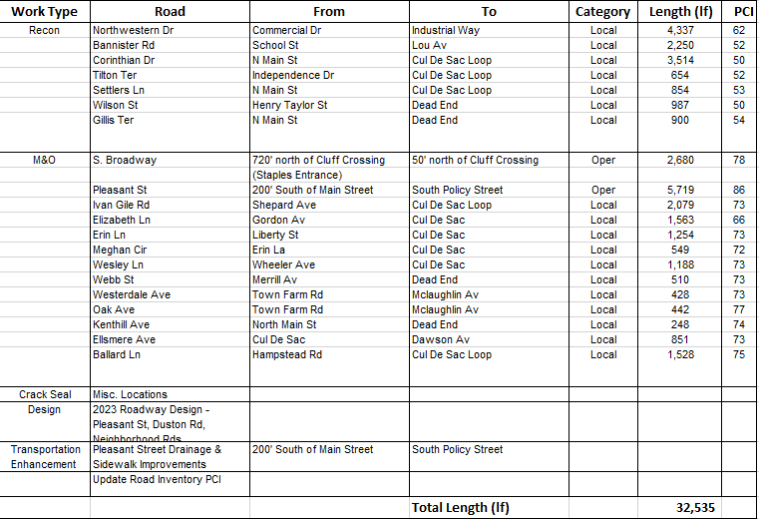
2022 ROAD LIST
ROAD STABILIZATION COMMITTEE

Slide 12
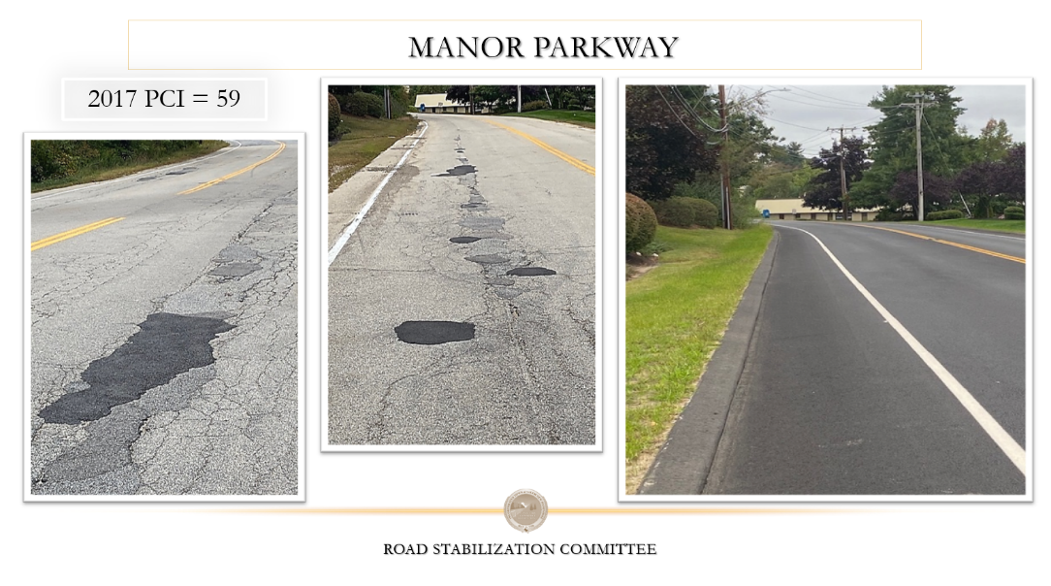
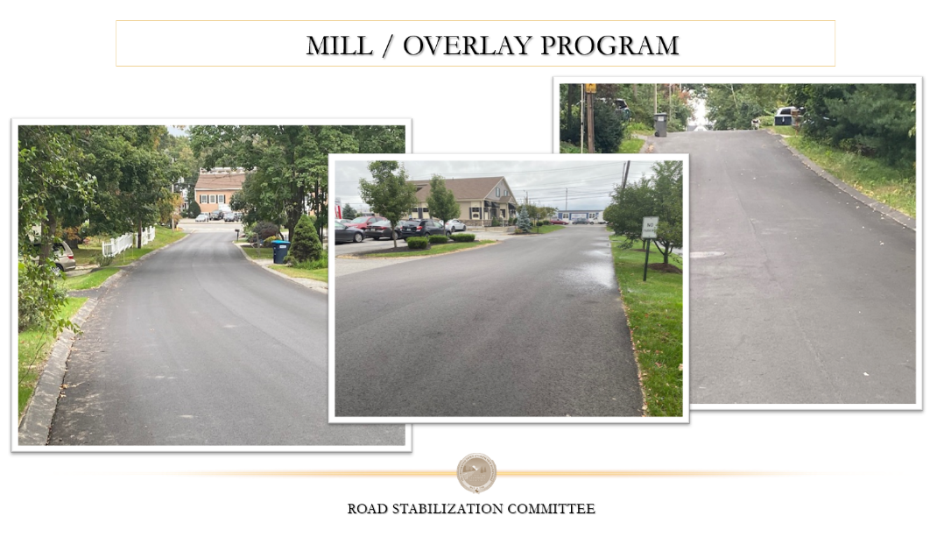
RECOMMENDATION
“The Board of Selectmen adopts the 2022-2031 Road Program as proposed by the Road Stabilization Committee.”

