Slide 1

MUNICIPAL BUILDINGS ADVISORY COMMITTEE
TOWN OF SALEM NH
UPDATE to THE Board of selectmen
NOVEMBER 14, 2022

Slide 2
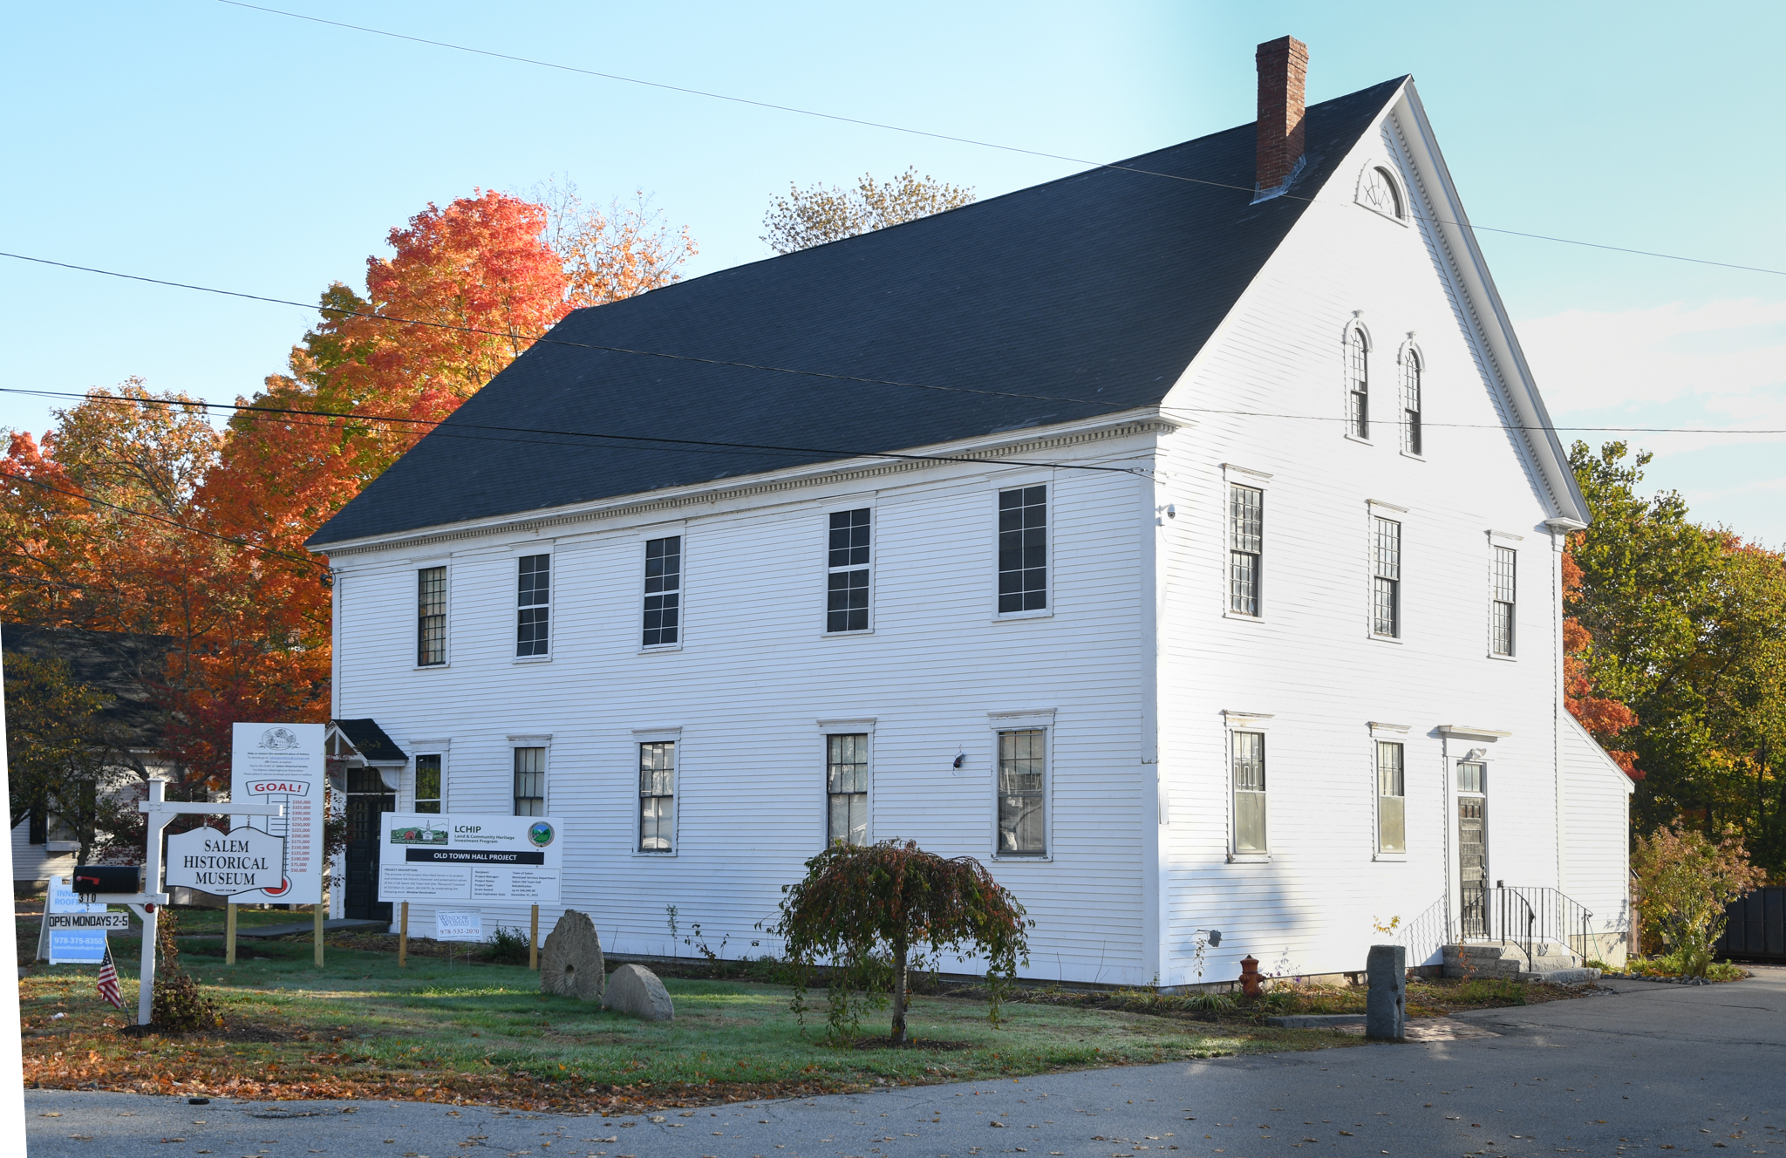
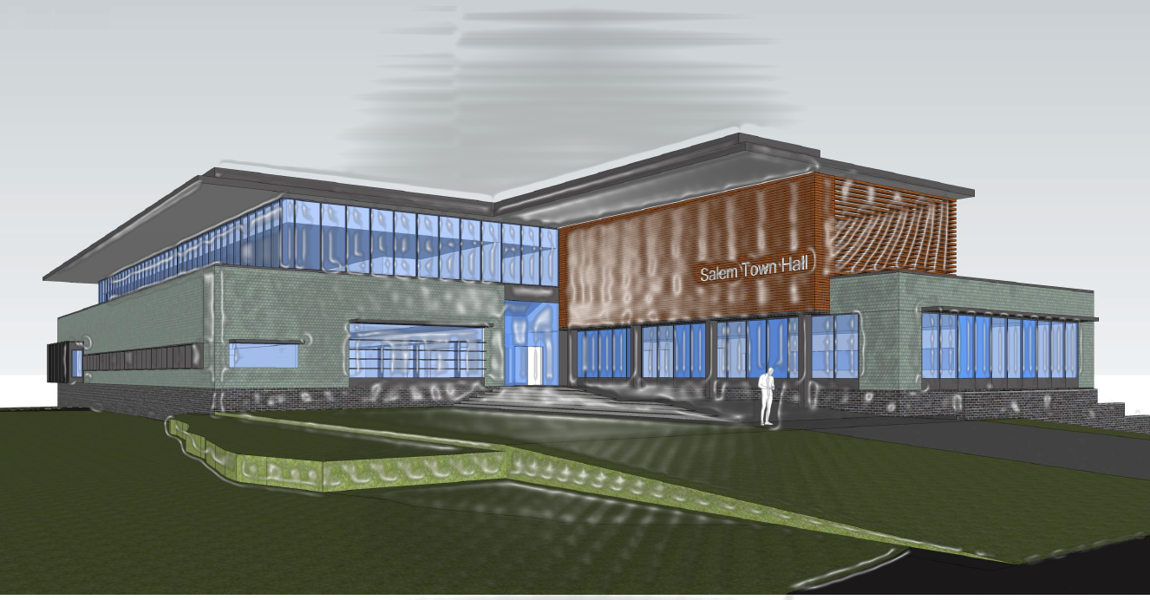
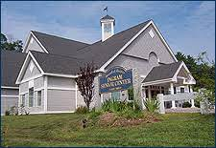
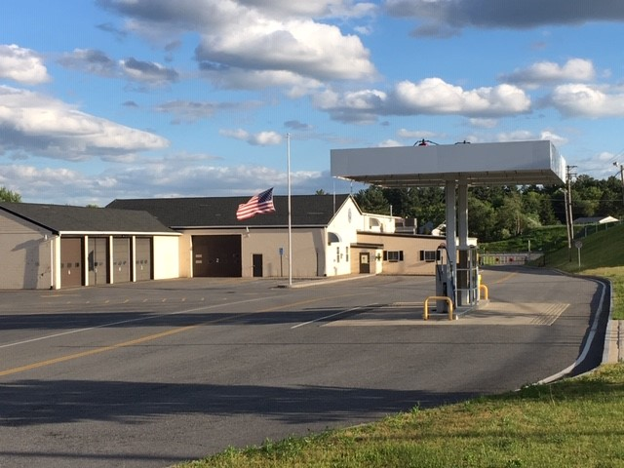

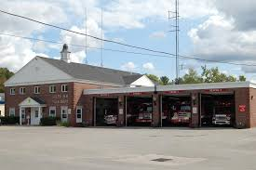
PROJECT UPDATE
Window Restoration On-Going, LCHIP Grant
Siding Replacement Complete
Fundraising Underway
ICON – Finalizing Building Program and
Setting date for Conceptual Deliverables to BOS
RFQ 2022-037 – Facility Assessment, will be reposted in November
MBAC
Weston and Sampson – Finalizing Feasibility Study
Next Steps - Due Diligence Structural Building Evaluation, Site Geotechnical
MBAC reviewed and discussed August 2019 Harriman Report
Police Internal Working Group reviewed locations and building size
MBAC reviewed and discussed Harriman and HL Turner Reports
Fire Internal Working Group developed Facilities Plan

Slide 3
MBAC CHARGE BY BOS
The Municipal Buildings Advisory Committee is hereby established to create a plan and/or strategy for the coordination of specific investments for capital improvements and general maintenance of key Town Buildings and properties that support public services to the residents and visitors of Salem.
The Municipal Buildings Advisory Committee is hereby established to create a plan and/or strategy for the coordination of specific investments for capital improvements and general maintenance of key Town Buildings and properties that support public services to the residents and visitors of Salem.

Slide 4
MBAC PLAN / Strategy
Salem School District Model
Owners Project Manager – RFQ 2021-011
MGL Project Delivery Methods for Public Construction
Keep Front-end Expenses Low
Produce Conceptual Design and Real Total Project Cost
Warrant Article Ready Project

Slide 5
2019 FIRE AND POLICE FACILITY SPACE NEEDS ASSESSMENT
POLICE DEPARTMENT HEADQUARTERS
• Inadequate space in the sallyport to accommodate more than one cruiser.
• Inadequate space to securely house vehicle evidence.
• Inadequate space for public access functions and large meetings.
• Inadequate capacity to accommodate mandated staff training.
• Inadequate office areas to accommodate current and future employees.
• Inadequate space to safely process and store evidence.
• Building age will call for electrical, HVAC and plumbing upgrades to maintain operation in the near future.
• Building lacks the capacity to accommodate upgraded technology integration needs.
• Facility includes portable/modular buildings and sheds that are inappropriate to support the facility needs of the department.
• Inadequate parking capacity to accommodate current and future staff.
• Inadequate parking capacity to accommodate public visitors.
• Current site contains challenges and restrictions such as wetlands and mandated setbacks on otherwise developable portions of the site.
• Inadequate space in the sallyport to accommodate more than one cruiser.
• Inadequate space to securely house vehicle evidence.
• Inadequate space for public access functions and large meetings.
• Inadequate capacity to accommodate mandated staff training.
• Inadequate office areas to accommodate current and future employees.
• Inadequate space to safely process and store evidence.
• Building age will call for electrical, HVAC and plumbing upgrades to maintain operation in the near future.
• Building lacks the capacity to accommodate upgraded technology integration needs.
• Facility includes portable/modular buildings and sheds that are inappropriate to support the facility needs of the department.
• Inadequate parking capacity to accommodate current and future staff.
• Inadequate parking capacity to accommodate public visitors.
• Current site contains challenges and restrictions such as wetlands and mandated setbacks on otherwise developable portions of the site.

Slide 6
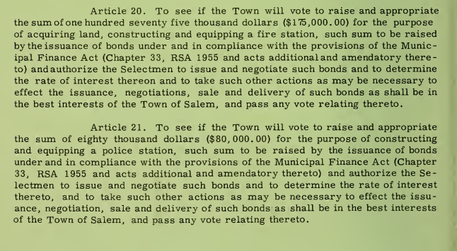
1965 TOWN MEETING WARRANT

Slide 7
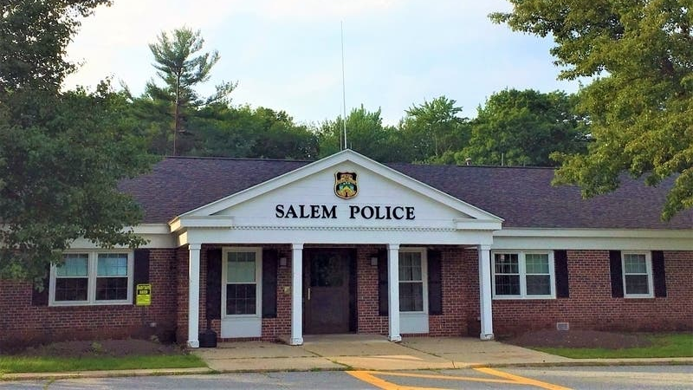
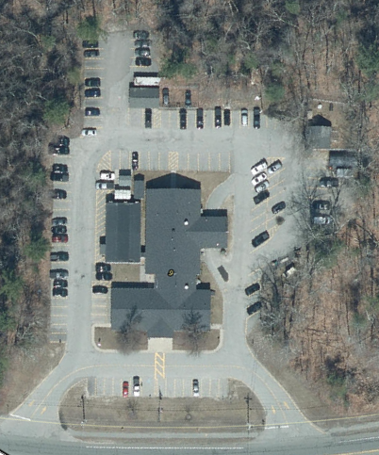
TOWN OF SALEM NH POLICE DEPARTMENT
Police Department Headquarters:
9 Veterans Memorial Parkway
Built in 1966
3,724 SF
14 Full Time Officers

Slide 8
1976 SALEM NH ANNUAL REPORT
COMMENTARY
The most pressing current need we have is for an expansion of the headquarters facility. As noted in the 1976 report to the people, our present building is insufficient in terms of space and design. Planned and erected in 1965 to house a department consisting at that time of 14 full time men, the building now ser­vices over fifty full time employees daily and grows more cramped and inefficient with each passing week. In 1965, we responded to 1,854 complaints, and recorded less than 150 actual arrests. In 1976, we logged in excess of 15,000 documented complaints and over 1,300 arrests. Obviously these totals do not include uncounted thousands of other contacts made with our citizens and visitors where an official report was not filed. The lack of space to hold roll-call, or to brief personnel prior to going on duty, makes it difficult to carry out necessary measures. Our communications center, the operation center of any modern police department, is a 10' x 15' room housing along with all the sophisticated equipment necessary to the func­tions of the police station, a shift supervisor, a dispatcher and additional personnel as the work load requires. The investigation section is a 13' x 16' room, in which six people work regularly. These are but two examples of overcrowding. The lack of storage and work space hamper us and reduce efficiency.
These problems should be addressed and remedied. Certainly, with the advent of new businesses and particularly the arrival of an operation employing the numbers projected for the Digital plant, along with the normal growth we anticipate in the Town, the service demands on the Police Department will not lessen.
The citizens of Salem have consistently supported the Police Department and our efforts to keep the Town as safe and secure as is possible. We hope we have been, and will continue to be, worthy of that support.
JOHN P. GANLEY
Chief of Police

Slide 9
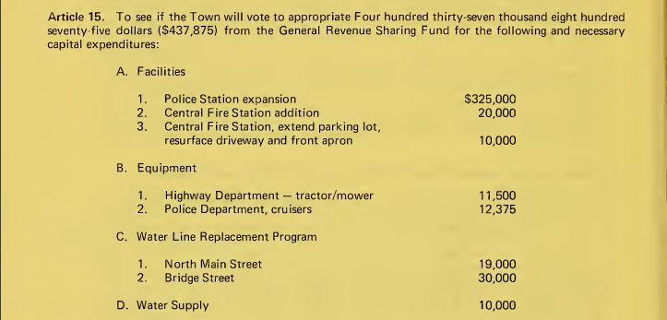
1977 TOWN MEETING WARRANT

Slide 10
TOWN OF SALEM NH POLICE DEPARTMENT
Police Department Headquarters:
Rear Addition
Built in 1978
4,902 SF
50 Full Time Officers
Cumulative: ~ 8,626 SF

Slide 11
1998 SALEM NH ANNUAL REPORT
“The police facility continues to be very cramped. We operate out of a facility of 9,000+ square feet that houses 75 full time employees. We have run out of office and storage space and have sacrificed floor space to other needs. This has a direct impact on our ability to do the job the best way possible.”
STEPHEN MacKINNON
Chief of Police

Slide 12
TOWN OF SALEM NH POLICE DEPARTMENT
“In 1999 we attached a house trailer to the building to expand our cramped floor space. This area will be used for long term storage and to replace office and interview areas that were given up for other purposes. The biggest problem that continues to affect police operations is the lack of space.”
STEPHEN MacKINNON
Chief of Police
Police Department Headquarters:
2 Manufactured Trailer Units
Added in 1999
1320 SF
75 Full Time Staff
Cumulative: ~ 10,741 SF

Slide 13
2002 SALEM NH ANNUAL REPORT
The Future
“The Department need for space is critical. The present building does not meet ADA requirements, has an antiquated electrical system, suffers from plumbing problems, HV AC problems, and does not meet our storage, evidence handling, and working space requirements. Our communications system is presently undergoing an upgrade, thanks in part to a State grant. A Building Committee has been designated by the Board of Selectmen to study the requirements for a new facility. We would appreciate the community's support in the construction of a new Police Station in 2004.”
PAUL DONOVAN
Chief of Police

Slide 14
POLICE BUILDING REVIEW COMMITTEE (PBRC)
CHARGE:
Choose the location for the new Police Station
Determine building space needs today and for the next 30 years
Determine what taxpayers in Salem can afford to pay in taxes for a new Police Station

Slide 15
PBRC: DEFINE LOCATION
The PBRC voted to recommend that the site shall be within a reasonable distance of Town Hall and other services, within the Town Center District.
Site 1 - Was recommended
Site 4 – Existing parcel
Site 5 - Abenaki

Slide 16
PBRC SIZE RECOMMENDATION
Square Feet and Future
The PBRC voted that the building design shall be for a 28,800 square foot building.
The PBRC voted that the building design shall include a schematic expansion plan for 6,500 square feet.

Slide 17
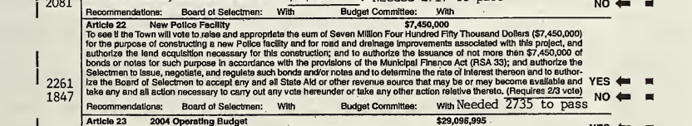
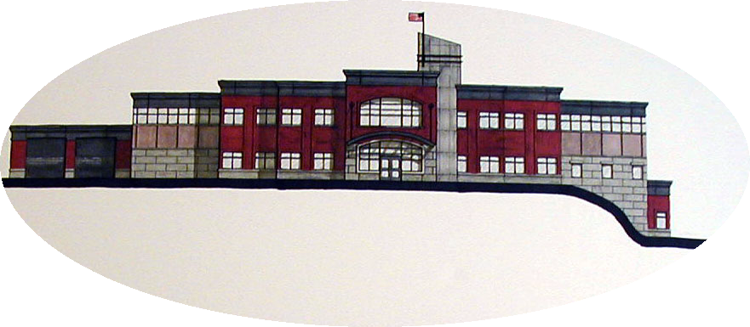
2004 TOWN WARRANT

Slide 18
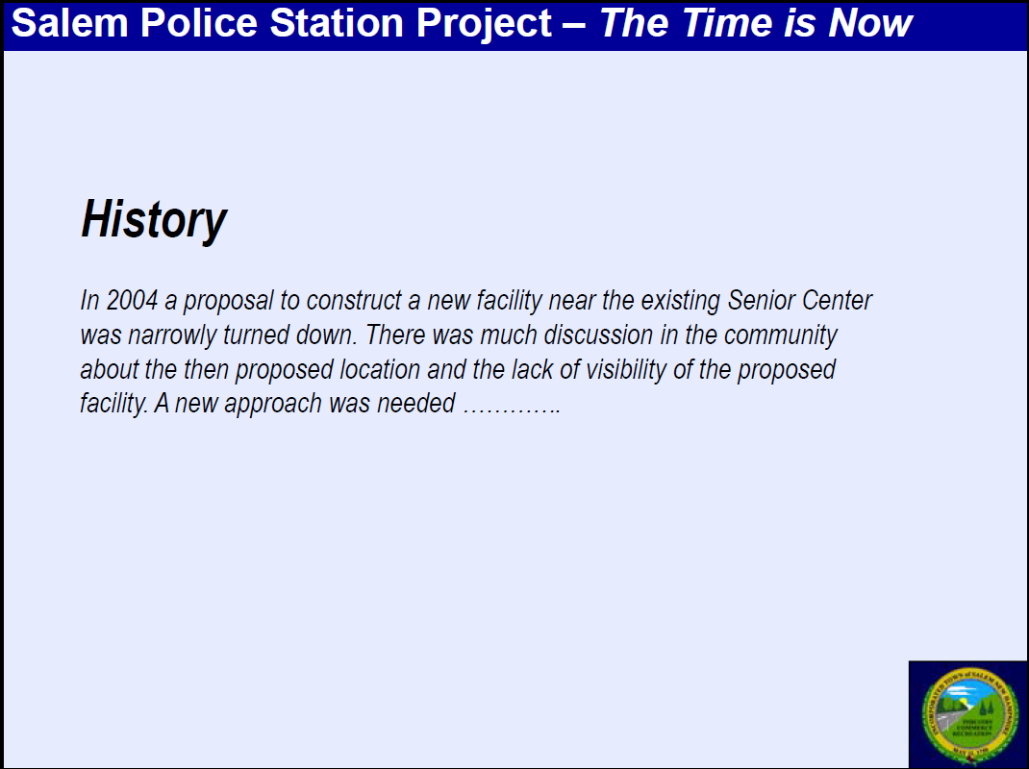
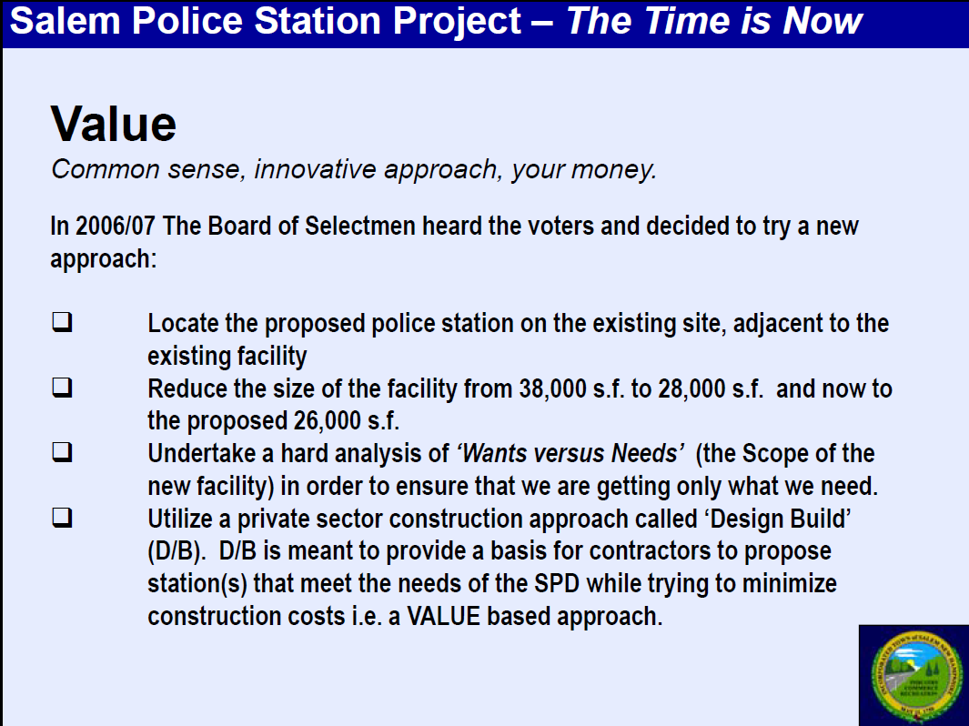
TOWN OF SALEM NH POLICE DEPARTMENT

Slide 19
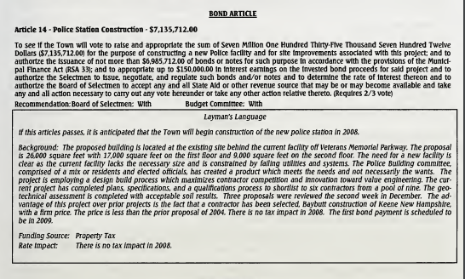
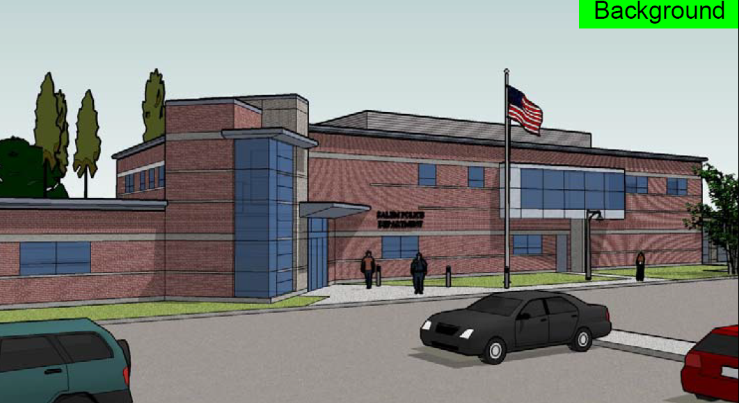
2008 TOWN WARRANT

Slide 20
TOWN OF SALEM NH POLICE DEPARTMENT
2008 Addition
Police Department Headquarters:
1999 Manufactured Units Removed
Replaced with 3 New Manufactured Units
2115 SF
75 Full Time Staff
Cumulative: ~ 13,880 SF

Slide 21
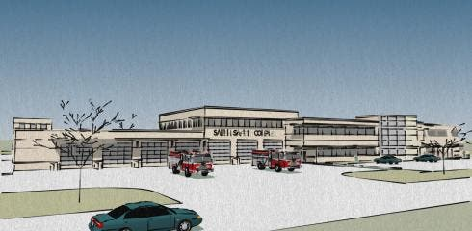
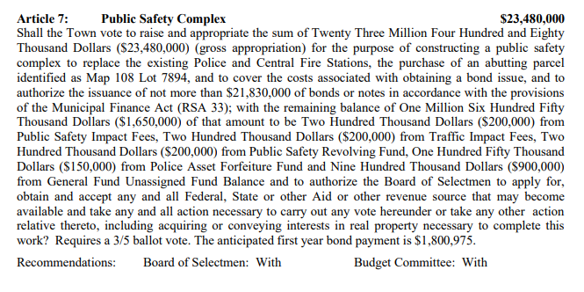
2015 TOWN WARRANT
Police: 26,535 SF
Fire: 27,830 SF

Slide 22
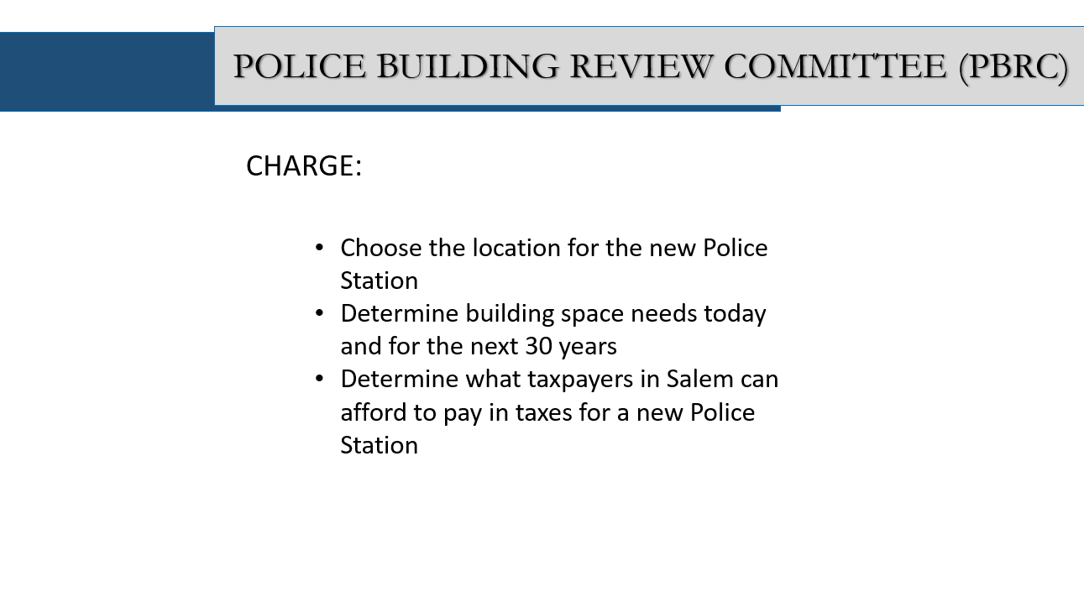
MBAC CONSIDERATIONS
LOCATION
SIZE
COST

Slide 23
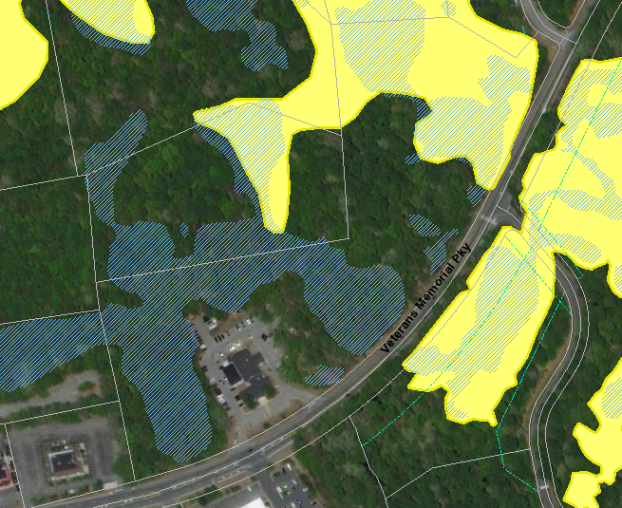
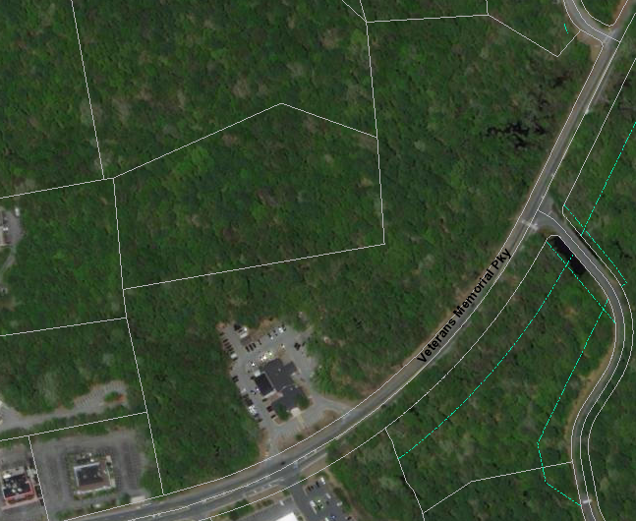
CURRENT LOCATION
5.44 ACRES

Slide 24
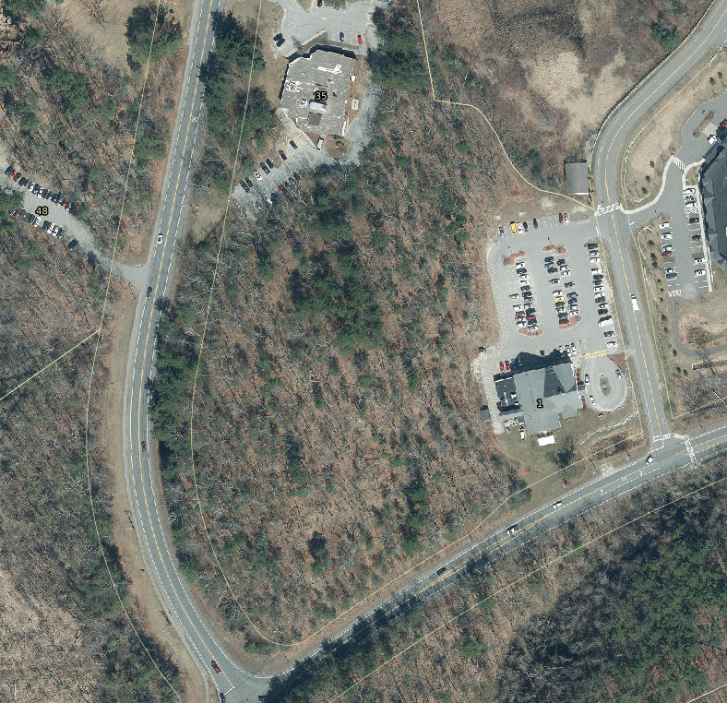
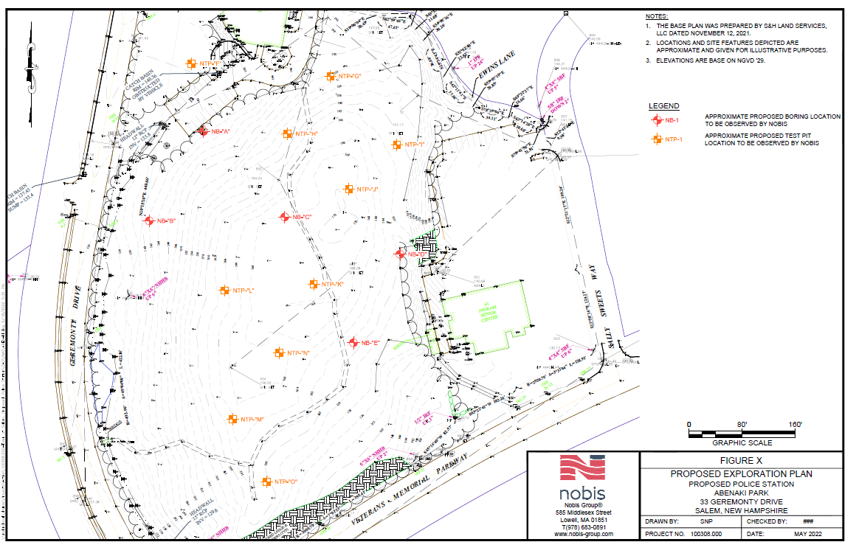
ABeNAKI
At the Edge of Megalopolis, 1974 Book, Page 7
“The quartz pegmatite at the intersection of Geremonty Drive and Veterans Memorial Parkway is an example of what was probably the most recent geological event in Salem.”
Survey is complete
Geotechnical Exploration: $16,800.00
Preliminary Site Engineering $66,282.36

Slide 25
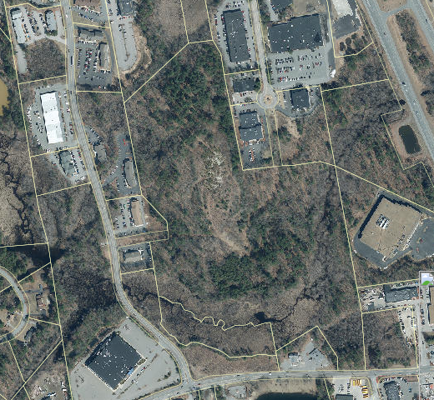
ARTICLE 9 - 2022 Town warrant WEST SIDE LAND PURCHASE
Large Lot – 47.15 acres
Small Lot – 4.15

Slide 26
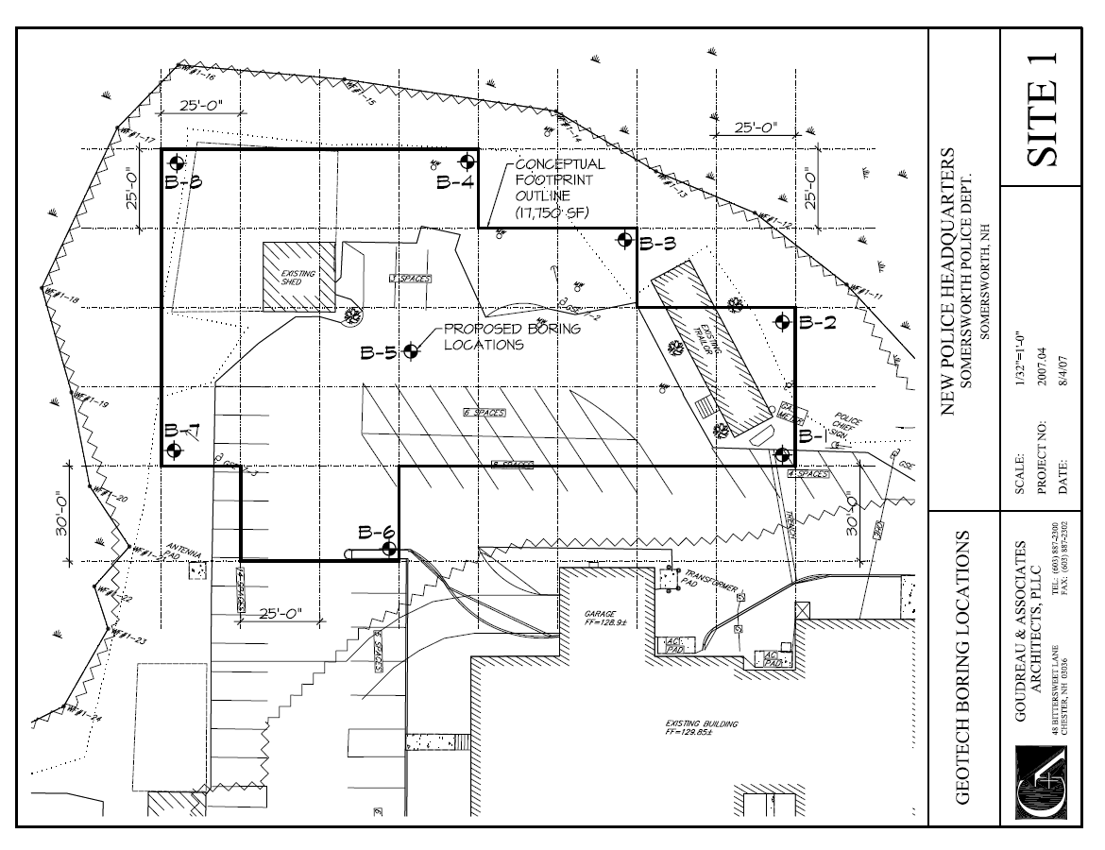
MBAC RECOMMENDED LOCATION
TOWN OWNED
2007 and 2014 GEOTECHNICAL REPORTS ON FILE
CENTRALLY LOCATED
MINIMAL SITE WORK
ABILITY TO GO VERTICAL

Slide 27
MBAC CONSIDERATIONS
LOCATION
SIZE
COST

Slide 28
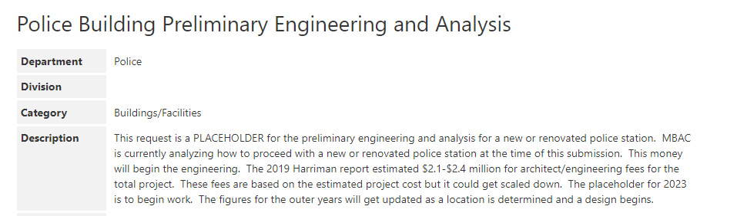

POLICE DEPARTMENT - CIP

Slide 29
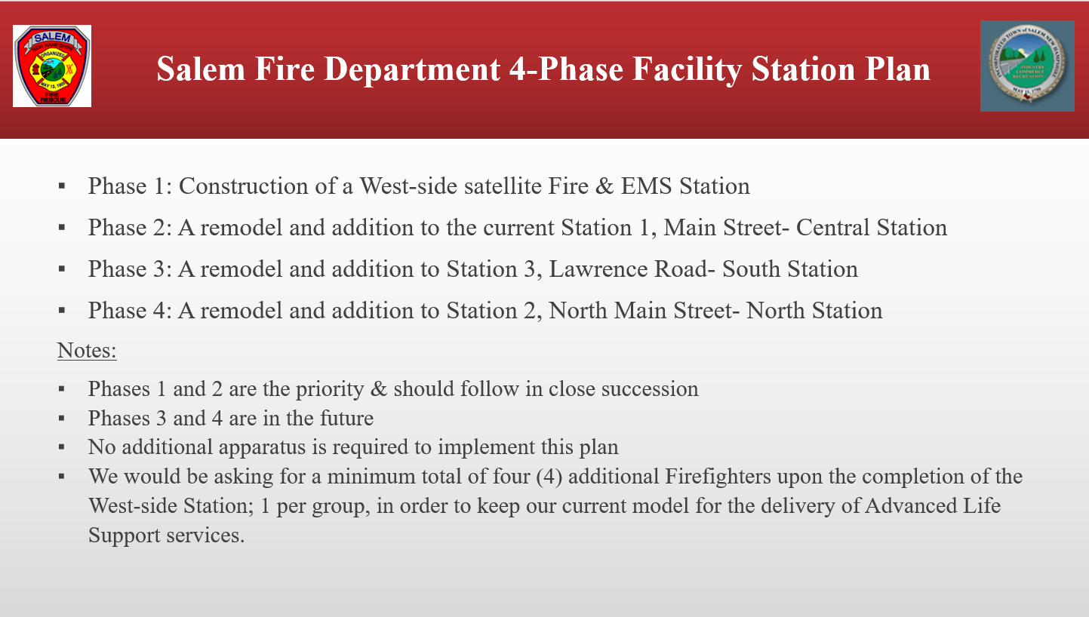
FIRE DEPARTMENT

Slide 30

FIRE DEPARTMENT

Slide 31
WEST SIDE LAND
Large Lot – 47.15 acres
Small Lot – 4.15

Slide 32
DISCUSSION

