Slide 1

MUNICIPAL BUILDINGS ADVISORY COMMITTEE
TOWN OF SALEM NH
UPDATE to THE Board of selectmen
APRIL 18, 2022

Slide 2
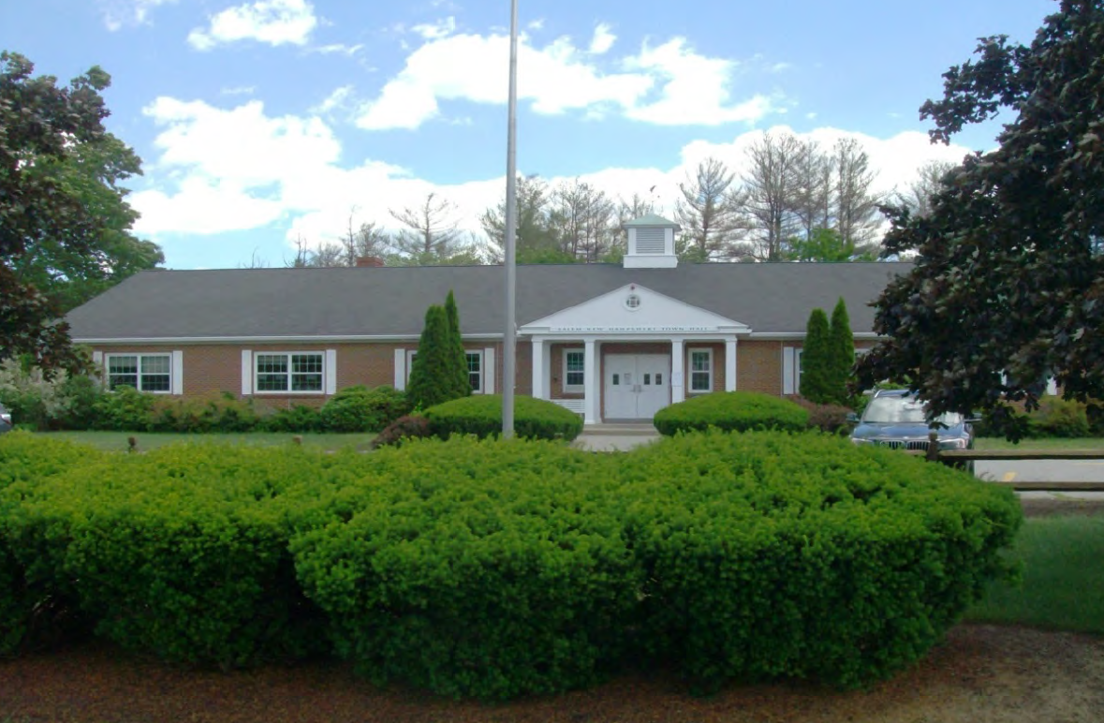
TOWN HALL PROJECT
The Salem Town Hall building was constructed in 1967. The two-story building is constructed of a concrete masonry foundation with wood framed walls, wood truss roof framing, and a brick facade. Several additions were added over the years, one in the late 1970’s/early 1980’s on the east side of the building, and a second addition was constructed in the early 1990’s on the south side of the building which used to accommodate the NH Department of Motor Vehicles (DMV). The DMV vacated the building several years ago and the area is now used by multiple departments. The total area of the building is 19,100 square feet with 12,200 square feet on the first or lower level and 6,900 square feet on the upper level.
FACILITY ASSESSMENT – HL Turner October 2017

Slide 3
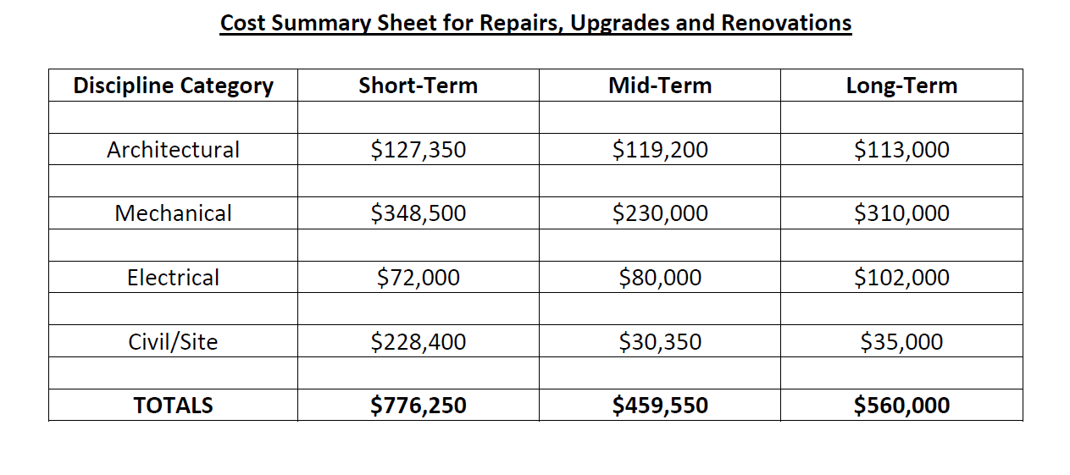
2017 FACILITY ASSESSMENT
To provide an accurate accounting of all items that may be classified as deferred maintenance or capital repair/improvements.
To calculate opinions of cost for all identified maintenance and capital improvement items using an established method of construction and cost estimating data.
To assemble a report and database that identifies a 10‐year capital planning cycle to address all identified maintenance items.
SPACE NEEDS STUDY – HL Turner April 2018
In general, the Salem Town Office building is definitely showing its age. Many of the finishes including walls, ceilings, and floors are worn and outdated. Exterior sealants and painted finishes need replacement or recoating. Insulation levels in the ceiling are insufficient. The mechanical and other systems and equipment have aged and many are at, or have exceeded, their useful life. There is a myriad of ductwork and various air handling units throughout the building that do not work well with the present configuration

Slide 4
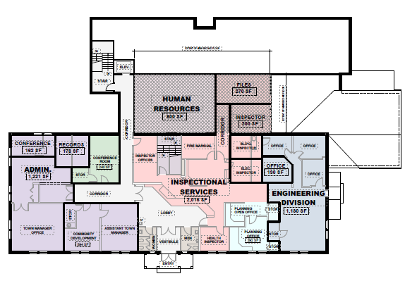
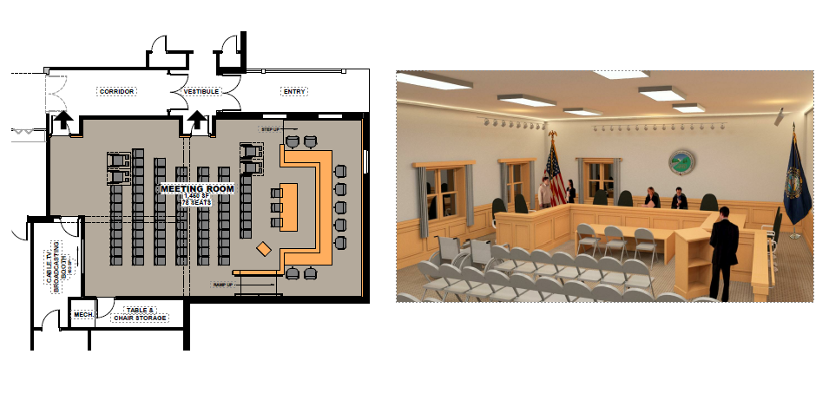
2018 SPACE NEEDS STUDY
The study was intended to address space planning to reconfigure the Knightly Meeting Room moreover include space planning for the entire Town Hall Building to determine where improvements could be made notwithstanding creating more effective space.
Architectural conceptual floor plan schemes were developed based on the space use / space needs information received.
The concepts showed various options for reconfiguring the building spaces, relocating departments to improve public efficiencies and interdepartmental adjacencies, as well as separate and consolidate storage need requirements by town departments and other user groups.
The total combined cost to upgrade all component elements of the building and reconfigure the existing spaces to accommodate the current use and needs of the Salem Town Hall Building is comparable to constructing a new building, specifically designed for the current and future anticipated spaces in the Salem Town Hall Building

Slide 5
2022 – TOWN HALL PROJECT
MUNIICIPAL BUILDINGS ADVISORY COMMITTEE
PROJECT CONSULTANTS:
RFQ 2021-011 Owner’s Project Manager April 2021
Selection Complete – Trident
RFQ 2021-020 Architectural Services September 2021
Selection Complete - ICON

Slide 6
2022 – TOWN HALL PROJECT
ICON DESIGN SCOPE
PROJECT CONSULTANTS:
RFQ 2021-011 Owner’s Project Manager April 2021
Selection Complete – Trident
RFQ 2021-020 Architectural Services September 2021
Selection Complete - ICON

Slide 7
2022 – TOWN HALL PROJECT
ICON DESIGN SCOPE
TASK 1 – PROGRAMMING + CONCEPT PLANNING
Schedule: 8 weeks
TASK 2 – CONCEPTUAL DESIGN + ESTIMATING
Schedule: 4 weeks design + 3 weeks estimating
TASK 3 – EXISTING CONDITIONS VERIFICATION + BASE REVIT MODEL
Schedule: 4 weeks – concurrent with Task 2
Preliminary conceptual designs (three alternatives) – plans, cost estimate, schedule/implementation plan and summary of pros and cons to BOS for selection of Preferred Option.

Slide 8
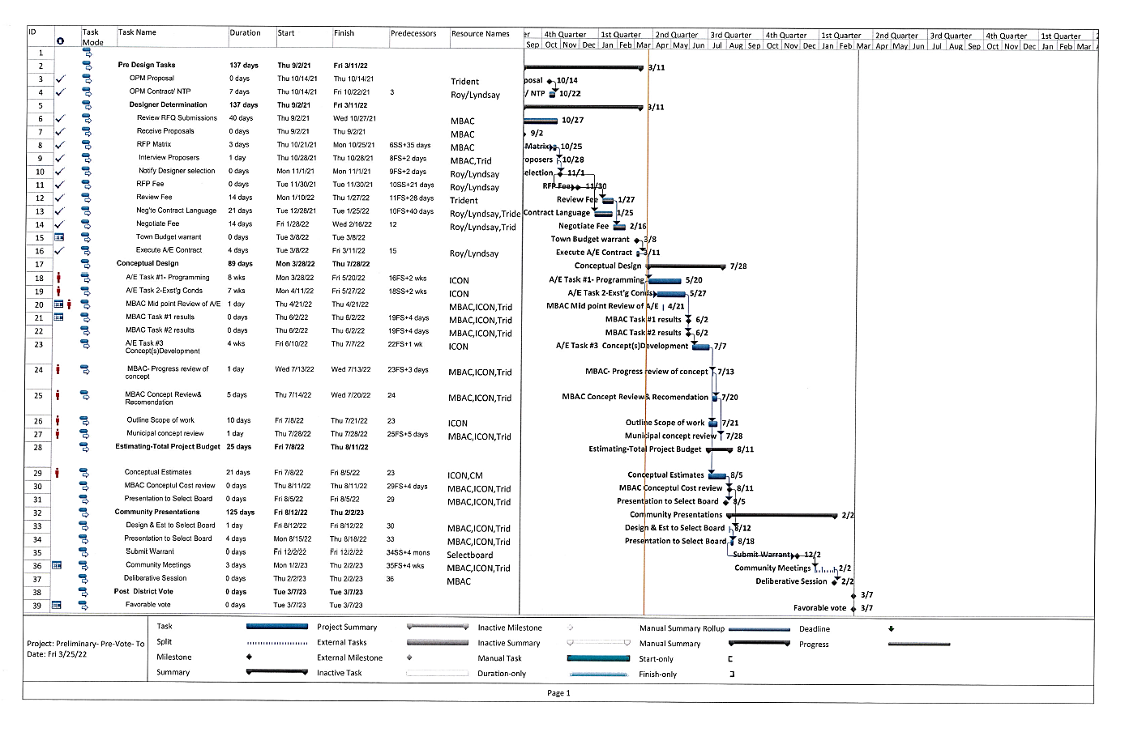
PROJECT SCHEDULE

Slide 9
DISCUSSION

