Slide 1

MUNICIPAL BUILDINGS ADVISORY COMMITTEE
TOWN OF SALEM NH
UPDATE to THE Board of selectmen
APRIL 4, 2022

Slide 2
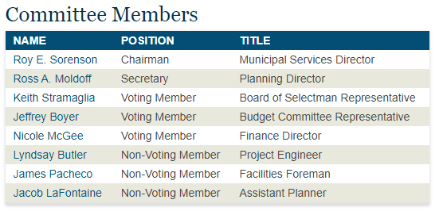
MBAC
The Municipal Buildings Advisory Committee is hereby established as an ad hoc group to review, evaluate, and make recommendations to the Board of Selectmen regarding town-owned buildings, not including Police or Fire, for the consideration of major capital improvements.
The Municipal Buildings Advisory Committee is hereby established as an ad hoc group to review, evaluate, and make recommendations to the Board of Selectmen regarding town-owned buildings for the consideration of major capital improvements.
Joe Devine – Assistant Town Manager
Trident – Owners Project Manager

Slide 3
BUILDINGS
Ingram Senior Center
Millville Circle Recreation Building
Hedgehog Park Recreation Building
Old Library
Old School House
Old Hose House
Depot Train Station
Water Treatment Plant
Transfer Station
Pine Grove Cemetery Garage
Parks Building (Old Rockingham Road)
Palmer School
Town Hall
District Court
DPW (All Buildings)
Police Station
Central Fire
North Fire
South Fire
Old Town Hall

Slide 4
PROFESSIONAL SERVICES
RFQ - Request For Qualifications
An RFQ is a qualifications-based selection process. It is NOT a bid. It is a request for firms to submit their qualifications to be considered for a project. It is applicable for professional services. The intent of an RFQ is to allow the Town to select who they feel is the most qualified for a project. The Town can negotiate a fee with its chosen selection and if terms cannot be reached, it has the option to go to the second choice and so on.

Slide 5
REQUEST FOR QUALIFICATIONS
RFQ 2021-007 Municipal Services Facilities March 2021
Selection Complete – Weston and Sampson
RFQ 2021-011 Owner’s Project Manager April 2021
Selection Complete – Trident
RFQ 2021-020 Architectural Services September 2021
Selection Complete - ICON

Slide 6
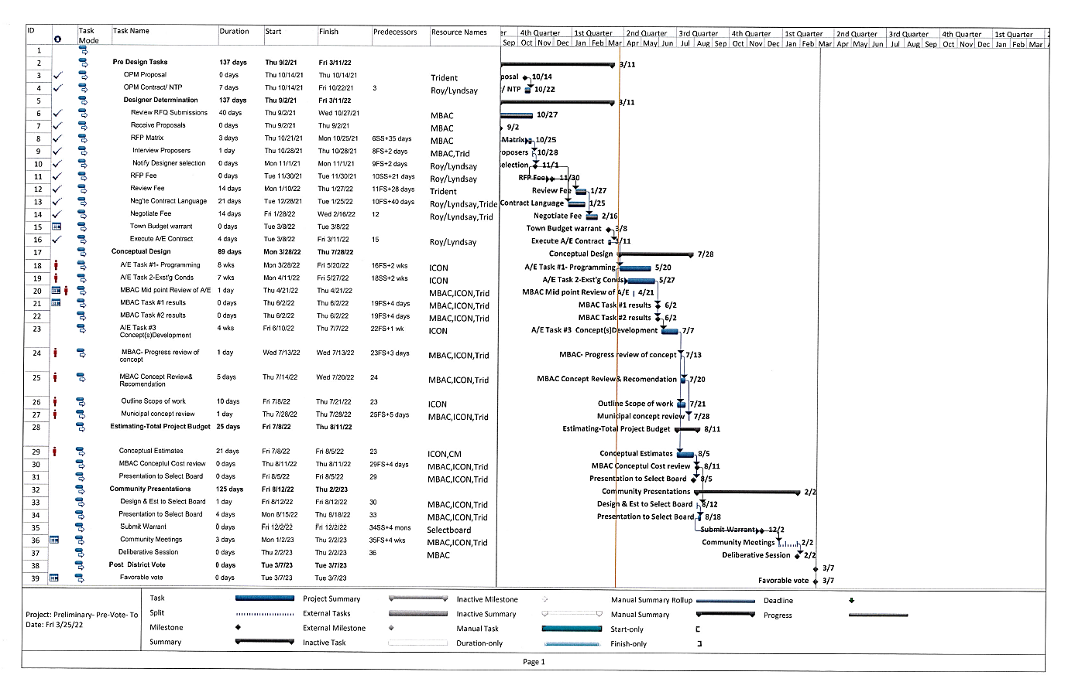
PROJECT SCHEDULES

Slide 7
DISCUSSION

