Slide 1

Town of Salem Facilities Update
Municipal Building Advisory Committee
March 24, 2022

Slide 2
Topics for Discussion
Courthouse roof leak of August 2021
Town wide bids for facilities
A/C unit at Town Hall

Slide 3
Courthouse Roof Leak August 2021
In August of 2021, a roof leak was reported in the Clerks area of the courthouse and the lower conference rooms
Clean up was conducted by Parks and Properties staff, with remediation completed by ServiceMaster
Roof patch repairs were completed by Scotts Roofing
Air quality testing was conducted by RPF Environmental
No mold was located in the area of the leak
Work covered by insurance included; drywall repairs, paint, carpet removal, ceiling tile repairs, and the moving of cubicles
Drywall, paint, and ceiling tile repairs were completed in the Fall of 2021

Slide 4
Courthouse Roof Leak August 2021
Due to court scheduling, carpet removal could not occur until February of 2022
In February, the final repairs were completed with the removal of existing carpet and replacement with carpet squares

Slide 5
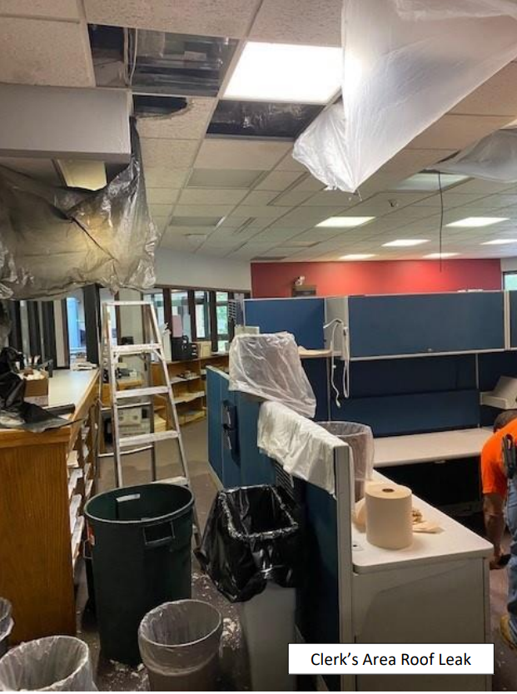
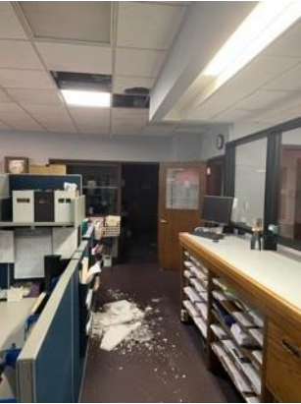
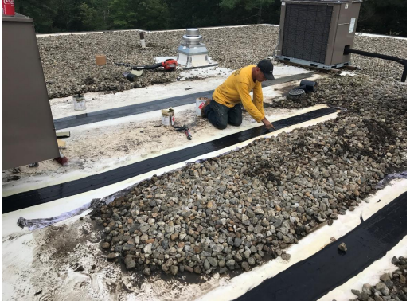
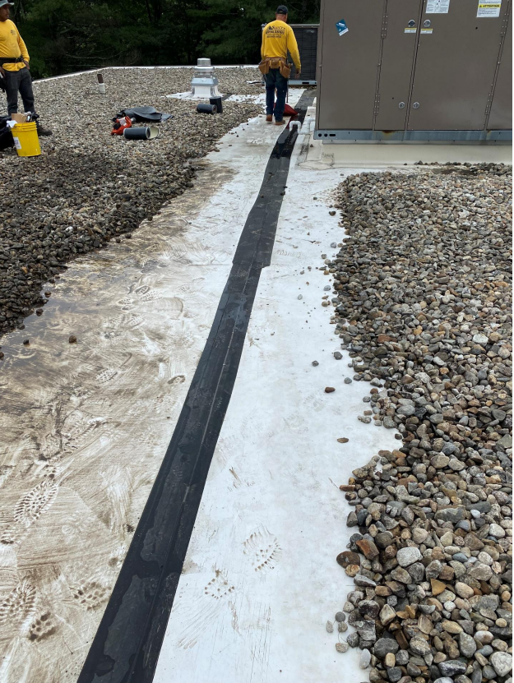
Courthouse Roof Leak August 2021

Slide 6
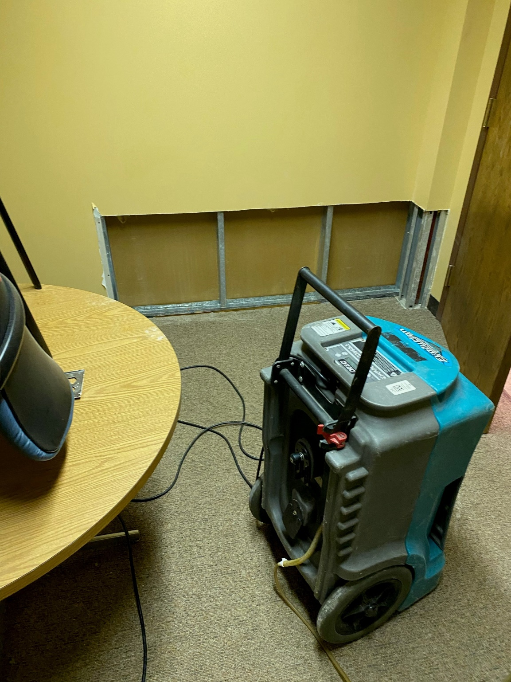
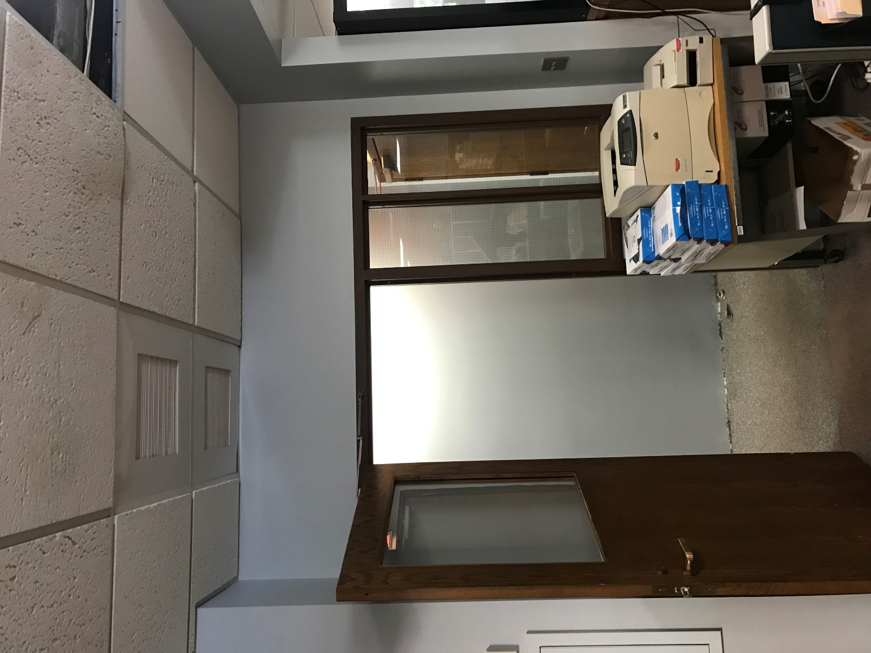
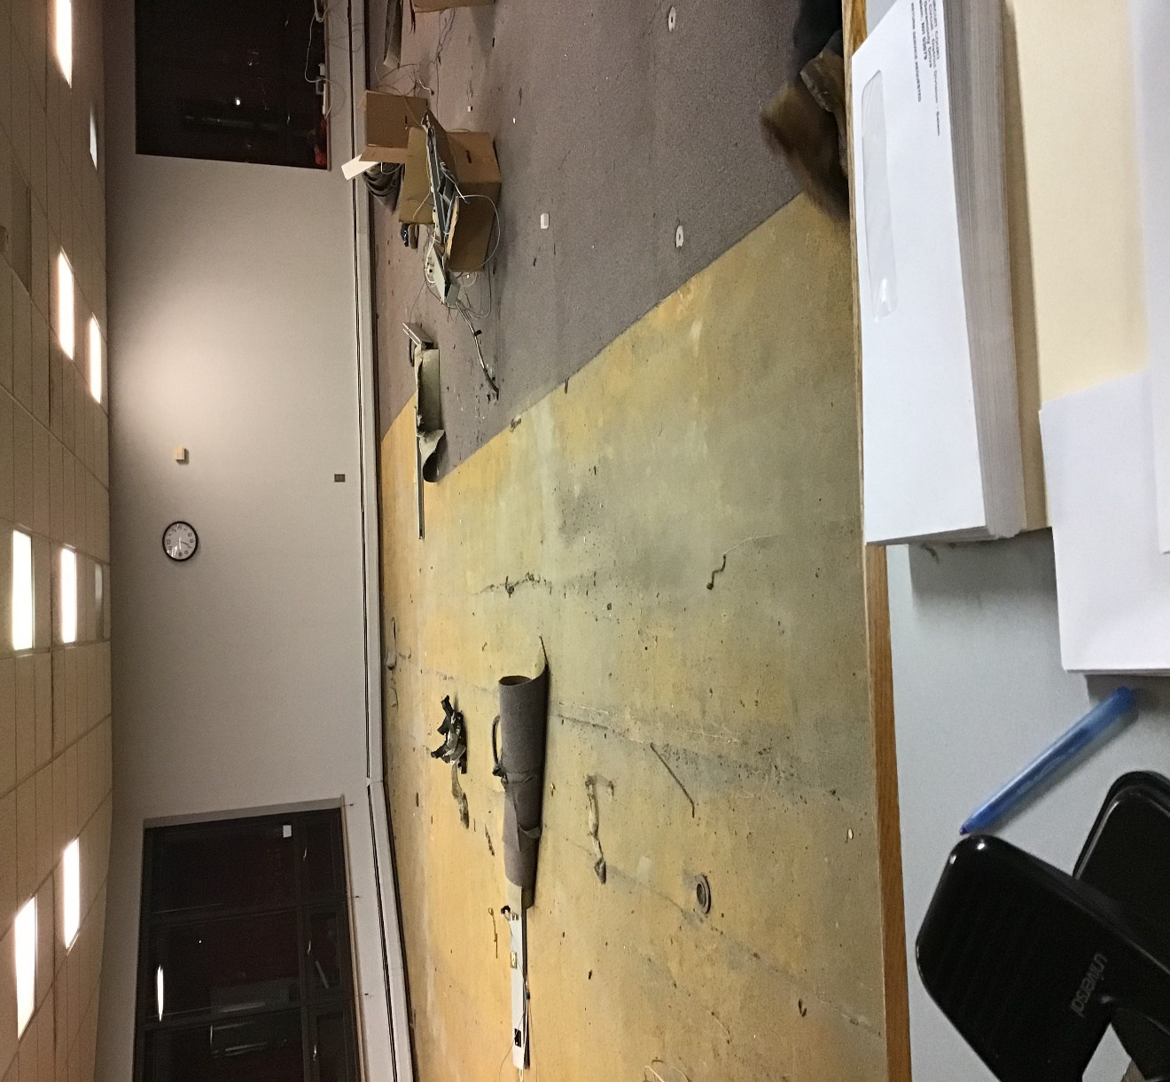
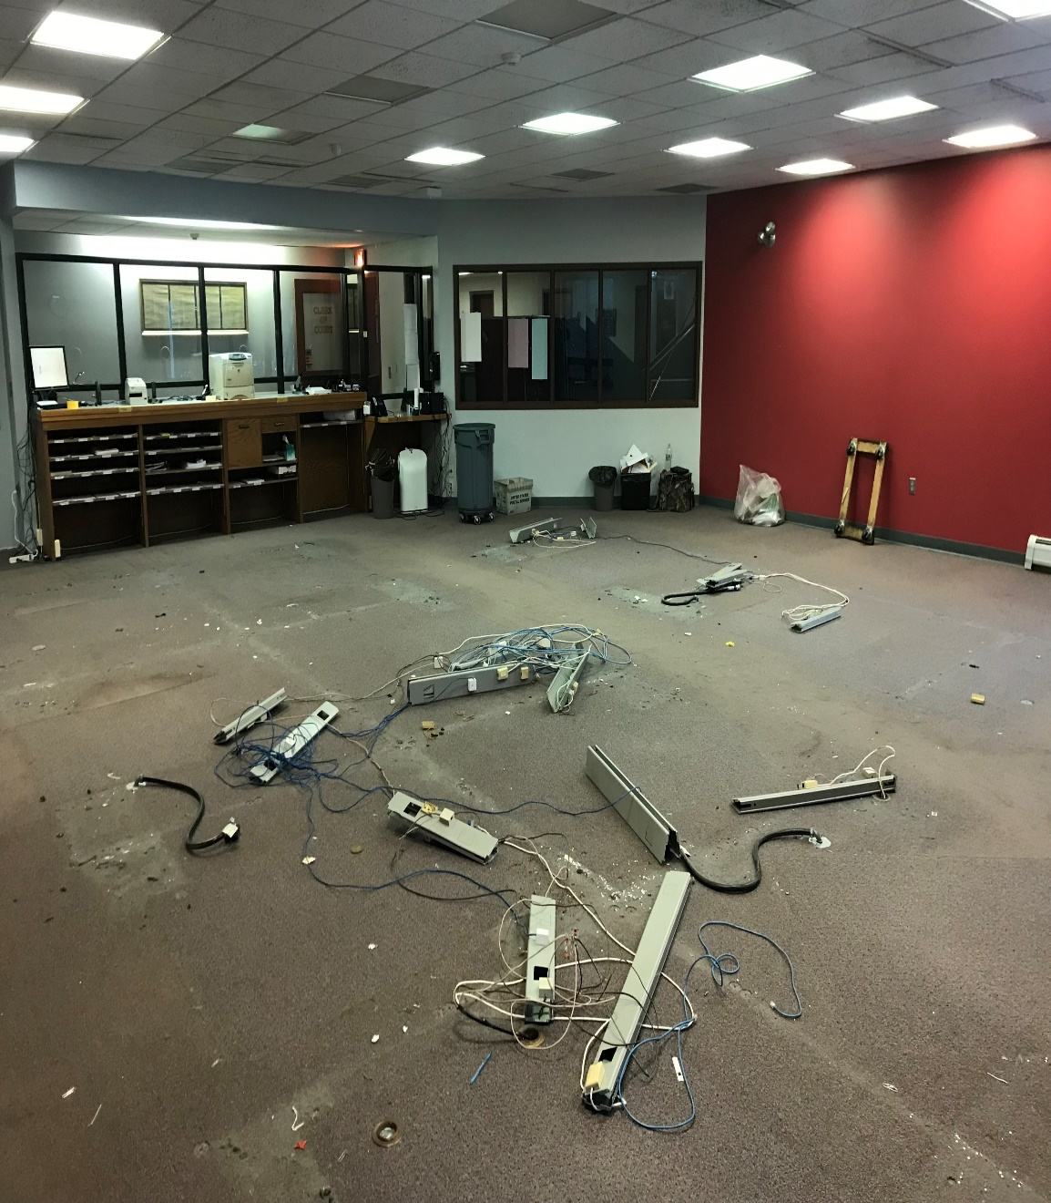
Courthouse Roof Leak August 2021

Slide 7
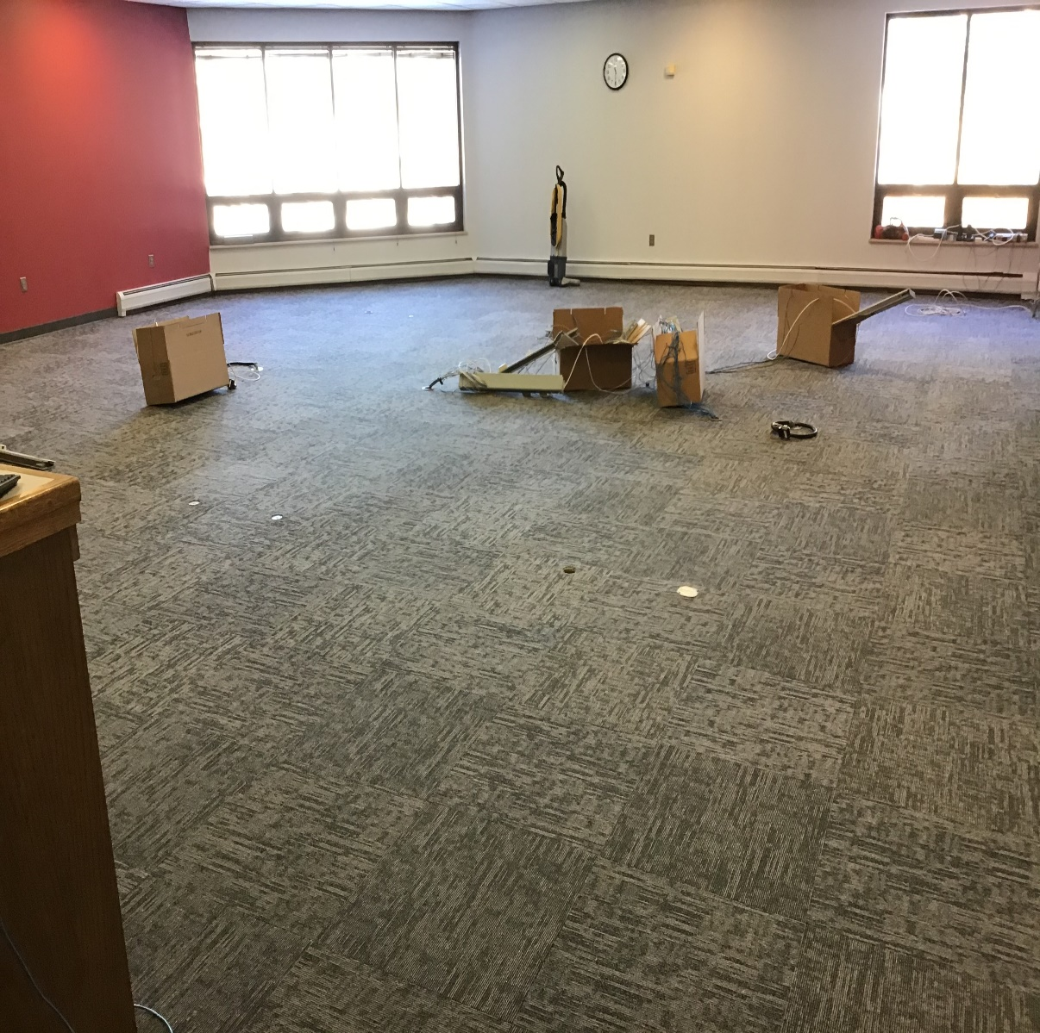
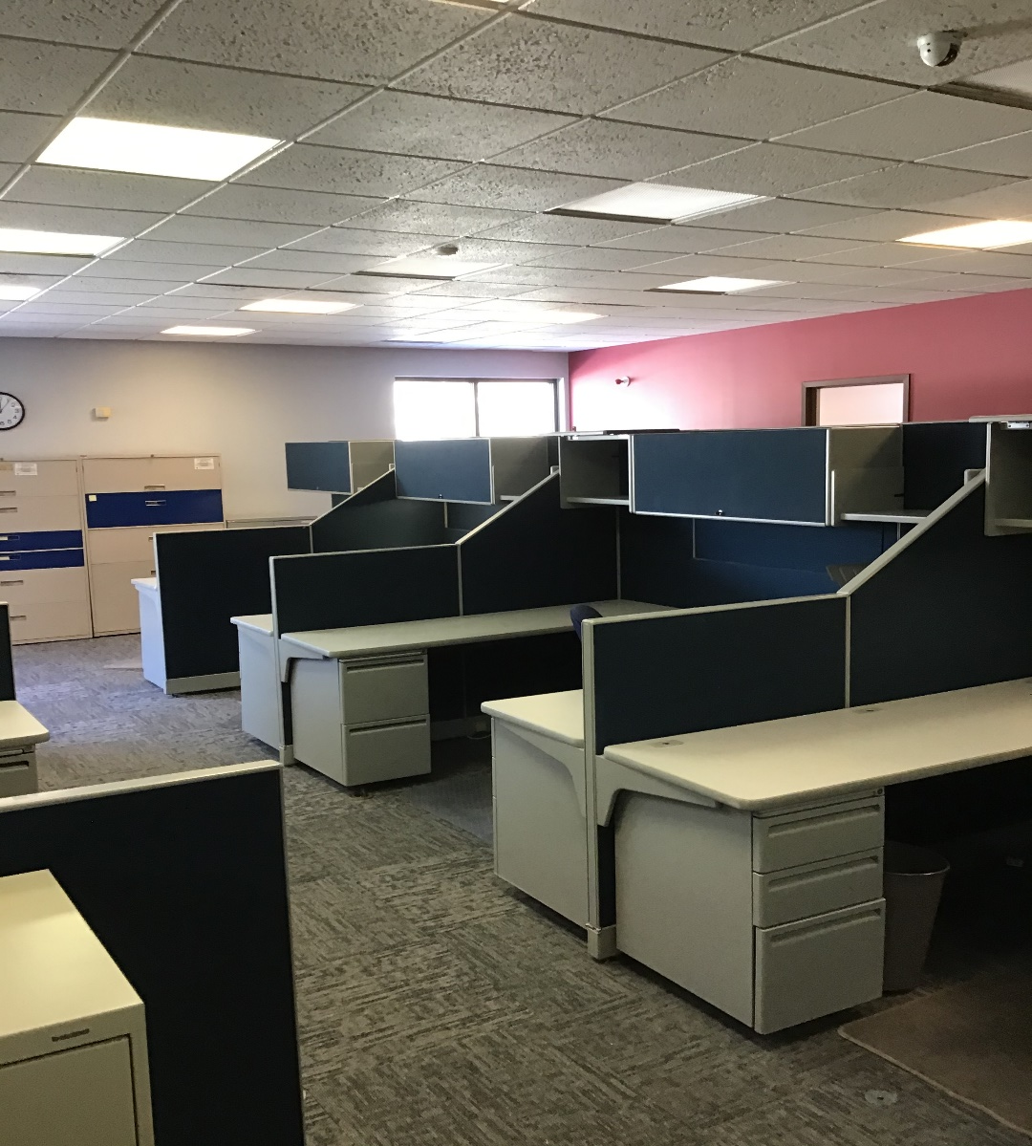
Courthouse Roof Leak August 2021

Slide 8
Facility Services Bids 2022
In 2022, Municipal Services Department went to bid for services related to town facility needs
Prior to this year, every department had their own set of contractors for similar services. With these bids we are now able to streamline the services
Bids will be on a 3-year contract term
Bids varied from multiple contractors, to single contractors
Contractors can be used by all departments within the Town of Salem

Slide 9
2022 Town Bids
List of Bids
Electrician
Plumber
General Contactor
Elevator Services
Pest Control
Generator Services
HVAC
Fire Alarm Services
Building Alarm Services
Overhead Doors
Landscape Services
Irrigation, hydroseeding, bark mulch blowing
Red: Indicates bids have been awarded or are in the process of being awarded
Black: Indicates services that have yet been awarded

Slide 10
A/C Unit # 2 at Town Hall
During Spring preventive HVAC maintenance at Town Hall
The contractor found that Unit # 2 is currently not operating
The compressor and valves for the unit were found to be nonoperational when tested
Recommendation from the contractor is replacement of unit

Slide 11
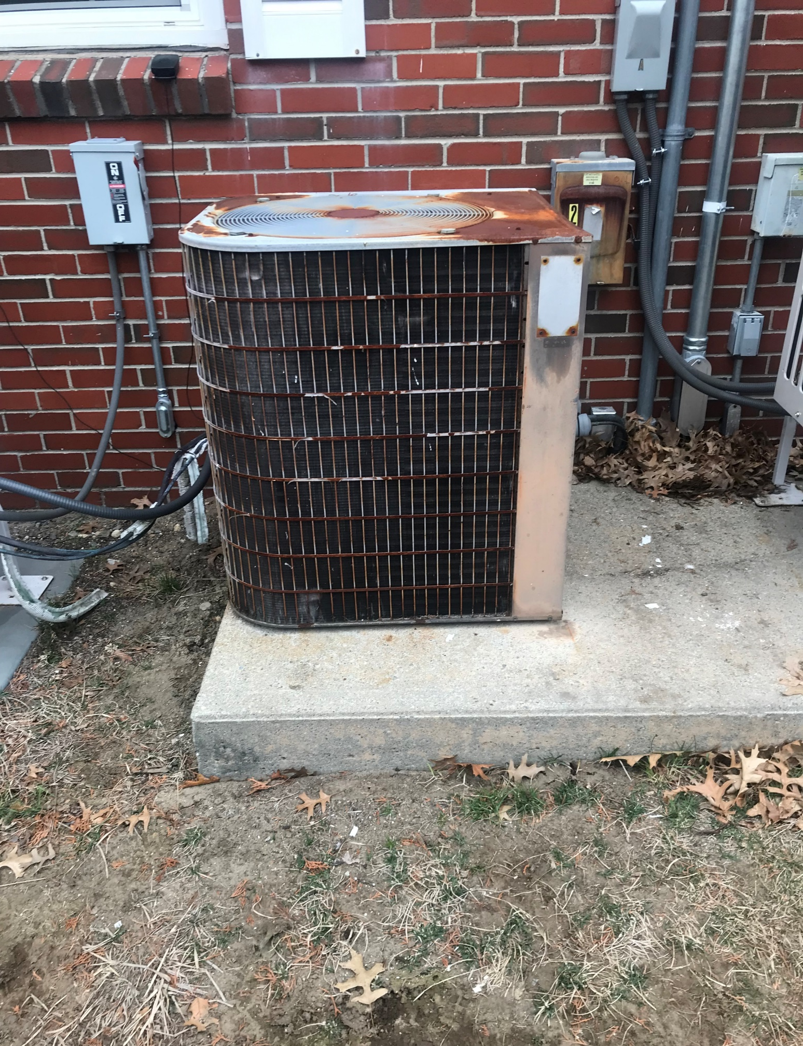
A/C Unit # 2 Town Hall
Lennox air conditioner 5-ton unit
Model year: 1984
Services the Downstairs Area, (i.e. Head Clerk, Tax Collector, and Assessing Area)
Air handler located in Human Services closet
Unit currently uses R-22 refrigerant, EPA is currently switching to R-410A

Slide 12

Questions ?

