Slide 1

MBAC
MUNICIPAL BUILDINGS ADVISORY COMMITTEE
March 24, 2022

Slide 2

Ingram Senior Center
William E. Palmer School
Hedgehog Park Recreation Building
Millville Circle Recreation Building
Community Services BUILDINGS

Slide 3
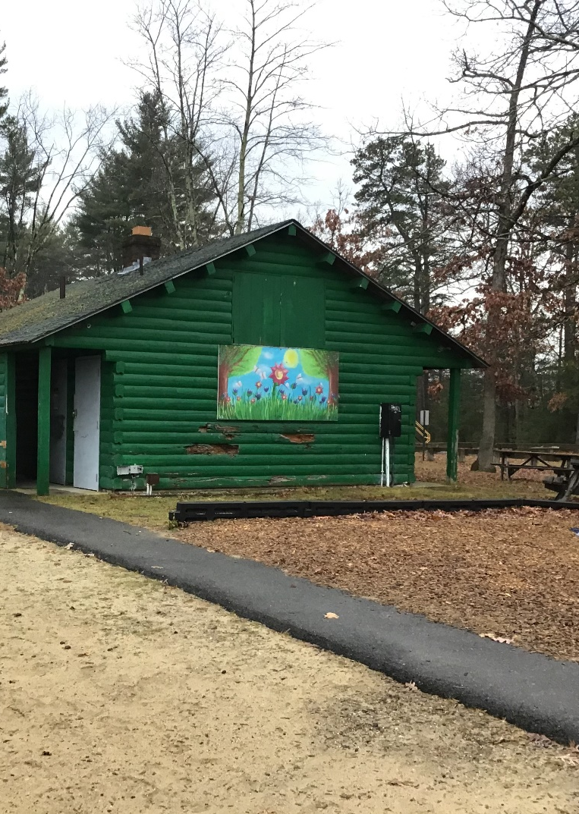
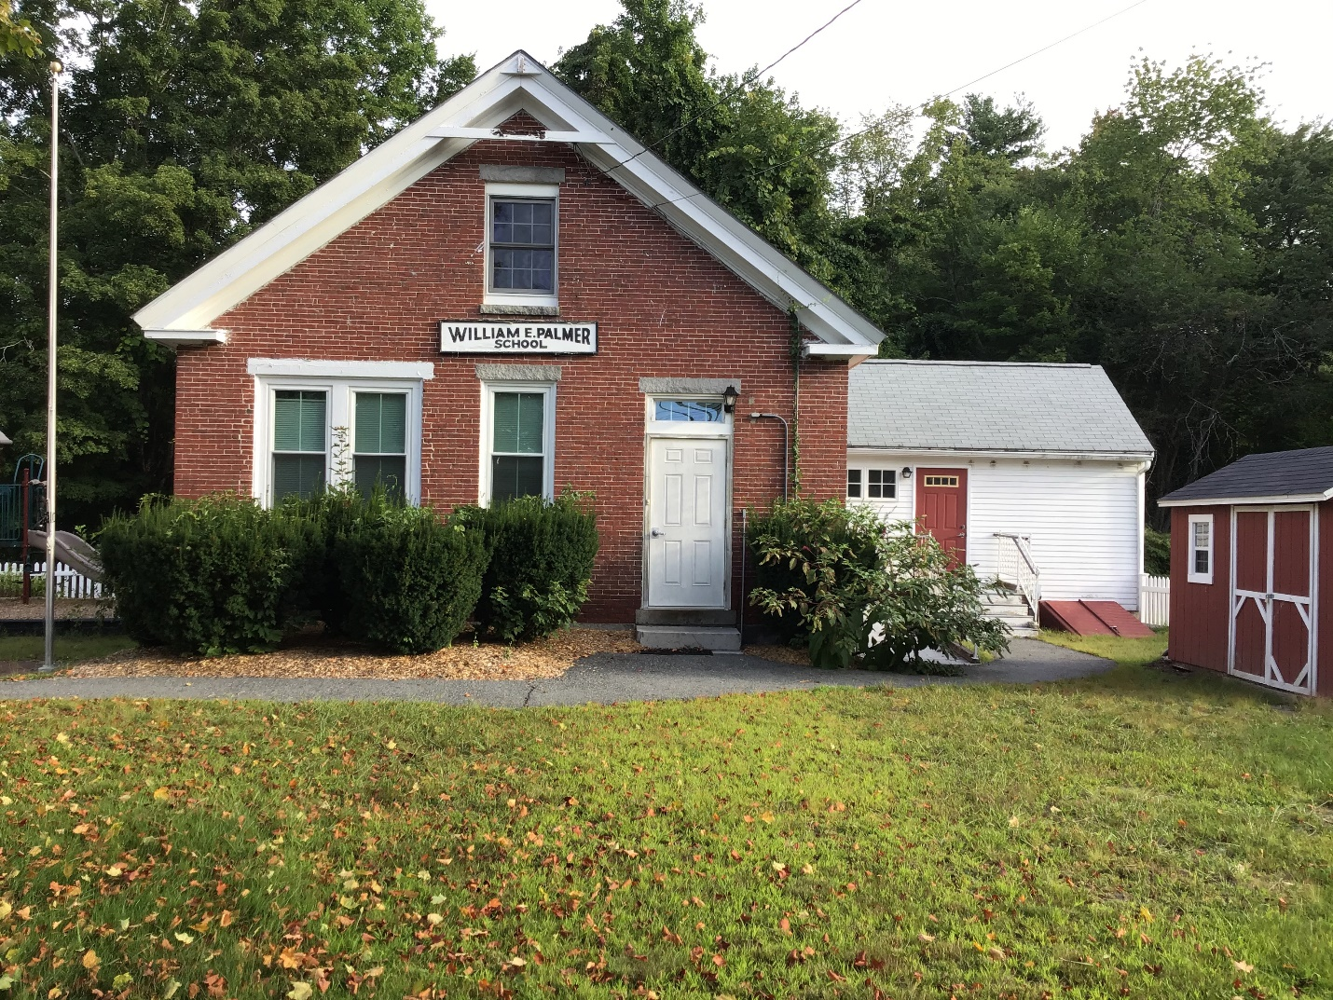
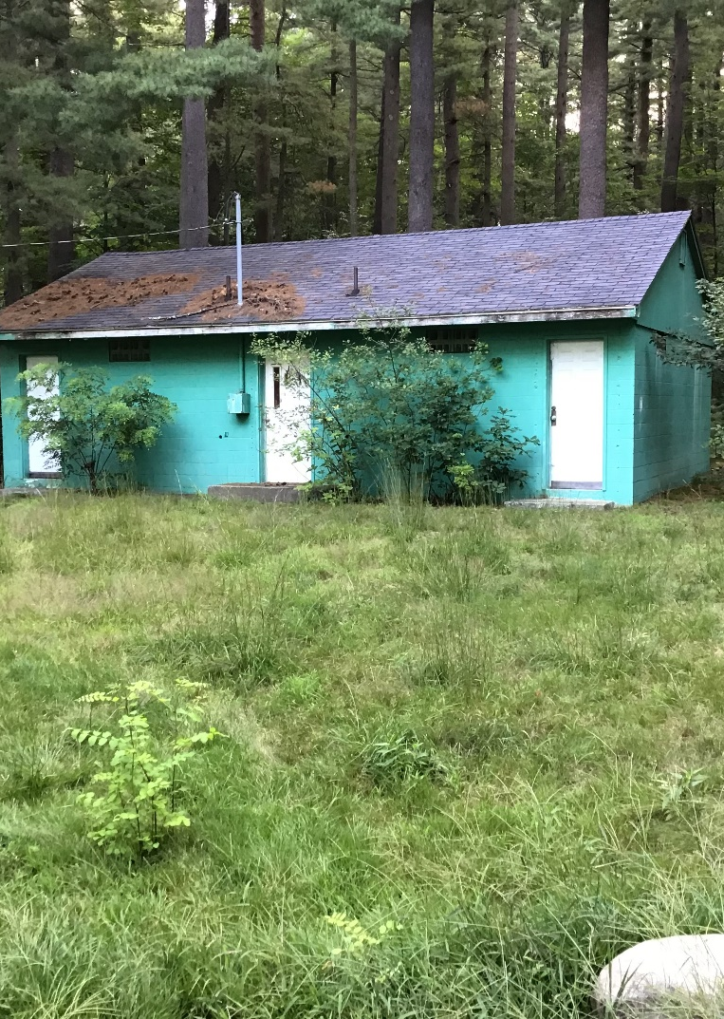
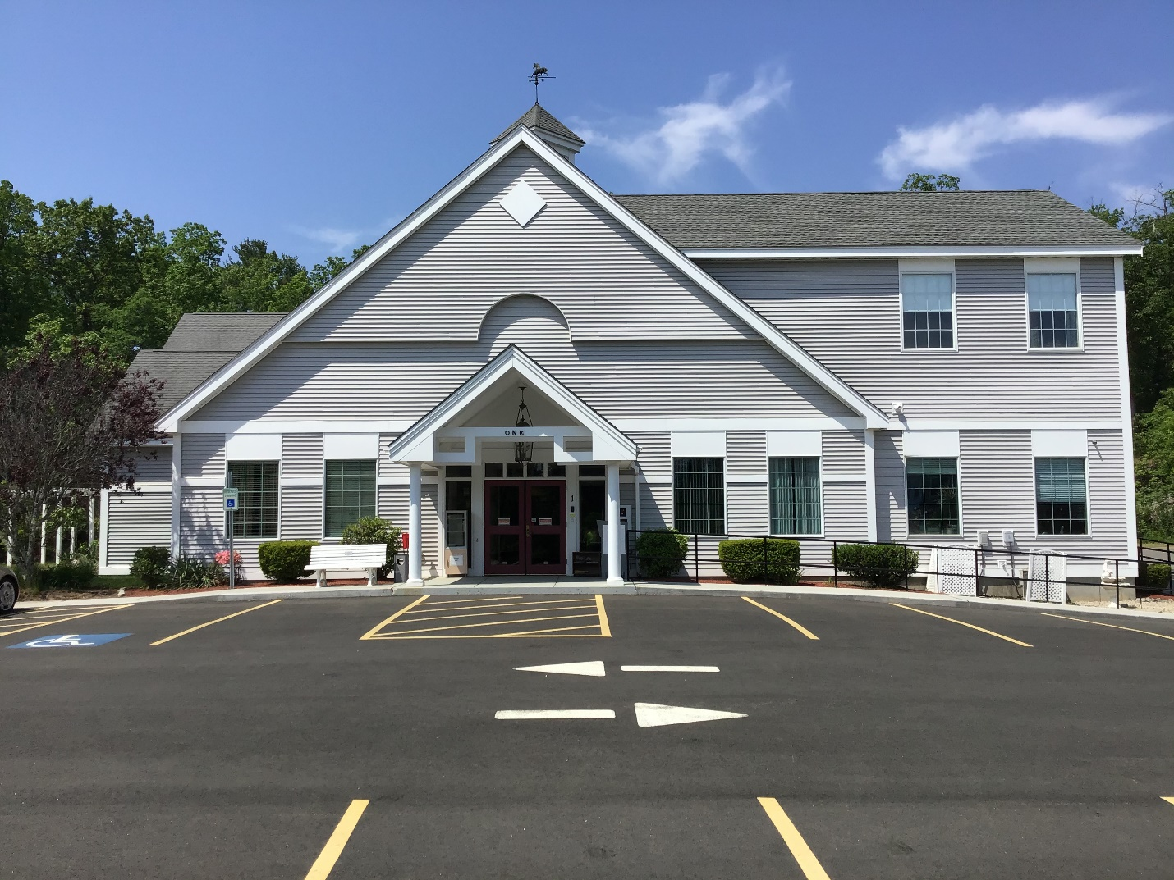
COMMUNITY SERVICES

Slide 4
Ingram Senior Center
20 Years Old
1. HVAC replacement
2. Attic insulation
3. Front roof line design hazard
4. Roof replacement
5. Guardrail concrete
6. Storage needed
7. Cover gas meter
8. Patio? ARPA funds?

Slide 5
HVAC Financials
2018
2019
2020
2021
Repairs & Maintenance
$6,420
Heat/AC Yearly Cost
$9,471
Total: $15,891
Repairs & Maintenance
$8,710
Heat/AC Yearly Cost
$9,210
Total: $17,920
Repairs & Maintenance
$7,099
Heat/AC Yearly Cost
$9,310
Total: $16,409
Repairs & Maintenance
$8,022
Heat/AC Yearly Cost
$10,767
Total: $18,789

Slide 6
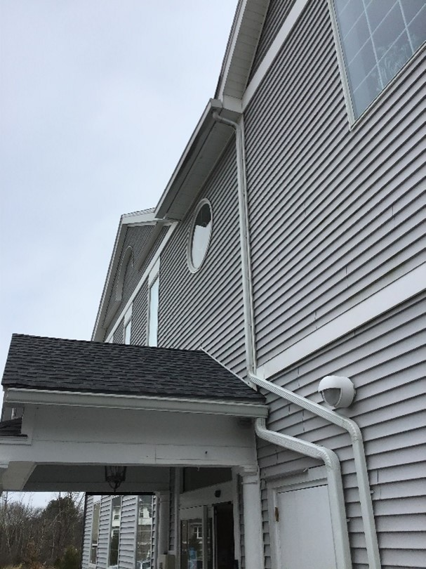
Roof
Roof line issues, which allows for icing issues on sidewalk/ramp creating a safety hazard

Slide 7
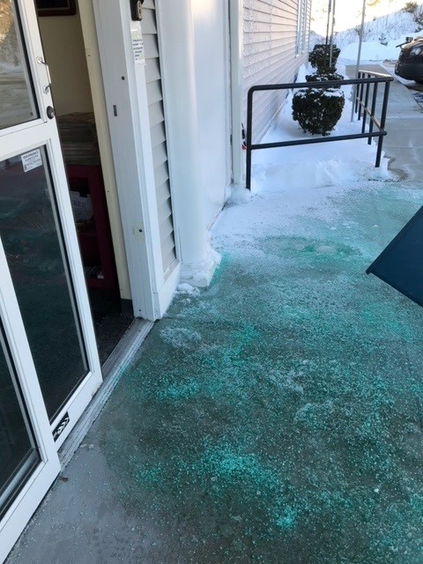
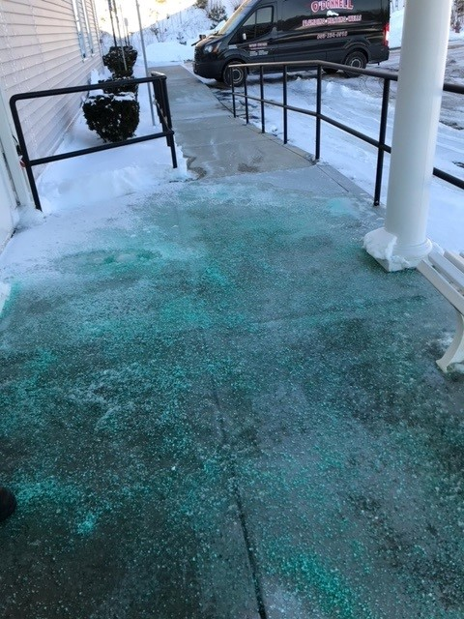

Slide 8
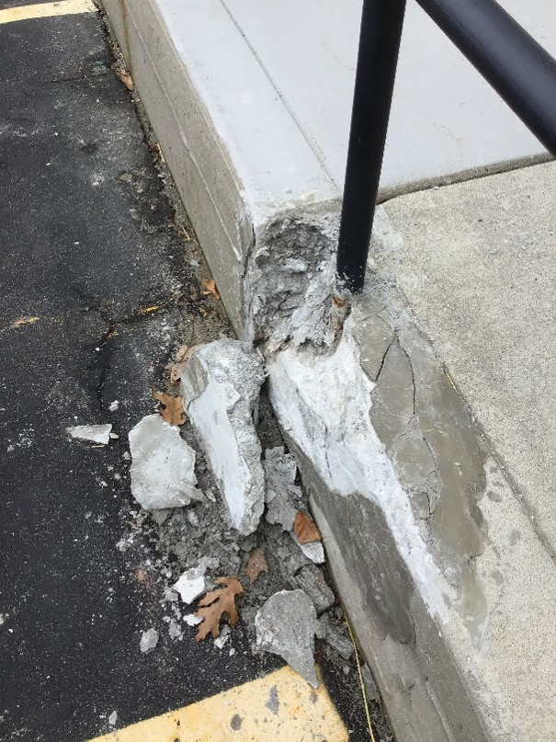
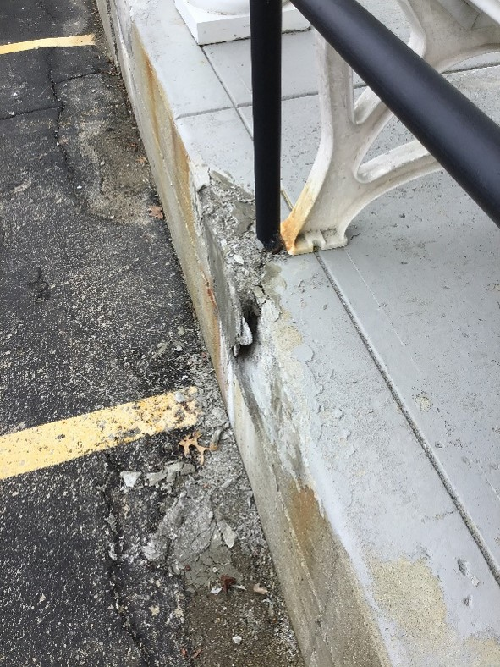
Front Sidewalk/Ramp
Concrete damage around handrail
Concrete damage

Slide 9
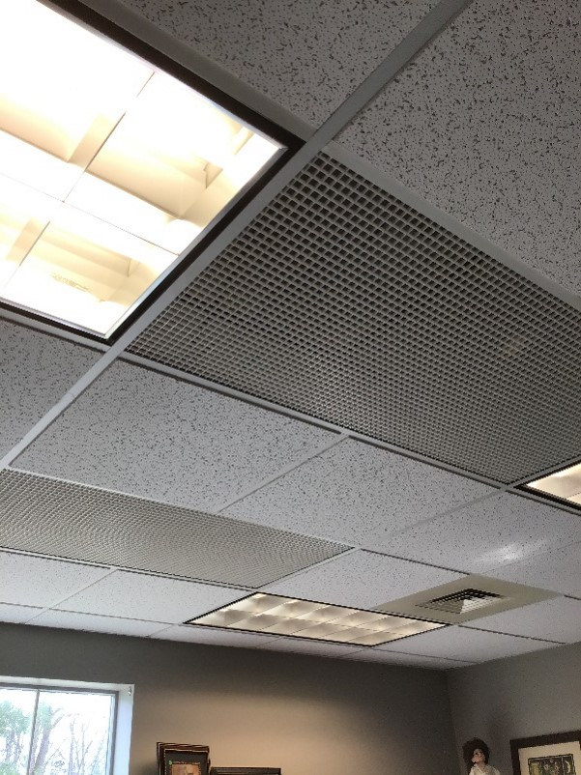
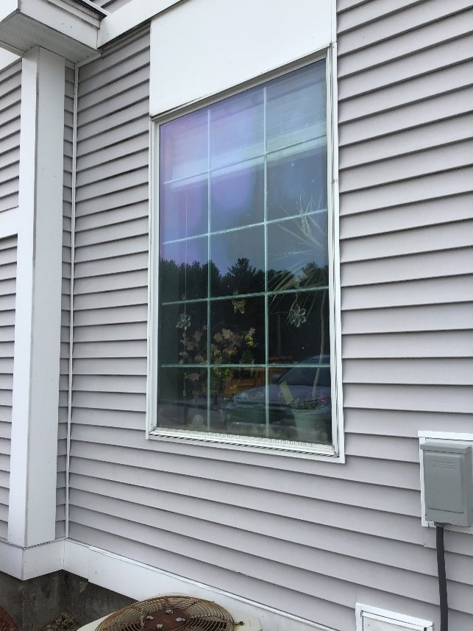
Plastic grates for air circulation, due to improper spray foam application
Window glaze and stain
**Windows do not open for air circulation

Slide 10
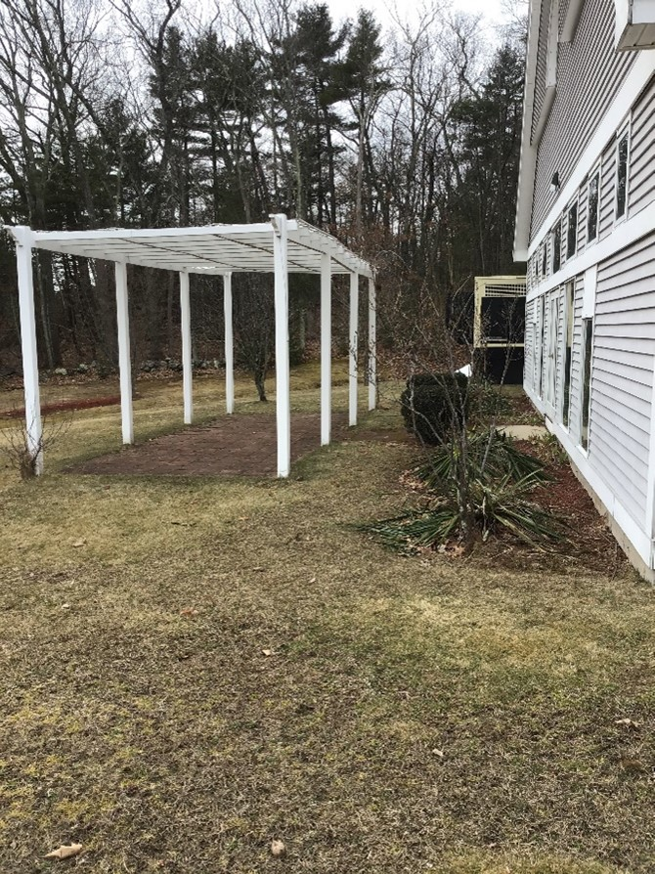
Potential patio area

Slide 11
William E. Palmer School
Built in 1853
169 years old
Ramp
Bowing back side of building
Paint chipping
Check for lead?
Register as a Historical Building?

Slide 12
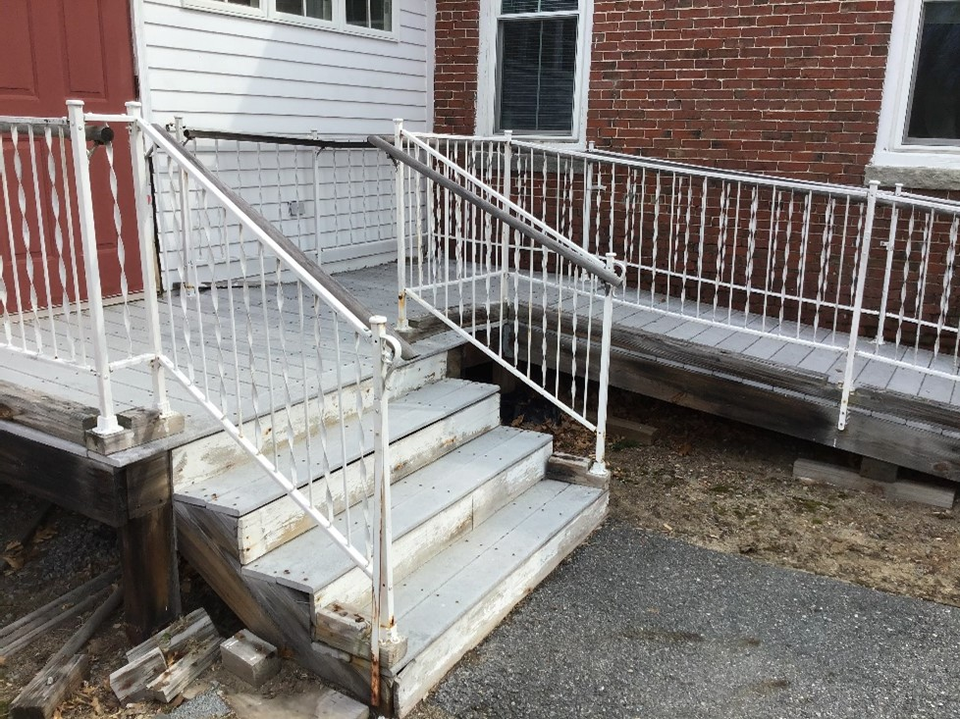
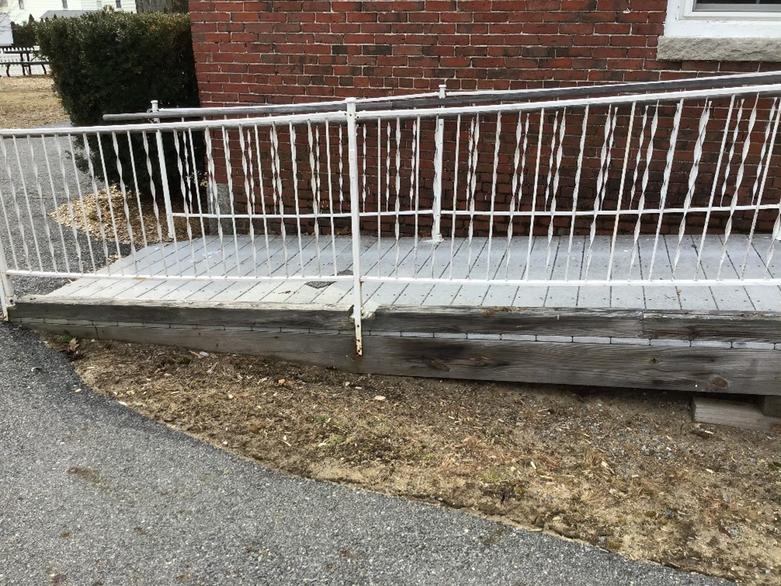
William E. Palmer School
Hazardous ramp
Hazardous steps

Slide 13
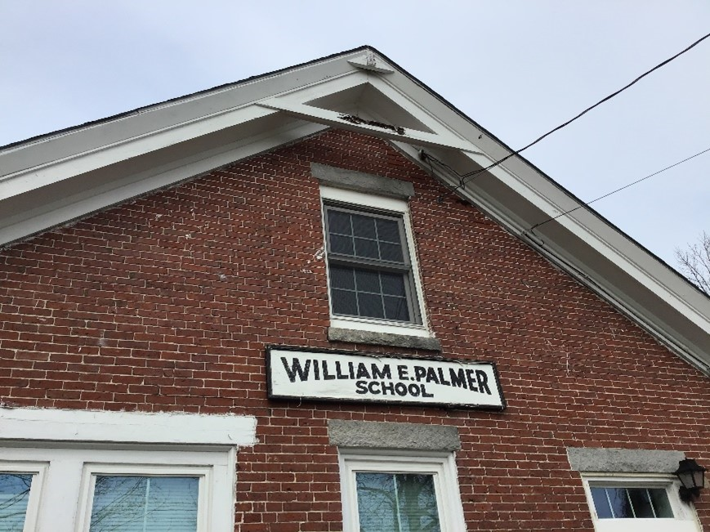
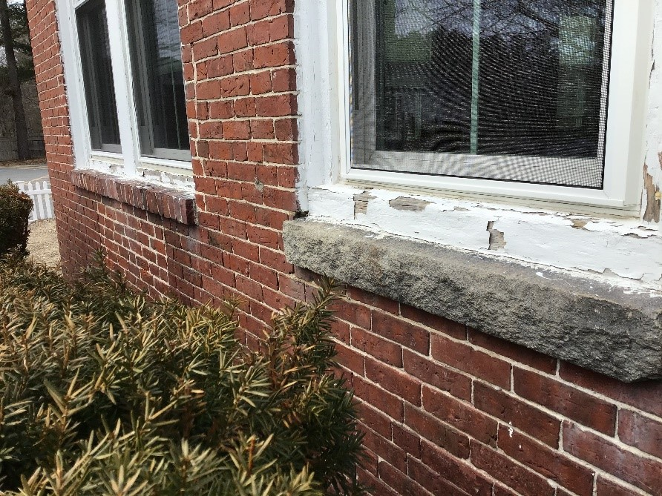
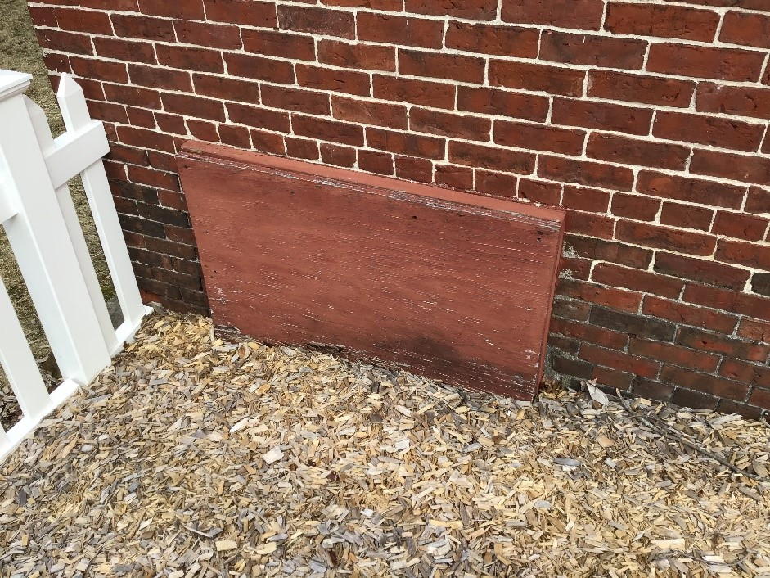
Paint chipping
Cellar

Slide 14
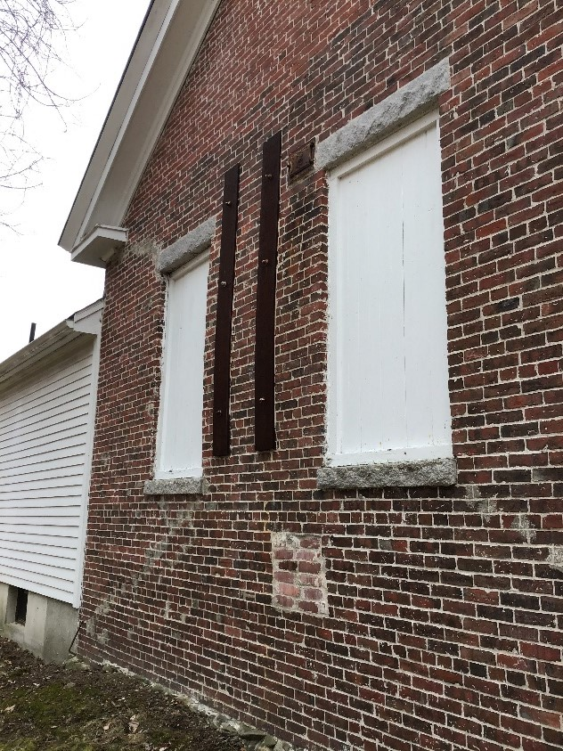
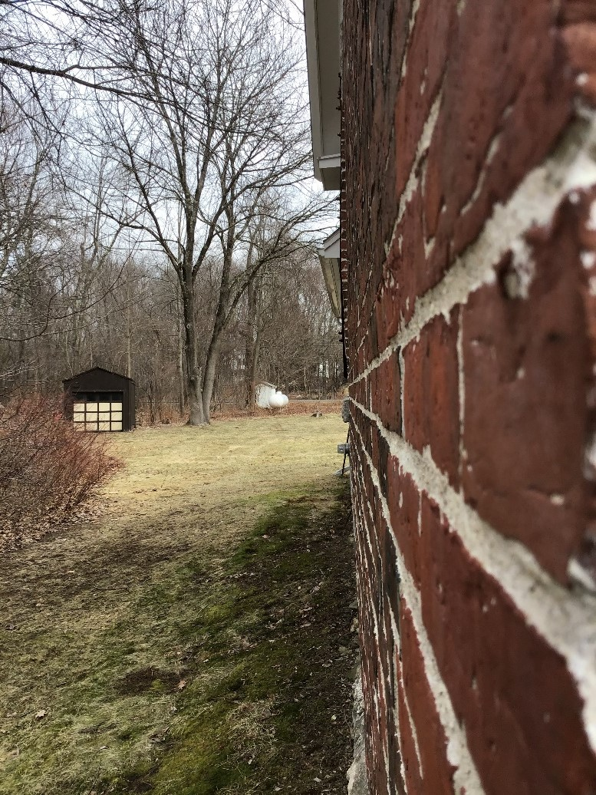
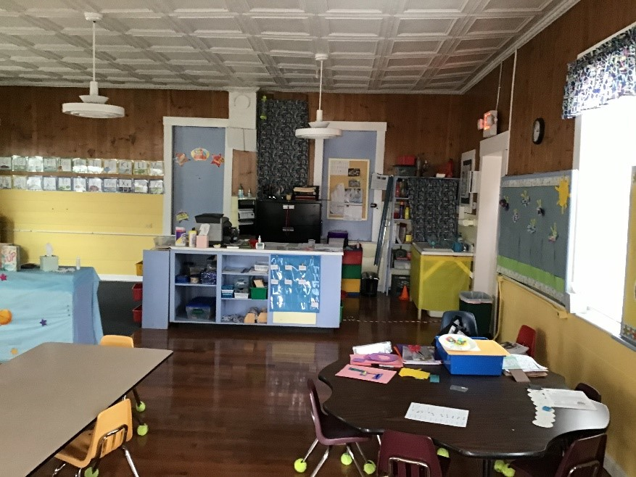
William E. Palmer School
Bow in wall
Bow in wall
Interior

Slide 15

Hedgehog Park
LWCF Grant 2010
Building hazardous
Wood rotted
Roof needs replacing
Rodent infested
Tree work
Tear down?

Slide 16
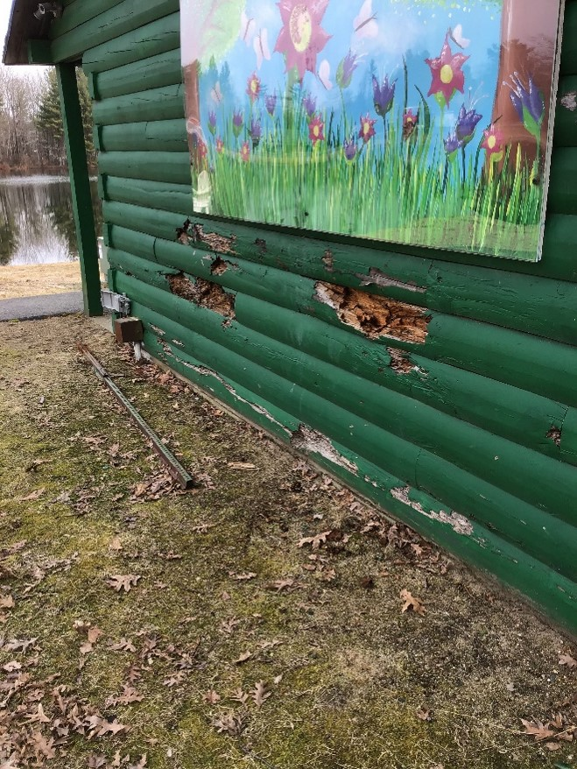
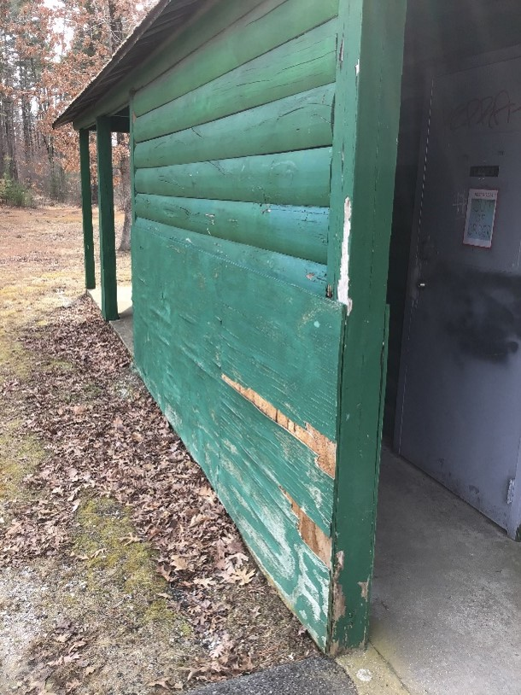
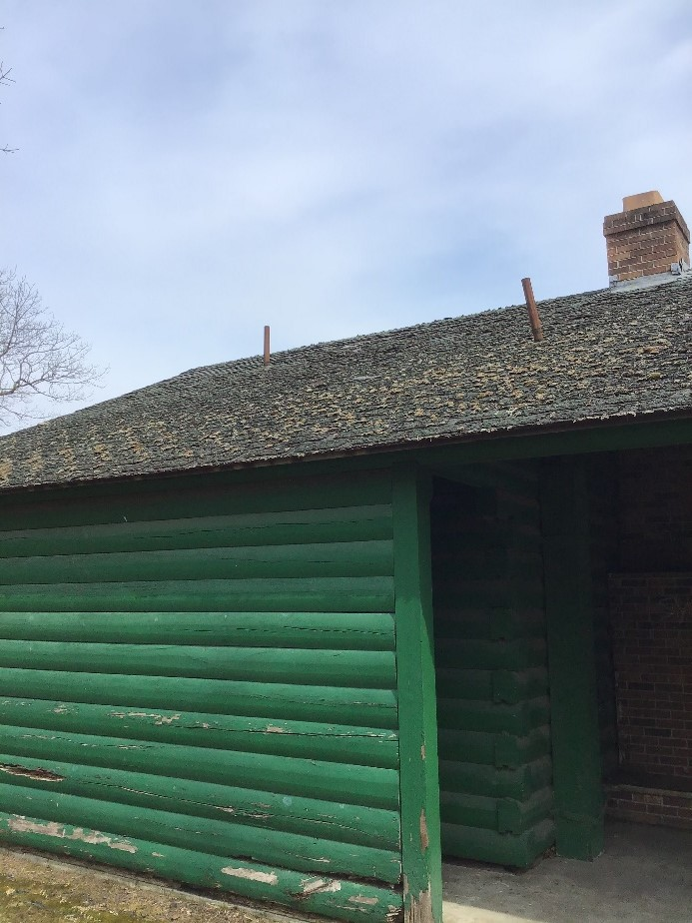
Hedgehog Park
Wood damage
Wood damage
Roof needs replacing
Wood damage

Slide 17

Millville Building
Hazardous conditions
Rodent infested
Tear down?

Slide 18
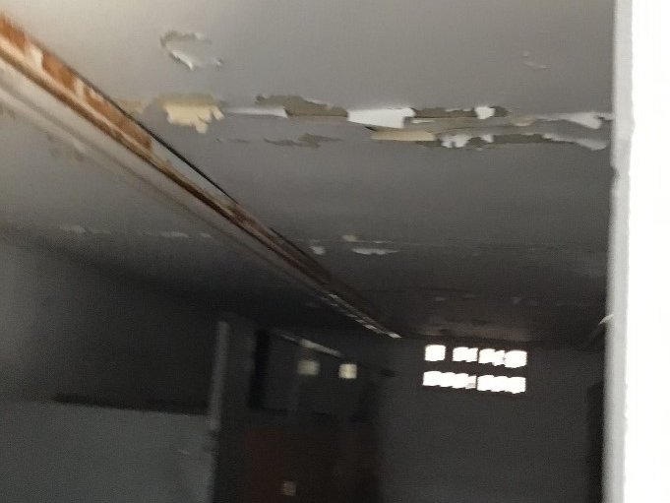
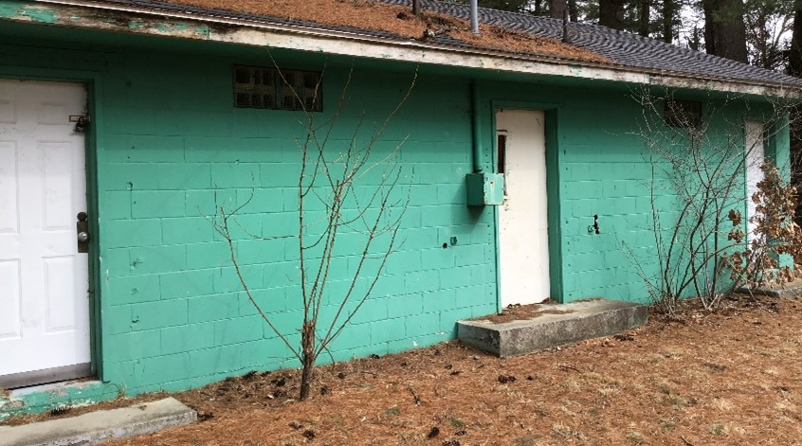
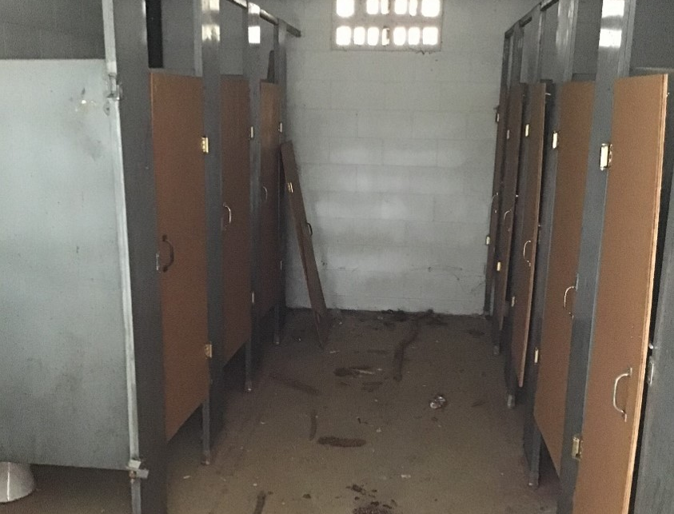

Slide 19
DISCUSSION

